Slide 1
If absent Friday, Pick up a Review packet from the front table.
The government has two ways to affect the economy, ______________ Policy and ______________ Policy.
(Hint: One is controlled by Congress, the other by the Federal Reserve.)
For extra credit, write out the ENTIRE statement above, with the correct answers (put your name on it) and DropBox it.

Slide 2
Mid Course Review 7
Mr. Wyka
Economics
Citrus High School
Notes:
Questions 39-47, and 54

Slide 3
Looking back….
Proportional
Takes the same % of tax from all taxpayers regardless of their income.
Progressive
The more $ a person makes, the higher % of tax he/she pays.
Regressive
Taxes lower incomes at a higher % than higher incomes.

Slide 4
So, knowing what you know about taxes, let’s try some questions.
This tax structure require ALL earners to pay the same percentage of their income.
Proportional Tax
A sales tax is considered a ____________ tax because poor income earners pay a larger percentage of their income in sales taxes than high income earners.
Regressive Tax

Slide 5
Investing Your Money
Stocks – Ownership shares in a company
Value is based on the performance of the company
Not guaranteed! Not Insured!
Bonds – A Loan Instrument
If you buy a bond, you are LOANING money to the company or gov’t who issued the bond.
They agree to pay you INTEREST plus the face value of the bond.
U.S. Gov’t bonds are guaranteed (barring a Zombie Apocalypse, then run for your lives).
Corporate or company bonds are not guaranteed.

Slide 6
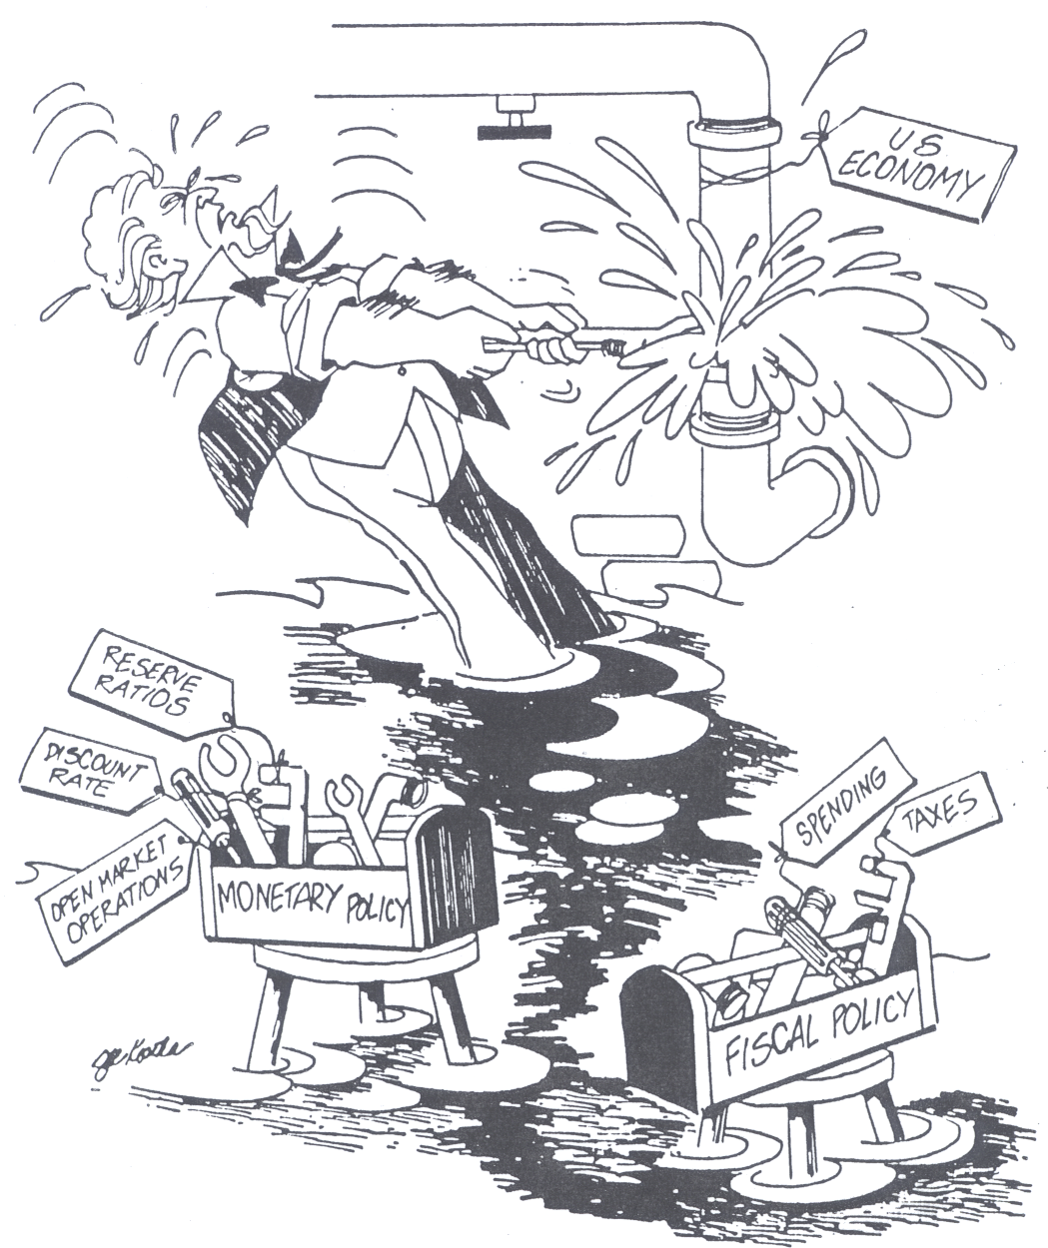
How the Government Stabilizes the Economy
Gov’t has two tools to affect the economy:
Monetary Policy
The Fed
Fiscal Policy
Congress & the President

Slide 7
Let’s talk about Fiscal Policy
Fiscal Policy is Congress’ (and the President’s) tool to affect the economy. Congress can:
Raise or Lower Taxes
Increase or Decrease Spending
What combination would reduce the budget deficit?
Expansionary Fiscal Policy
Lower Taxes and Increase Spending
Contractionary Fiscal Policy
Increase Taxes and Decrease Spending

Slide 8
Remember the Federal Reserve?
Do you remember what its primary function is?
I’ll give you a hint: It’s a type of policy they use to affect the nation’s economy.
I’ll give you another hint: It’s not Fiscal Policy.
The Federal Reserve’s Primary Business is Conducting MONETARY POLICY!!!!!!!!

Slide 9
Reviewing Externalities

Slide 10
A Negative Externality is…
An economic activity that imposes a negative side effect on an unrelated third party.
Examples:
Pollution from a coal power plant
Noise from whistle tips
Destruction of landscape and free spaces in the construction of a new roadway
Pollution from your 20 year old pick up truck that burns through 3 quarts of oil a week.

Slide 11
Negative Externalities….
Harms Third Parties
Positive Externalities….
Helps Third Parties

Slide 13
Circular Flow Model
Is X the
Product Market
Factor Market
Is Y the
Product Market
Factor Market

Slide 14
Think about it….
How will a global shortage of petroleum (gasoline, people!) affect the prices of ordinary goods and services?
Since petroleum is used in the transport AND production of virtually all goods and services,
PRICES ARE LIKELY TO INCREASE
Notes:
46

Slide 15
Comparative Advantage
Comparative Advantage is an economic principle that states that countries should produce the goods they make most efficiently and trade those goods with other countries.
In this idea, countries that trade according to COMPARATIVE ADVANTAGE will gain from international trade.
Notes:
47

Slide 16
Comparative Advantage
David Ricardo is credited with developing the Comparative Advantage theory.
David Ricardo, Economist Dude
Notes:
54

