Slide 1
Pick up a Review packet from the front table.
1. What will happen when two nations trade based on each nation’s comparative advantage?
Each country will lose from international trade.
Each country will gain from international trade.
Each country will consume less of all the goods it can produce.
Each country will consume more of all the goods it can produce.
2. What economist is credited with developing the theory of comparative advantage?
For extra credit, write out your correct answers (put your name on it) and DropBox it.

Slide 2
Mid Course Review 8
Mr. Wyka
Economics
Citrus High School
Notes:
Questions 48 – the end

Slide 3
Comparative Advantage
Hours to Mow Hours to Trim
One Lawn One Hedge
Bob 1 4
Larry 5 2
Based on the information above, who should specialize in Mowing? Trimming?

Slide 4
What’s a Tariff?
A tariff is a tax on imported goods.
Why?
One argument is that tariffs protect domestic producers from foreign competition.
Who benefits? Who is hurt?
Notes:
49

Slide 5
The W.T.O. (World Trade Organization)
The Role of the W.T.O. is to resolve trade disputes among its member countries.

Slide 6
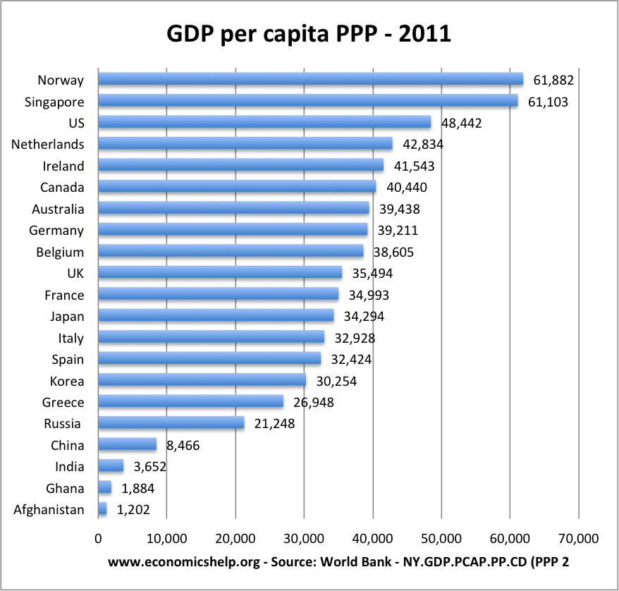
What can we say about the United States using this chart?
Notes:
52

Slide 7
Standard of Living
Per capita GDP is used as the basis for determining a nation’s Standard of Living.
Based on this, which country has the highest Standard of Living in the chart on the previous slide?
The lowest?
Notes:
53

Slide 8
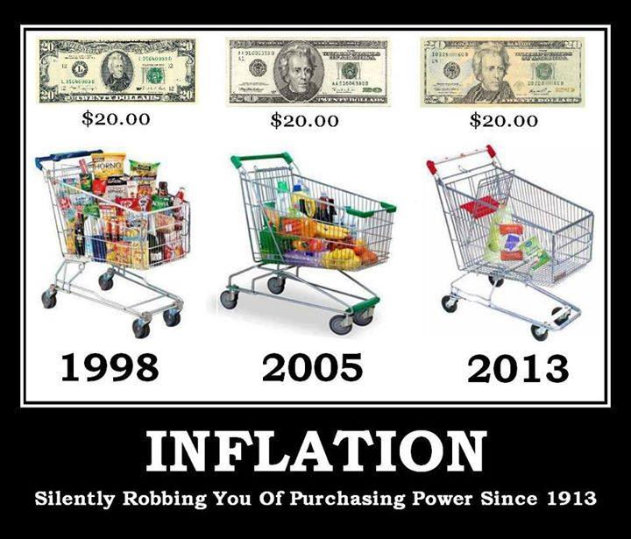
Inflation
An Oversupply of Money can Cause Inflation

Slide 9
Positive Externality – the Flu Vaccine
The Flu Vaccine is a good example of a Positive Externality.
You get it so YOU don’t get sick, but by YOU not getting sick, you also don’t spread it to others.
As such, the government might want to SUBSIDIZE the flu vaccine to make it cheaper and encourage citizens to get it.

Slide 10
Positive Externality – the Flu Vaccine
The government often SUBSIDIZES positive externalities like the Flu Vaccine to encourage more people to participate.
Notes:
51

