Slide 1
The Neolithic Revolution
Guiding Question: How did the Neolithic Revolution change the course of history?

Slide 2
Key Vocabulary:
Agricultural Revolutions → Origin and consequences the introduction of agriculture, domestication of animals, and a more sedentary life during the later part of the Stone Age
Civilization →Society that has highly developed material and spiritual resources and a complex cultural, political, and legal organization; an advanced state in social development
Sedentary → Moving about very little; not migratory
Pastoral → Relating to a shepard's work; rural
Domestication → To take and control for one’s own purposes
Institution → An organization, system, or establishment founded for a specific purpose

Slide 3
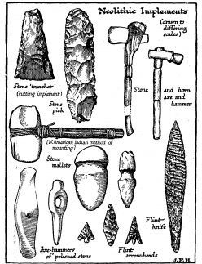
What technological innovations are associated with the growth of agriculture?
Why the shift?
Domestication and Semi-cultivation
New Innovations: Slash-and-burn and swidden agriculture
Overtime, the sophistication of tools made agriculture easier
Why not call it the Neolithic Revolution?

Slide 4
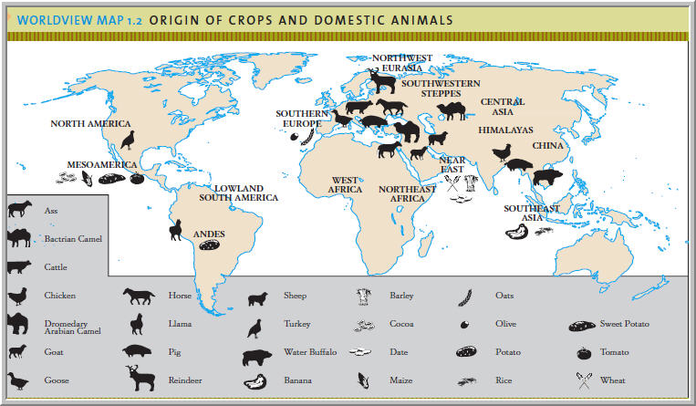
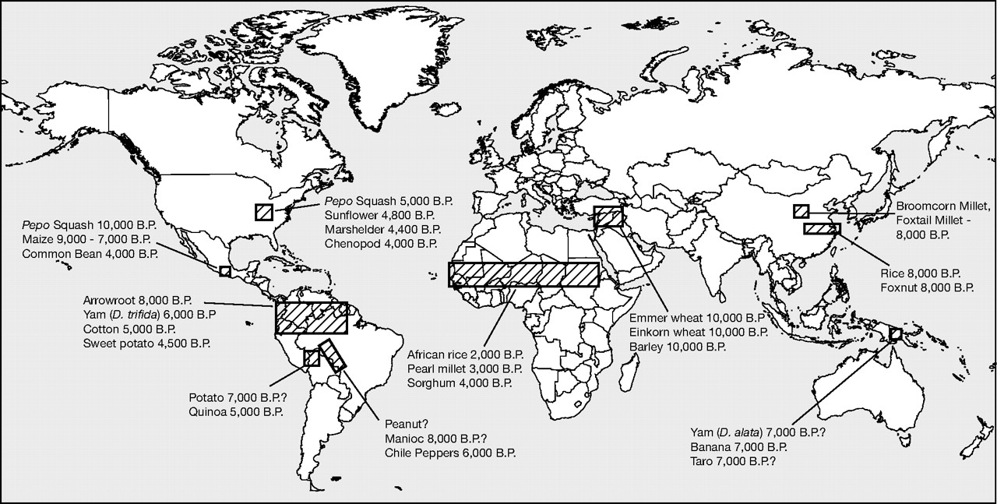
What various crops & animals were developed or domesticated during the Neolithic Revolution?
Animal Domestication → Dog first, then sheep, goats, cattle, water buffalo, pigs
Selective Breeding
Mixed farming and herding → Largely determined by environmental factors

Slide 5
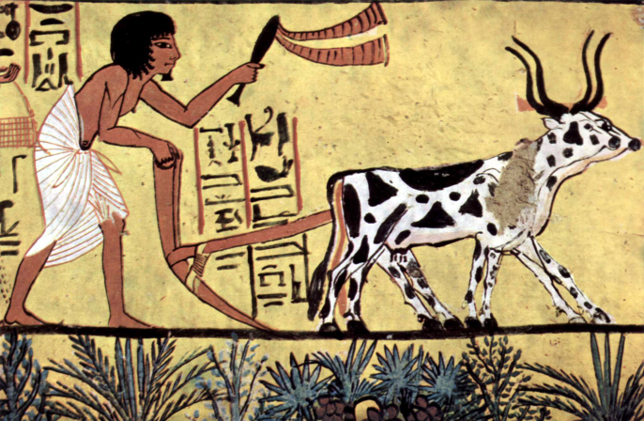
What were the environmental effects of the Neolithic Revolution?
Why did so many adopt Agriculture? End of the Pleistocene Epoch brought the Holocene
Why did others still reject agriculture?
Pastoralism ruled in N. America, Australia, and Northern Eurasia
Demographic Shifts: 2 million people 13,000 years ago, 50-100 million people 7,000 years ago.
For the first time, humans dominated and controlled their environment, beginning the process of species loss, destruction of arable land, and altered traits in species

Slide 6
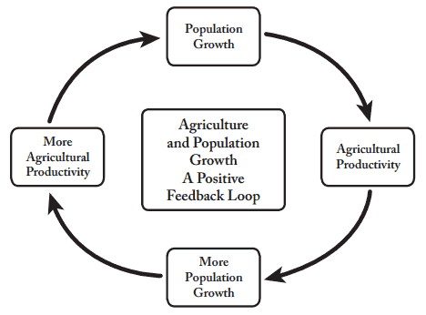
What effect did pastoralism & agriculture have on the food supply?
Agriculture and pastoralism dramatically increased the food supply by making it consistent and allowing for surpluses
Side effects?

Slide 7
How did the Neolithic Revolution affect human societies economically & socially?
Benefits and Risks?
Violent or peaceful process?
Expansion = surpluses and slow rate
Importance of private property
Wealth determined by land ownership
Rise of Institutions→ Nuclear families (no), kinship networks (yes)
Women’s status ↓ as their role in food acquisition diminishes

Slide 8
Cultural Expressions
Religion → Shift to focus on Earth Mother, Sky God, and ancestor cults
Language → Likely necessitated out of trade (Similarity in language groups)
Political Systems → Surpluses and private property meant the need for protection and order, leading to the rise of governments, legal systems, and professional militaries
Economics → Surpluses and tool innovation allowed for more specialization of labor; this in turn led to social hierarchies in which some occupations were deemed more important than others

Slide 9
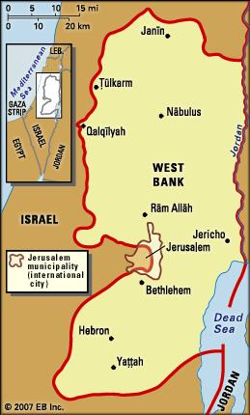
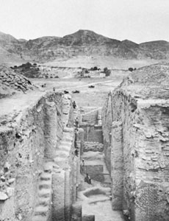
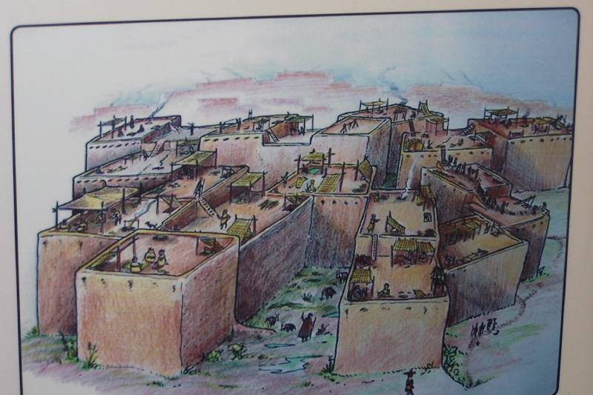
The First Towns
Çatalhöyük (Çatal Hüyük) - a very large Neolithic proto-city in southern Anatolia (Turkey), inhabited from approximately 7500 BC to 5700 BC.
Jericho is one of the earliest continuous settlements in the world, dating perhaps from about 9000 bce.

Slide 10
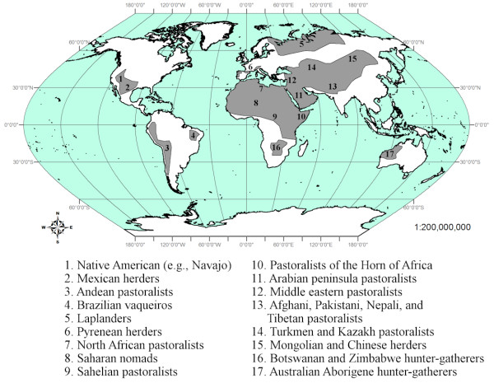
Where did pastoralism persist even after the Neolithic Revolution?
Why not shift to a sedentary, agricultural lifestyle?
Cultural Tradition
Poorly suited environment
Not healthier
Not easier
Not as varied a diet

Slide 11
Questions to Consider:
The Agricultural Revolution marked a decisive turning point in human history. What evidence might you offer to support this claim? How might you argue against it?
Was the Agricultural Revolution inevitable? Why did it occur so late in the story of humankind?
“The Agricultural Revolution provides evidence for ‘progress’ in human affairs.” How would you evaluate this statement?

Slide 12
Useful Video Links:
http://www.youtube.com/watch?feature=player_detailpage&v=GEm6LWh8D_s (Catal Huyuk and the Neolithic Revolution)
http://www.youtube.com/watch?v=Yocja_N5s1I&feature=player_detailpage (Crash Course – Agricultural Revolution)

