Slide 1
From Hunter-Gatherers to Settled Societies
1 of 2
a.k.a. From Paleolithic Life to Neolithic Life
Mr. Wyka’s AP World History
Citrus High School
Corresponding with Ch 1 Amsco WHAP Review book

Slide 2
A Note About Dates:
What is BCE?
B.C. = Before Christ
A.D. = Anno Domini (“In the Year of our Lord”)
Issues with this?
B.C.E. = Before Common Era (Prior to zero)
C.E. = Common Era (Everything after zero)
B.C.E
C.E.
0

Slide 3
The Paleolithic Era 2.5 million years ago to about 8000 B.C. The longest span of human existence!
Guiding Question: What was it really like before 10,000 BCE?

Slide 4
Key Vocabulary:
Foragers → Those who wander for provisions such as food and shelter
Hunter-Gatherers → Members of a group of people who subsist by hunting, fishing, or foraging in the wild
Paleolithic → the longest phase of human existence, marked by a nomadic, hunting-gathering lifestyle.
Megaliths → stone of great size, especially one forming part of a prehistoric monument

Slide 5
What evidence explains the earliest history of humans and the planet?
The work of Archeologists, Anthropologists, and Evolutionary Biologists
Tools: Radio-Carbon Dating, DNA Analysis, and observation
Bone fragments, burnt logs and objects, artifacts, and tools provide these scientists with evidence with which to test their hypotheses.

Slide 6
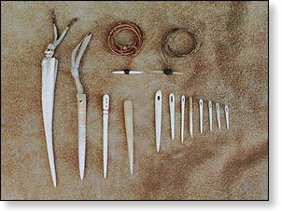
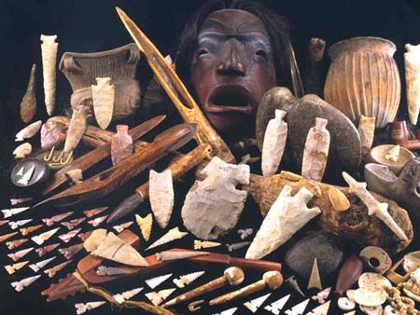
Hominids vs. Primates
Unlike other primates all hominids:
Are Bipedal
Are capable of abstract thought, profound emotions, and fine motor movements
Have a larynx capable of speech
Why is speech so important?

Slide 7
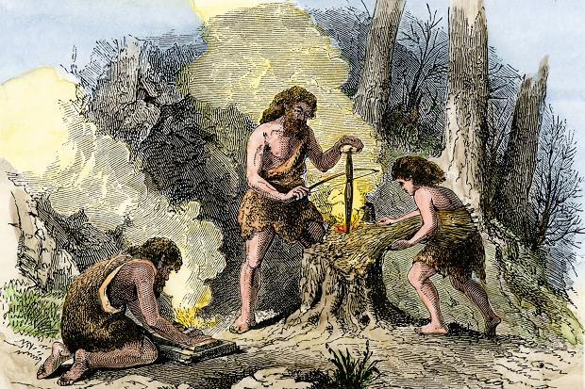
FIRE !!!!!!!
One of the greatest accomplishments of people …. Ever.
What are some of the ways the Control of Fire would have improved the life of Paleolithic peoples?

Slide 8
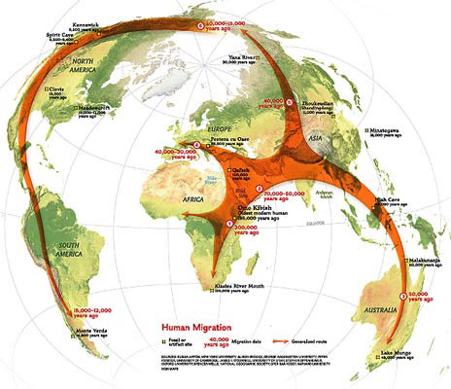
Where did humans first appear?

Slide 9
Migration
Homo sapiens (modern humans) first appeared in AFRICA about 200,000 (TWKO) years ago.
Hunter-Forager – survived by hunting and gathering food
Migration – necessary for survival because as the animals an plants moved, so did the people
Push Migration – Climate Change (ice age), Population Density
Pull Migration – New sources of food and fresh water
Humans gradually migrated to almost every corner of the earth

Slide 11
What were the characteristics of their society, technology, economy, and culture?
Gender Divisions
Men → Hunting
Women → Gathering
Egalitarian ???
Family Life:
Size of clans
20-50 people
Two-parent family
Why did this become necessary?
Diet
Varied and fairly nutritious (when available)

Slide 12
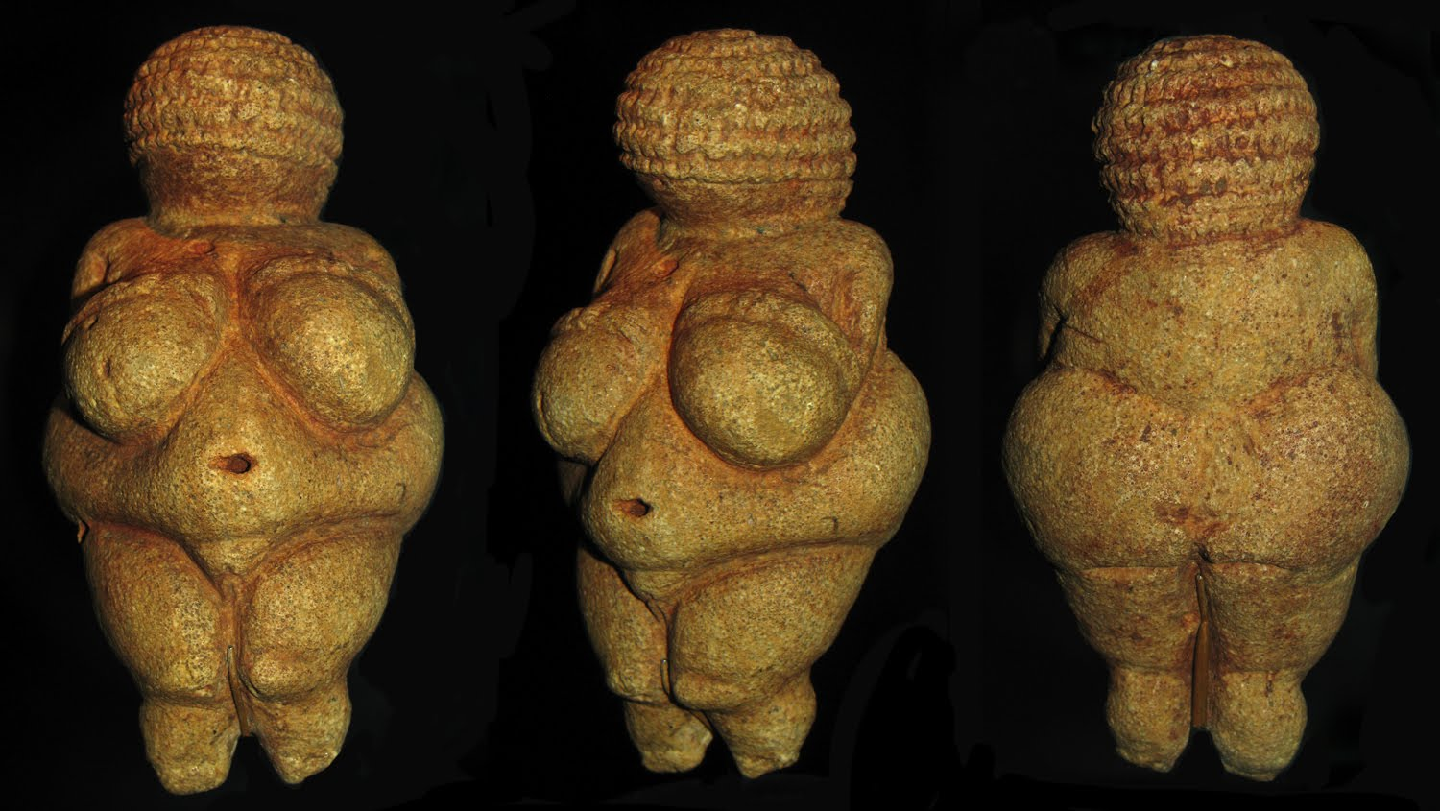
How might our attitudes toward the modern world influence our assessment of Paleolithic societies?
Notes:
Venus of Willendorf – Question students about its purpose. Why does it exist? What does it tell us? What does it reveal about the culture and values of Paleolithic peoples?

Slide 13
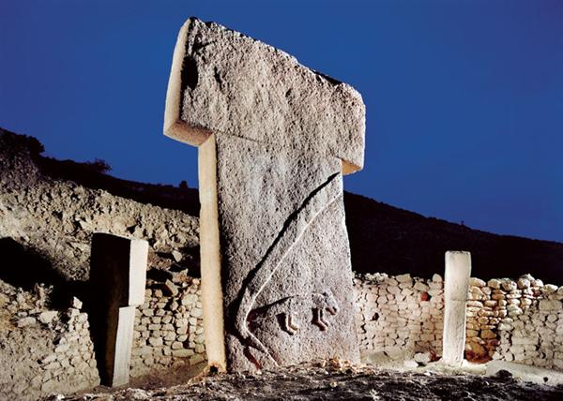
The First Megaliths?
Göbekli Tepe The First Temple Turkey
9500 B.C.

Slide 14
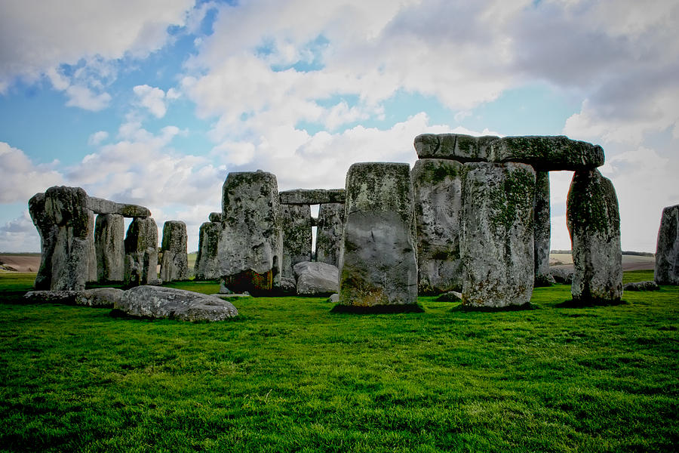
What does this reveal about the changes in Paleolithic societies over time?
Notes:
Stonehenge Megaliths – Ask students what they think it may have been used for. Why was it created? What does it reveal about their level of sophistication?

Slide 15
Quiz Time!
Take out a sheet of paper and pencil or pen.
Put your name on it and label it
Paleolithic Quiz.
Do your own work and please keep your eyes on your own paper.
When you are done, DropBox it.

Slide 16
What does B.C. mean and what is the other equivalent abbreviation you may see in your textbook?
What does A.D. mean and what is the other equivalent abbreviation you may see in your textbook?
How many years ago was 2000 B.C.?
The longest span of human existence, 2.5 million years ago to 10,000 years ago, is called the ___________________ era.

Slide 17
A stone of great size, especially one forming part of a prehistoric monument, is called a(n) _________________.
Members of a group of people who subsist by hunting, fishing, or foraging in the wild are called _______________.
The scientific name for modern humans is ____________________.
Where do modern Humans first appear in the archaeological record (in what continent)?

Slide 18
What was Göbekli Tepe used for (its purpose)?
Which statement describes the Paleolithic diet most accurately?
“Varied and Nutritious”
or
“Homogeneous and Less Nutritious”

Slide 19
Answers
B.C. means Before Christ. B.C.E. or Before the Common Era means the same thing.
Anno Domini or in the Year of the Lord. C.E. or Common Era means the same thing.
2000 B.C. was 4016 years ago.
The longest span of human existence is the Paleolithic Era.
Megaliths are large Paleolithic stone structures (i.e. Stonehenge or Göbekli Tepe )
Hunter-gatherers or Hunter-foragers subsisted by hunting, fishing, and foraging in the wild, and migrating with the food cycle.
Modern humans are called Homo Sapiens or Homo Sapiens Sapiens.
Modern humans originated in Africa (TWKO).
Göbekli Tepe was a temple, used for worship or religious reasons.
The average Paleolithic diet was pretty varied and nutritious, as opposed the diets of later humans in the Neolithic Era which were homogeneous, or not varied, and not particularly nutritious.

