Slide 1
Mr. Wyka’s AP World History
Post-Colonialism
1945-Present

Slide 2
Remember….
Colonialism primarily refers to European countries taking direct control over other lands during and after the Age of Exploration.
Think of the British worldwide colonial expansion, for example, which included our very own American 13 colonies!
Also, think of the carving up of Africa by European powers at the Berlin Conference of 1884-85.
However, remember that it wasn’t only European countries that did this.
Russia expanded across all of Asia.
Japan expanded into Okinawa.
Post-Colonialism is the aftermath of colonialism and imperialism.

Slide 3
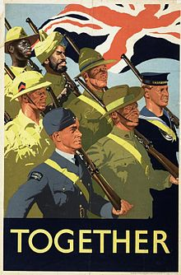
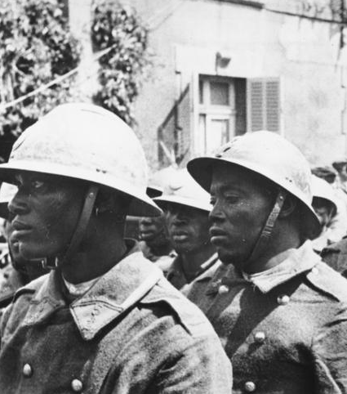
After World War II…
Many colonies provided troops and resources toward winning the war.
After the war, these colonies strove to gain their independence, which they believed was their due.
African soldiers serving in the French army.

Slide 4
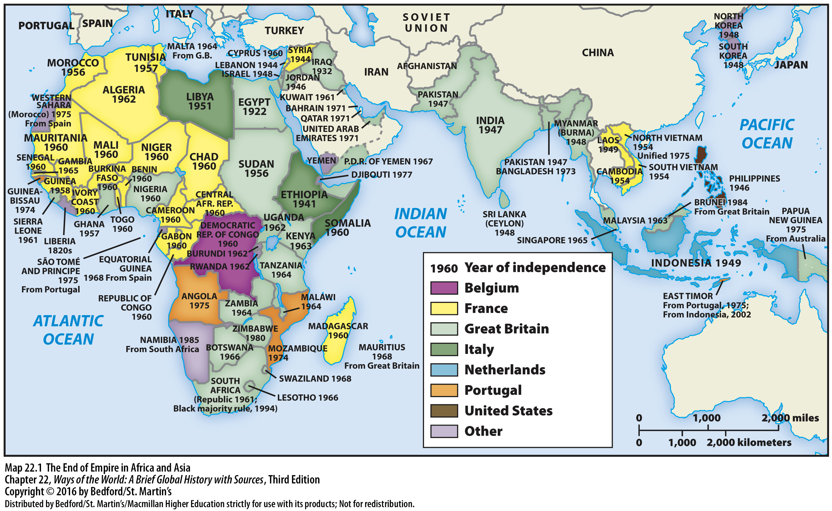

Slide 5
II. Comparing Freedom Struggles
A. The Case of India: Ending British Rule
1. Cultural identity primarily local before 1900
2. British rule promoted growing sense of Indian identity
3. 1885: establishment of Indian National Congress (INC)
Notes:
II. Comparing Freedom Struggles
The Case of India: Ending British Rule
The role of Mohandas Gandhi (1869–1948): had studied law in England but wasn’t a very successful lawyer, in 1893, took a job in South Africa, developed the political philosophy of satyagraha (“truth force”), back in India, Gandhi became a leader of the INC, attacked not just colonial rule but also mistreatment of India’s untouchables and the evils of modernization.
Gandhi embraced efforts to mobilize women: asserting spiritual and mental equality of women and men, without breaking with older Indian conceptions of gender roles.
Not everyone agreed with Gandhi: Jawaharlal Nehru embraced science, technology, and industry as future for India, others rejected nonviolence, especially important was a growing Muslim/Hindu divide, 1906: creation of an All-India Muslim League, some Hindu politicians defined the nationalist struggle in religious terms, Muhammad Ali Jinnah, head of the Muslim League, argued that regions of India with a Muslim majority should be a separate state (Pakistan, the land of the pure).
Independence in 1947 created two countries: Pakistan (Muslim, divided into two wings 1,000 miles apart), India (secular but mostly Hindu), process was accompanied by massive violence; some 1 million died, 12 million refugees relocated.
1948: a Hindu extremist assassinated Gandhi.

Slide 6
II. Comparing Freedom Struggles
A. The Case of India: Ending British Rule
4. Mohandas Gandhi (1869-1948)
5. Gandhi embraced effort to mobilize women
6. Those who disagreed with Gandhi
7. Independence in 1947: Pakistan and India
8. 1948: Hindu extremist assassinated Gandhi
Notes:
II. Comparing Freedom Struggles
The Case of India: Ending British Rule
The role of Mohandas Gandhi (1869–1948): had studied law in England but wasn’t a very successful lawyer, in 1893, took a job in South Africa, developed the political philosophy of satyagraha (“truth force”), back in India, Gandhi became a leader of the INC, attacked not just colonial rule but also mistreatment of India’s untouchables and the evils of modernization.
Gandhi embraced efforts to mobilize women: asserting spiritual and mental equality of women and men, without breaking with older Indian conceptions of gender roles.
Not everyone agreed with Gandhi: Jawaharlal Nehru embraced science, technology, and industry as future for India, others rejected nonviolence, especially important was a growing Muslim/Hindu divide, 1906: creation of an All-India Muslim League, some Hindu politicians defined the nationalist struggle in religious terms, Muhammad Ali Jinnah, head of the Muslim League, argued that regions of India with a Muslim majority should be a separate state (Pakistan, the land of the pure).
Independence in 1947 created two countries: Pakistan (Muslim, divided into two wings 1,000 miles apart), India (secular but mostly Hindu), process was accompanied by massive violence; some 1 million died, 12 million refugees relocated.
1948: a Hindu extremist assassinated Gandhi.

Slide 7
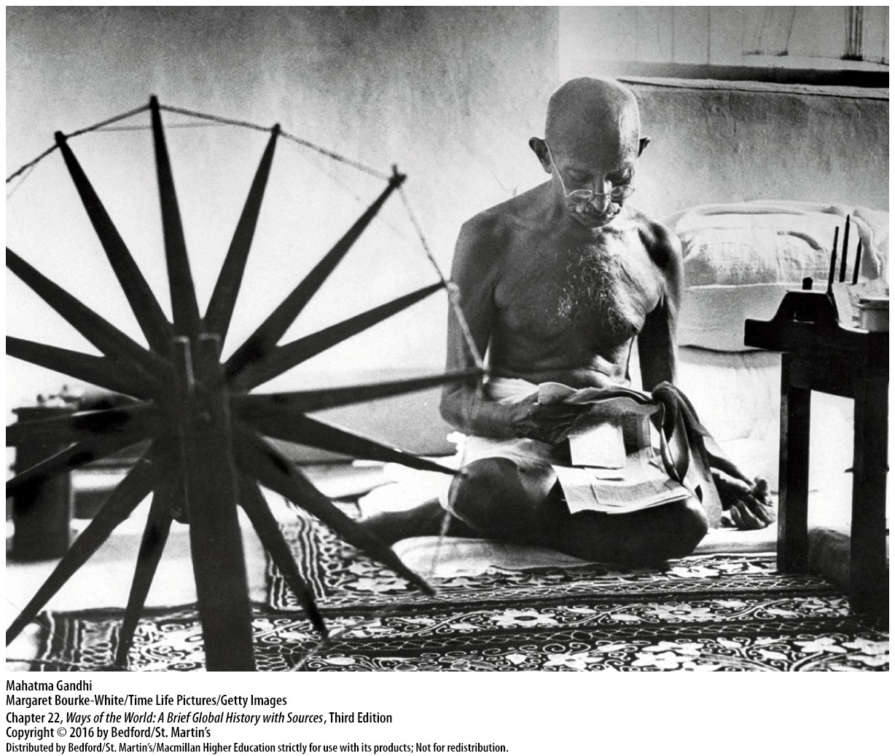

Slide 8
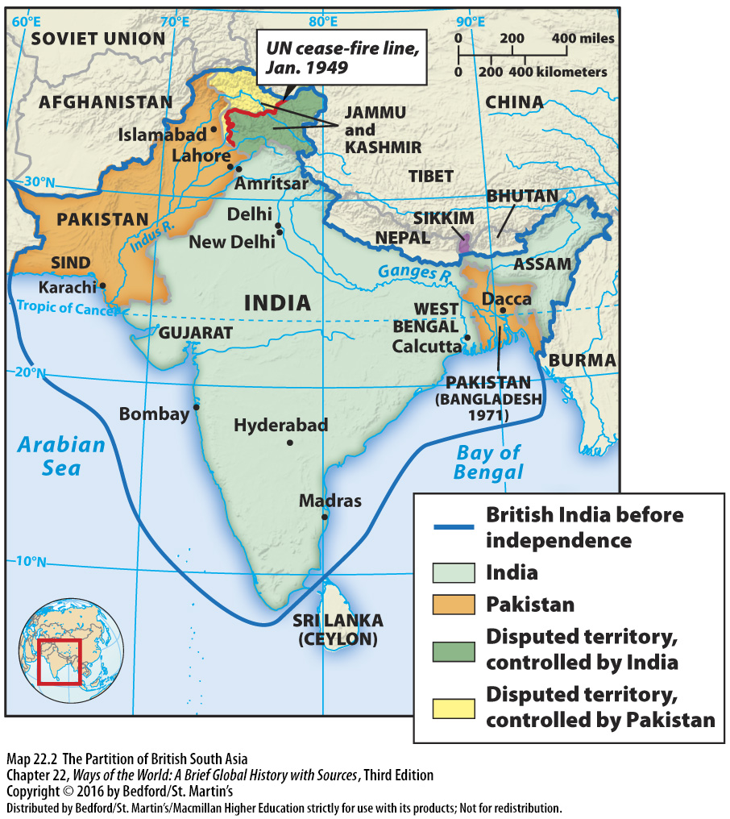

Slide 9
II. Comparing Freedom Struggles
A. The Case of South Africa: Ending Apartheid
1. Freedom from Great Britain in 1910
2. Mature industrial economy by early 1900s
3. African National Congress (ANC) founded in 1912
Notes:
II. Comparing Freedom Struggles
The Case of India: Ending British Rule
South Africa won freedom from Great Britain in 1910, but its government was controlled by a white settler minority. The white population was split between British descendants (had economic superiority) and Afrikaners (Boers) of Dutch descent (had political dominance). Afrikaners had failed to win independence from the British in the Boer War (1899–1902), both white groups felt threatened by any move toward black majority rule.
By the early 1900s, South Africa had a mature industrial economy: by the 1960s, had major foreign investments and loans, black South Africans were extremely dependent on the white-controlled economy.
The issue of race was overwhelmingly prominent: reflected in apartheid laws separating races.

Slide 10
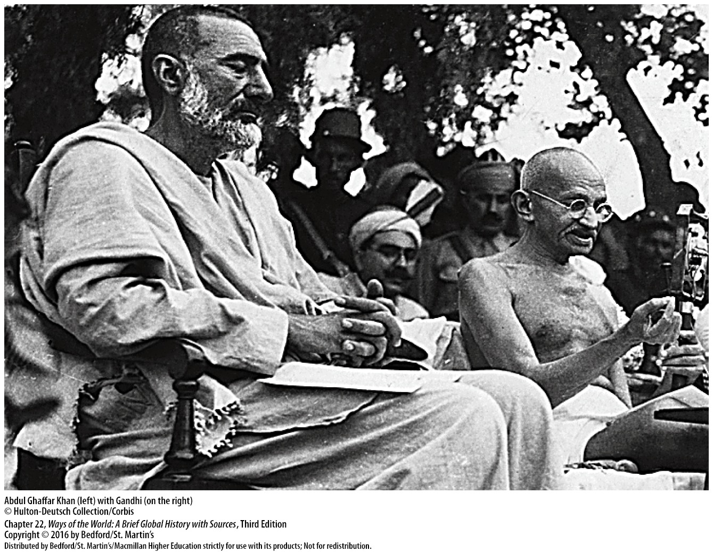

Slide 11
II. Comparing Freedom Struggles
A. The Case of South Africa: Ending Apartheid
4. Underground nationalist leaders
5. Growing international pressure
6. Negotiations began in the late 1980s
7. 1994: national elections brought the ANC to power
Notes:
II. Comparing Freedom Struggles
The Case of India: Ending British Rule
African National Congress (ANC) founded in 1912: like India’s INC, it consisted of elite Africans who wanted a voice in society, for 40 years, the ANC was peaceful and moderate, women denied full membership until 1943, but took action in other arenas including protests and boycotts, 1950s: moved to nonviolent civil disobedience, the government’s response was overwhelming repression.
Underground nationalist leaders turned to sabotage and assassination: opposition came to focus on student groups, Soweto uprising (1976) was the start of spreading violence, organization of strikes.
Growing international pressure: exclusion from international sporting events, economic boycotts, withdrawal of private investment funds.
Negotiations began in the late 1980s: key apartheid policies were abandoned, Mandela was freed and the ANC legalized.
1994: national elections brought the ANC to power: apartheid was ended without major bloodshed, most important threat was a number of separatist and “Africans only” groups.

Slide 12
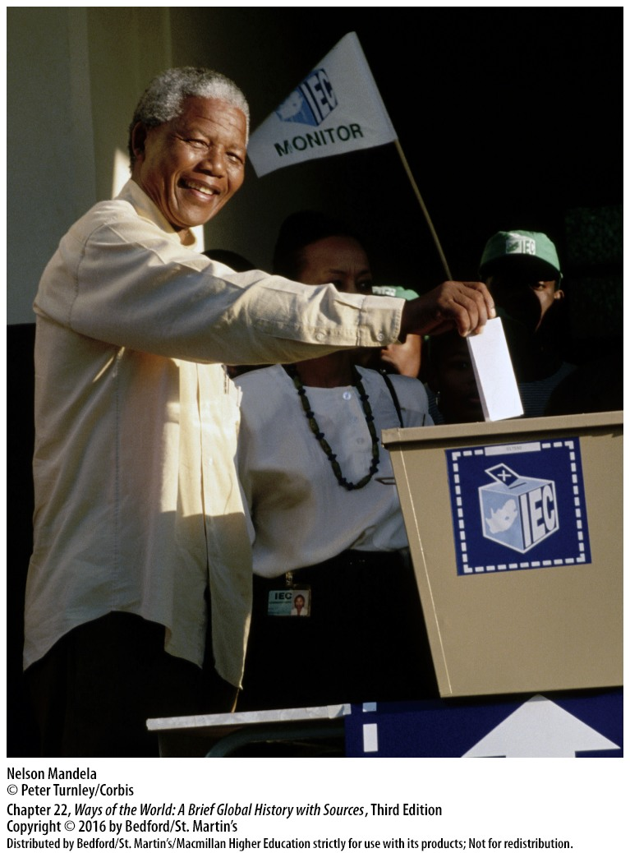

Slide 13
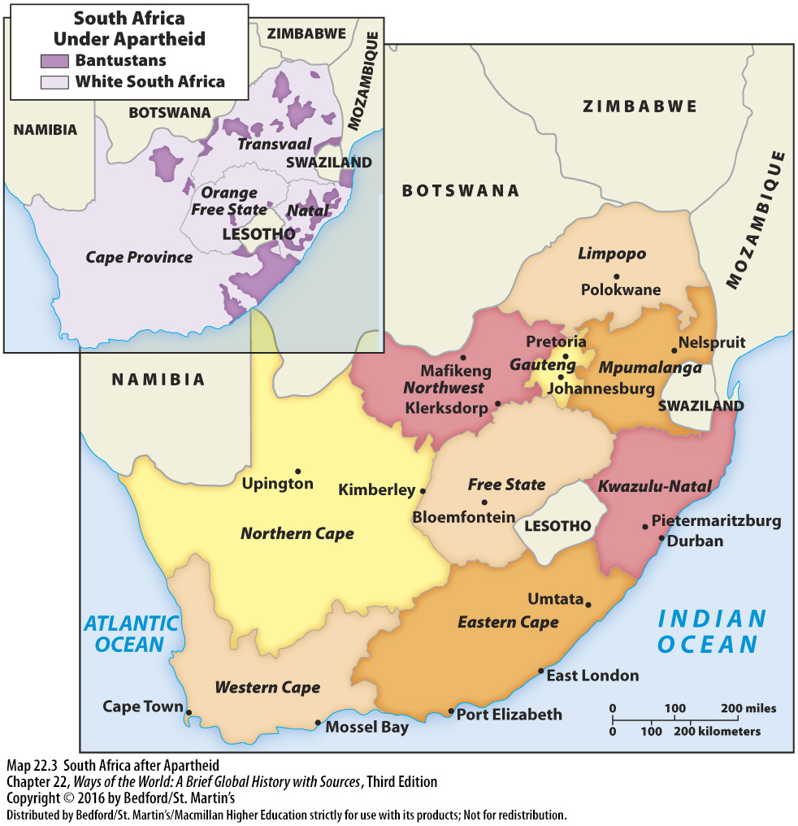

Slide 14
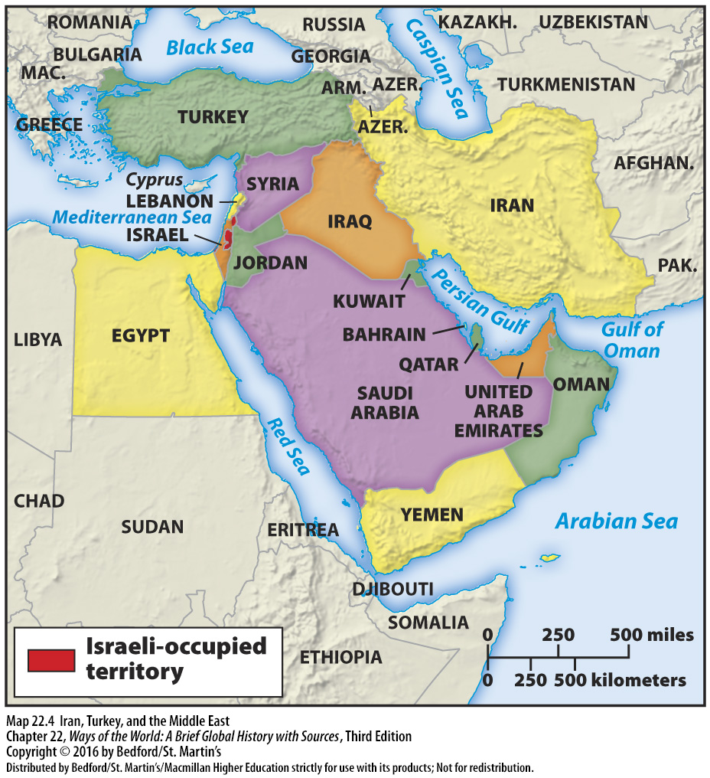

Slide 15
Post Colonialism Crash Course video
https://youtu.be/T_sGTspaF4Y

