Slide 1
Bellringer
Please enter quietly.
Turn in your Herodotus reading analysis homework.
Pick up a Geography of History bellringer and begin working it BEFORE the tardy bell rings.
You have 10 minutes to complete this bellringer and Dropbox it.

Slide 2
Rise of Classical Civilizations
Quick Summary
Mr. Wyka’s AP World History

Slide 3
The Mandate of Heaven
Classical China
The idea that Heaven approves of the emperor and his dynasty.
When things are going great, he can say, “look, I have the Mandate of Heaven!” But….
When things turn sour (famine, war, etc.), his enemies can use that as an excuse to rebel, “the emperor has lost the Mandate of Heaven! Let’s get him!”

Slide 4
The Qin Dynasty
Restored order after the Era of Warring States
Although short lived, the Qin dynasty set precedents that were followed in China for the next two thousand years, particularly
The idea of a strong, central government authority with the emperor at the head.
So important in the minds of Chinese that Qin became the name of the country.

Slide 5
The Han Dynasty
Came to power after the fall of the Qin
Lasted 400 + years
Contemporaneous with the Roman Empire
Period of high culture
Chinese still refer to themselves as the People of the Han.

Slide 6
The Early Chinese Dynasties
Shang (near mythical)
Zhou
Period of Warring States
Qin
Han

Slide 7
Classical India
The roots of Classical India began during the invasions (some say migrations) of the Aryan people c. 1500 B.C.
The oral epics of the Aryans are called the Vedas.
The Vedic religion is the ancestor of Hinduism

Slide 8
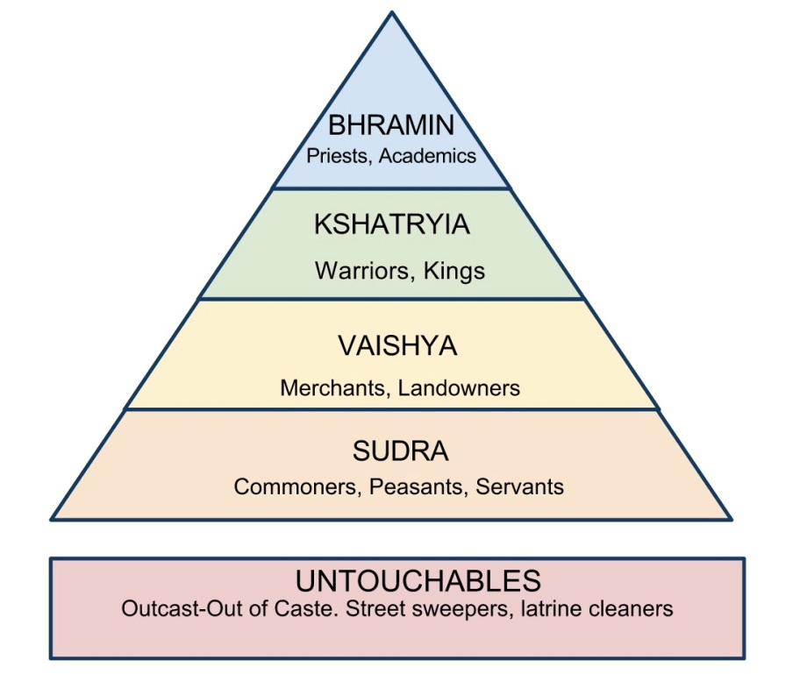
Aryan Society
Highly patriarchal (male dominated)
Socially stratified (caste system)
Classes (varna) based on skin color

Slide 9
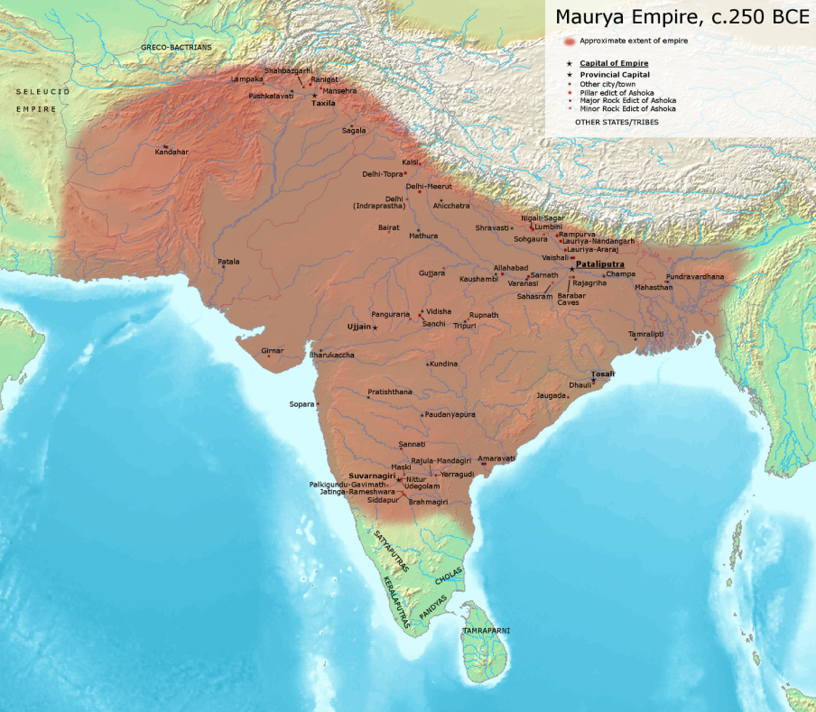
Mauryan Empire
The first great Indian empire
Spanned almost the whole sub-continent
Founded by Chandragupta in the 4th century B.C.
His grandson Ashoka, converted to Buddhism and spread his ideas throughout the empire on pillars.

Slide 10
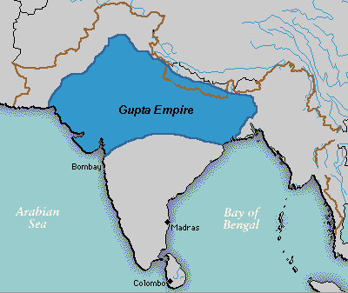
Gupta India
Authority became decentralized
Empire shrunk
Status of women decreased
Technological advances
Decimal system
Question: Why was slavery never widespread in Gupta India?

Slide 11
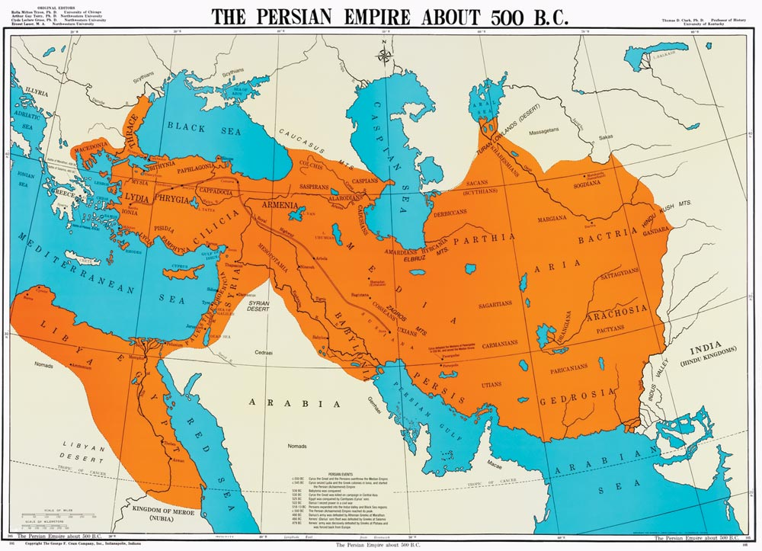
Persia
Zoroastrianism
Royal Road connected the large empire

Slide 12
Greek philosophy
The philosophy of Socrates, Plato, and Aristotle emphasized HUMAN REASON.

Slide 13
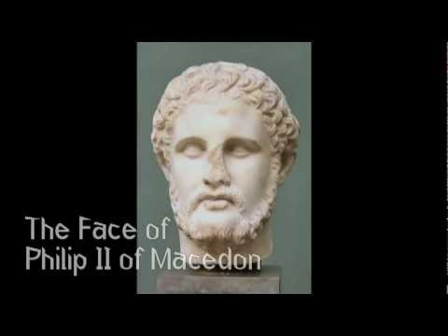
Philip II
Macedonian king who united all of Greece after the Peloponnesian War.
His son Alexander, continued the conquest after his father’s death, creating a huge land empire.

Slide 14
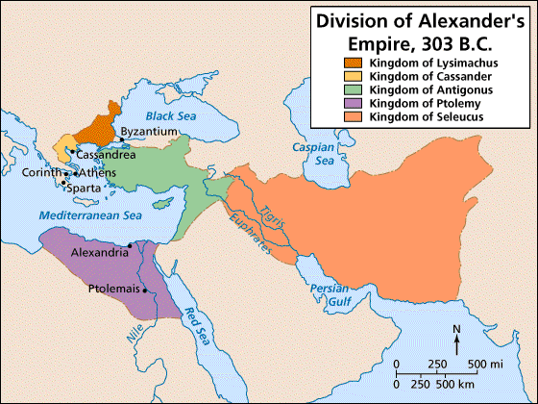
Alexander
Died at 32
His empire split among his generals who fought for supremacy.

Slide 15
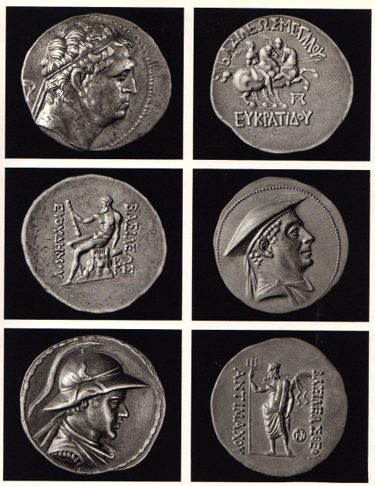
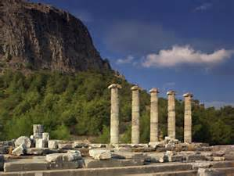
Hellenistic Age
Alexander’s Legacy
The period of his rule and that of his generals when the influence of Greece spread
Politics
Art
Architecture
Religion
Literature

