Slide 1
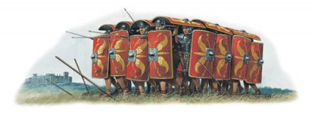
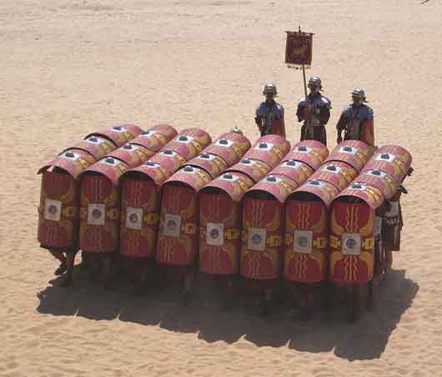
Chapter 1, lesson 1 The World of the Romans
Mr. Wyka - World History
Roman “Turtle” Formation
When? 264 B.C. – A.D. 476
Where? Europe and the Mediterranean Sea

Slide 2
The goal of this presentation is to give you a strong background before we move forward.
Please pay careful attention.
For note taking, write down words or concepts you don’t understand or have a question about and bring them up for discussion. Pay special attention to words in red (marinara sauce).

Slide 3
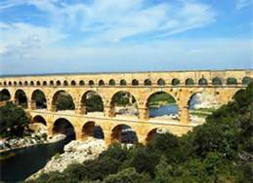
Essential Questions
How impact did Rome have on Western Civilization?

Slide 4
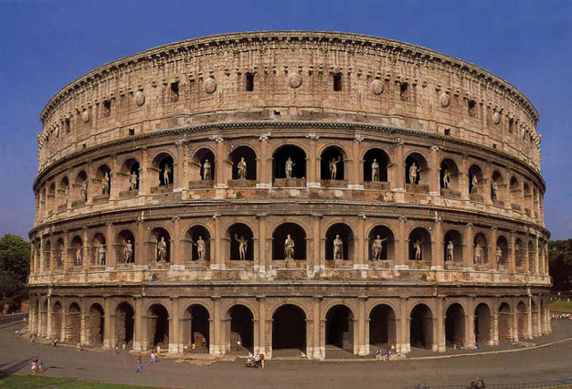
Lesson Vocabulary
Procurator
republic
Octavian
Caesar
Carthage
Julius Caesar
Early Christian Catacomb, Budapest, Hungary

Slide 5
Rome becomes a Power
The people of the little village of Rome expanded throughout Italy between 509 B.C. and 264 B.C.
They united almost all of Italy.
This was the time of the Roman Republic.
Rome wasn’t ruled by a king, but by a group of privileged noblemen, the Roman Senate.
Rule by a privileged few is called on oligarchy.

Slide 6
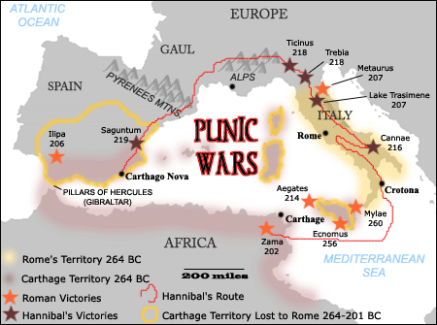
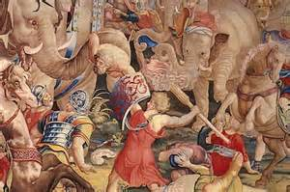
Rome becomes master of the Mediterranean Sea
Between 264 BC – 146 B.C.E. Rome fought a series of THREE wars against Carthage for mastery of the Mediterranean.
And won!
The Punic Wars

Slide 7
Military Leaders Gain Power
Military leaders such as Pompey, Crassus, and Julius Caesar fought bloody civil wars to gain control of Rome.
Octavian, a general, finally defeated a coalition of forces under Marc Antony and Cleopatra of Egypt and grabbed sole power of Rome.
The Senate named him Augustus.
Augustus (Octavian) became the first emperor of Rome.

Slide 8
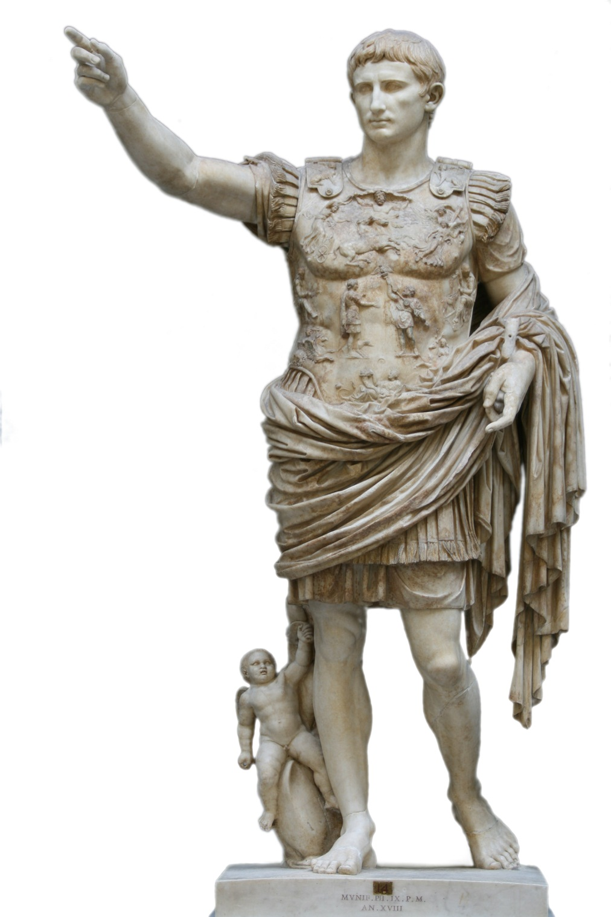

Slide 9
Roman Legacy
Political ideas – Republic, stability, citizenship
Roads, roads, and more roads
Law
Romance Languages
Architecture – archway, Circus Maximus, concrete, aquaducts
Preserved the art and legacy of Greece
Constantine declared official tolerance of other religions.

Slide 10
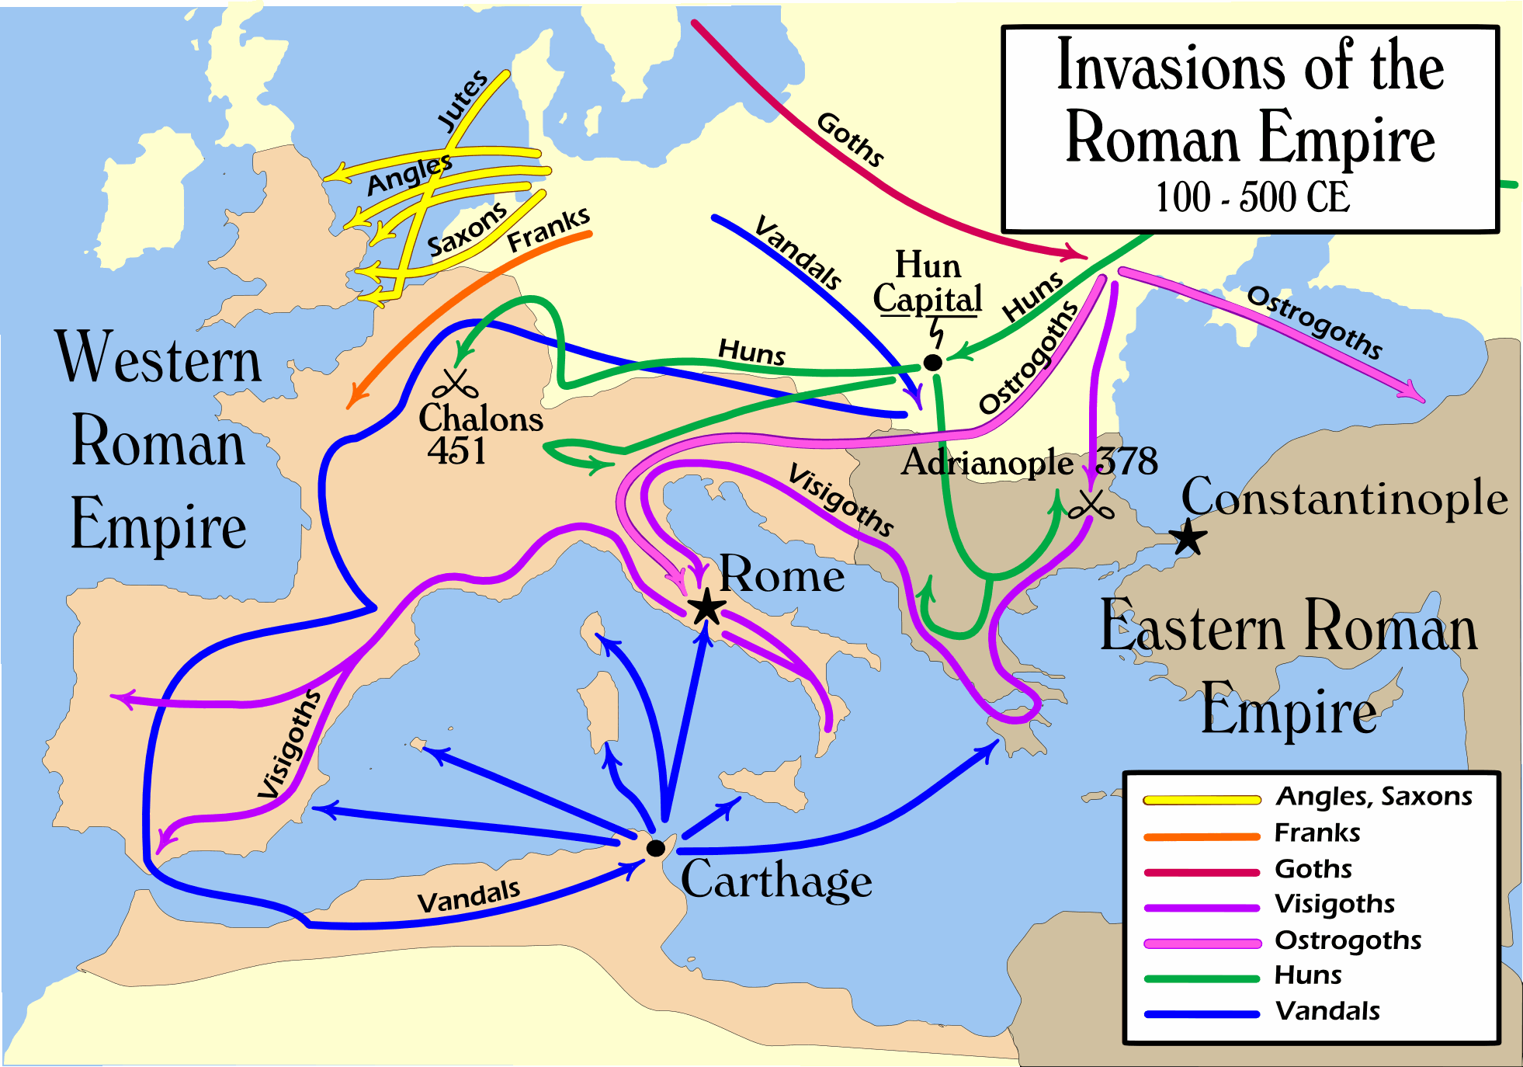
Decline and Fall of Rome
Civil Wars
Constant invasions by Germanic and other nomadic tribes
Brutal taxation
Slavery
Caused unemployment of the lower classes
Western Rome fell in A.D. 476
Eastern Rome continued for a thousand years!

Slide 11
Take out a sheet of paper.
Put your name on the top, your block, and today’s date.
Use your notes, but only YOURS and keep your eyes on your paper.

Slide 12
Early in its history, Rome was ruled by a privileged group of wealthy men. This group was called the Roman _______________.
Rule by one is called a monarchy. Rule by a privileged few is called a(n) _____________.
The Punic Wars of 264 BC – 146 BC were between Rome and what north African power?
Who eventually won the Punic Wars?
The victor of the Punic Wars won Mastery of the __________________ Sea.

Slide 13
Defeating his enemies, this man was named Augustus by the Roman Senate and became the first true Emperor of Rome.
The legacy of Rome to us today includes all of the following EXCEPT
Stable Law Codes
Political ideas such as the Senate and citizenship
Architecture
Advanced Military Technology
Preservation of Greek art & literature
Why do we clarify and say only “western” Rome fell in 476 C.E.?

Slide 14
Which of the following is NOT a reason for the fall of Rome given in this presenation?
Slavery
The Chinese monopoly on the production of silk
Brutal taxation
Civil wars between Roman generals
Nearly constant invasions from Germanic and other nomadic tribes.

