Slide 1
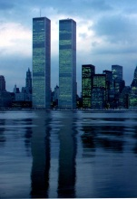
September 11, 2001
Mr. Wyka – Citrus High School
World Trade Center Towers

Slide 2
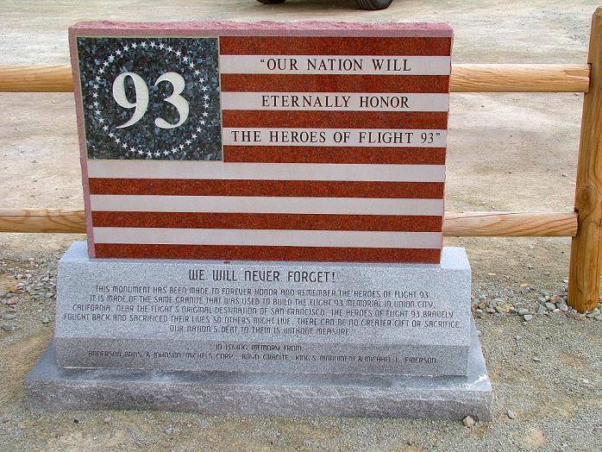
On a clear day, before 9 a.m. on September 11, 2001, members of a little known terrorist group attacked the United States.

Slide 3
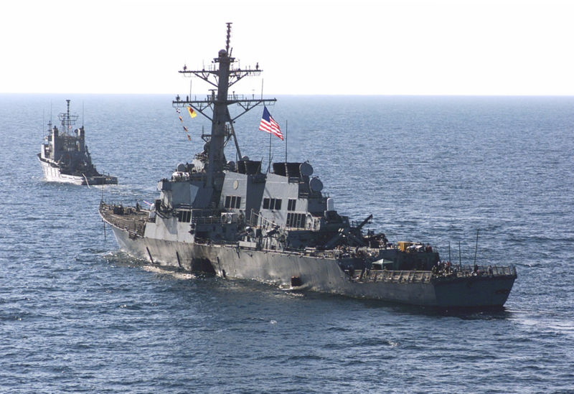
It was not their first strike.

Slide 4
1 Early 1990s
December 29, 1992, the first attack by Al-Qaeda. Yemen Hotel Bombings. Unsuccessfully targeted U.S. troops. 2 Australian tourists murdered. Planner – Osama bin Laden
February 1993 World Trade Center – truck bomb detonated in the parking garage. Intent? To bring down both towers. 6 people murdered. Injured more than 1000.
1994 Bojinka, Philippine Airlines Flight 434
2 1998 U.S.-embassy bombings
3 2000 USS Cole bombing

Slide 5
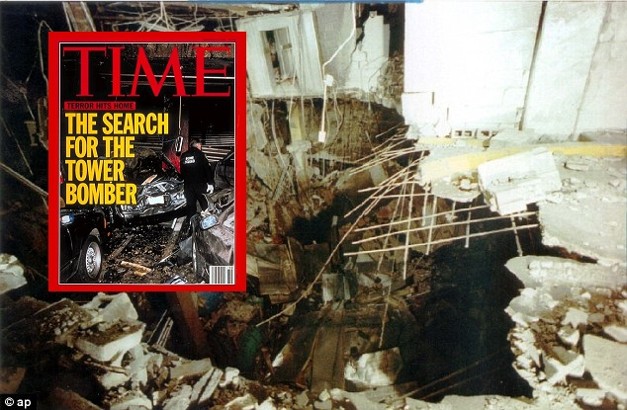
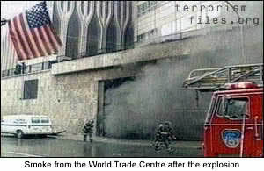
1993 World Trade Center bombing

Slide 6
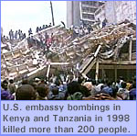
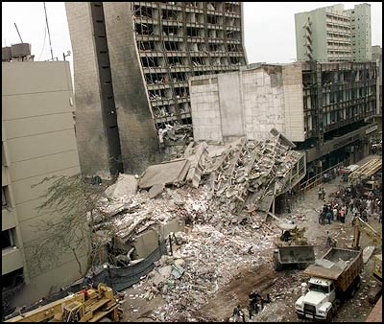
Remember

Slide 7
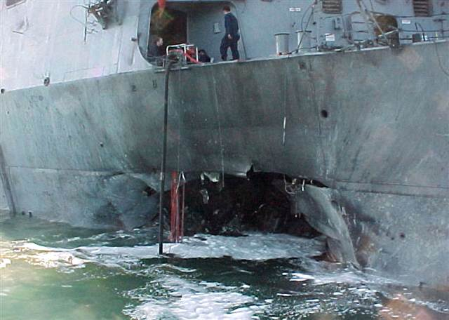
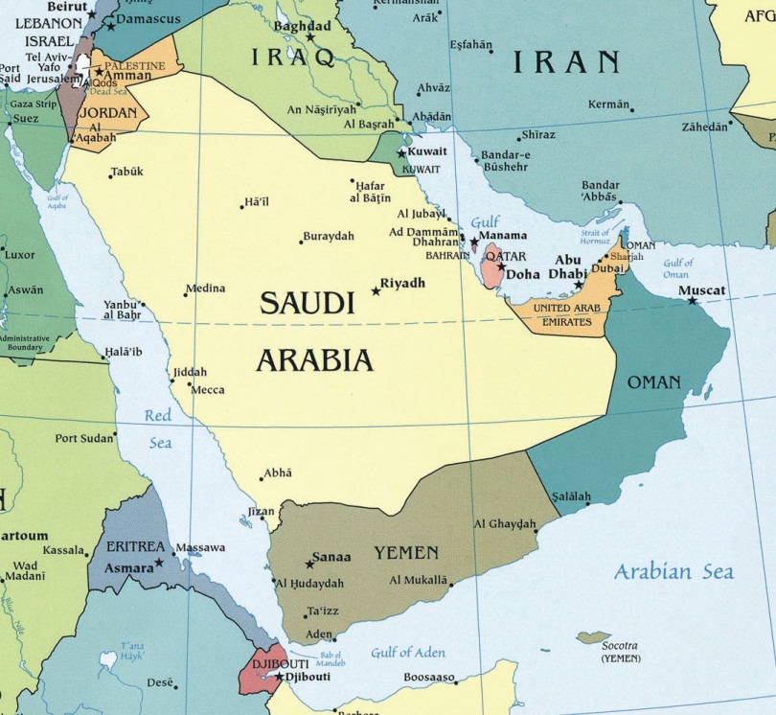
U.S.S. Cole, attacked 12 October 2000, while it was harbored and being refueled in the Yemeni port of Aden. 17 American sailors were killed, and 39 were injured.

Slide 8
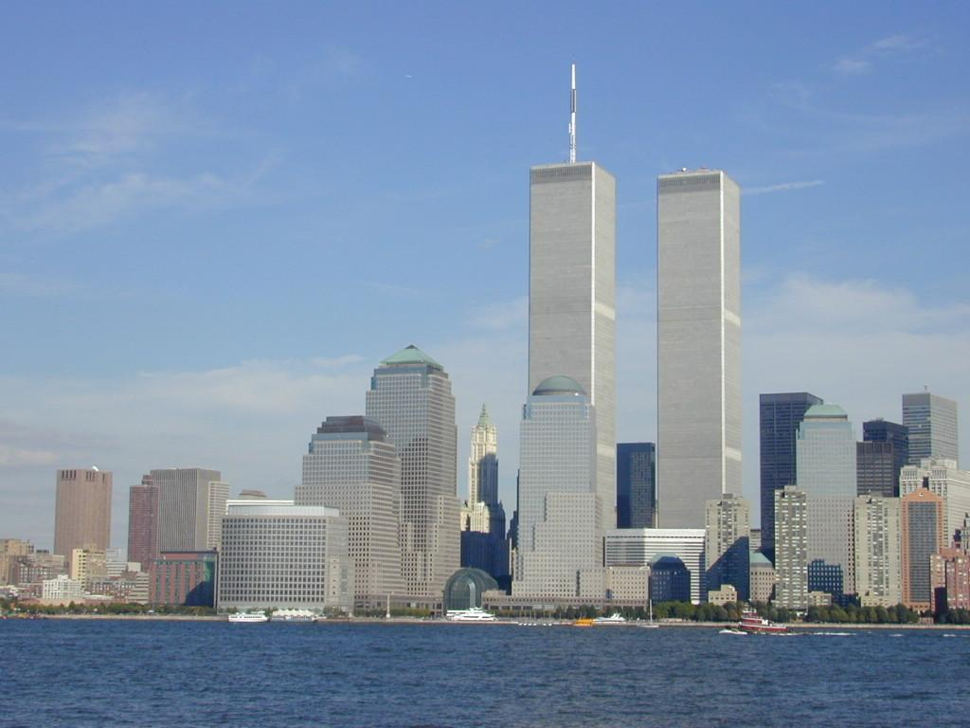
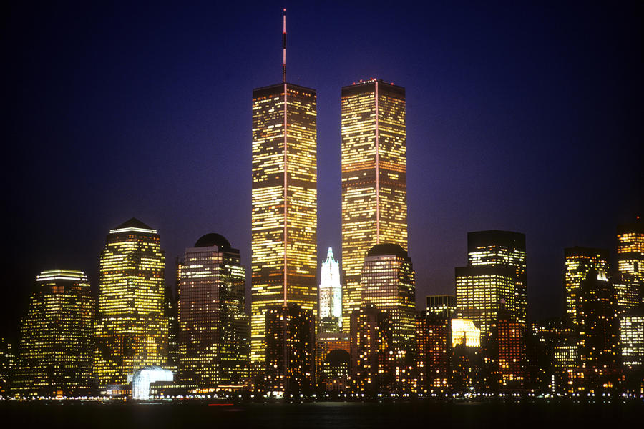

Slide 9
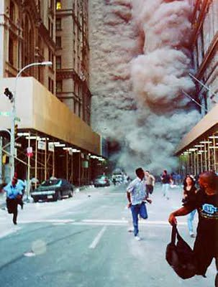
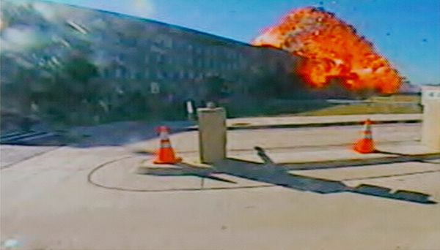
September 11, 2001
Four attacks against our nation by Al Qaeda hijackers.

Slide 10
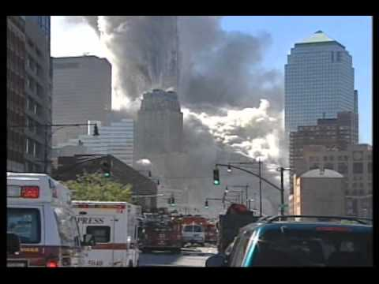
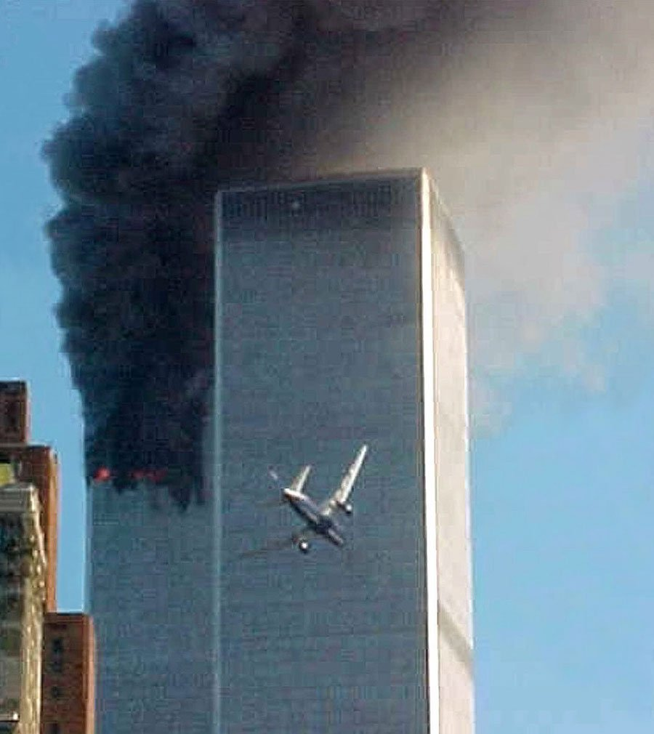
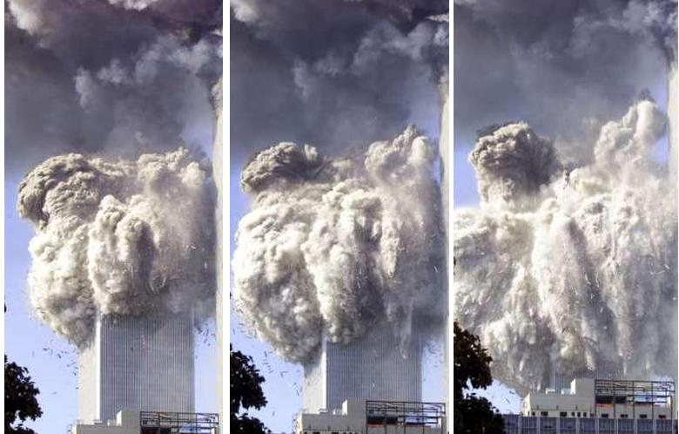

Slide 11
And it wasn’t Al Qaeda’s last strike
December 22, 2001, unsuccessful shoe bomb attempt (Richard Reid) on American Airlines Flight 63 from Paris to Miami.
April 11, 2002 – Ghriba synagogue bombing, Tunisia.
5 October 2002 Bali bombings
8 October 2002 – U.S. Marine murdered, Faylaka Island
6 November 2003 Istanbul attacks
7 February 2004 SuperFerry 14 bombing
8 March 11, 2004 Madrid train bombings
9 May 2004 Khobar massacre
10 July 7, 2005 London transport bombings

Slide 12
20.1 August 2003 Imam Ali Mosque bombing
20.2 February 2004 Irbil bombings
20.3 March 2004 Iraq Ashura bombings
20.4 April 2004 Basra bombings
20.5 July 2005 Musayyib bombing
20.6 September 2005 Baghdad bombings
20.7 November 2005 Khanaqin bombings
20.8 April 2006 Buratha Mosque bombing
20.9 November 2006 Sadr City, Iraq bombings
20.10 February 2007 Baghdad market bombing

Slide 13
11 July 23, 2005 Sharm el-Sheikh attacks
12 November 9, 2005 Amman hotel bombing
13 April 2007 Algiers bombings
14 February 2008 Kandahar bombing
15 June 2, 2008 Danish-embassy bombing
16 June 2009 Little Rock recruiting office shooting
17 December 2009 Northwest Airlines Flight 253
18 Dec 30, 2009
19 October 2010 cargo plane bomb plot
20 Iraq attacks

Slide 15
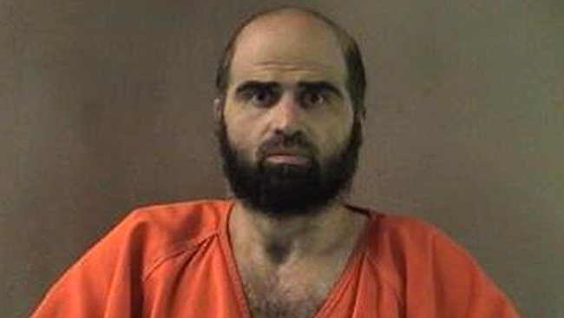
Fort Hood Shooting
On November 5, 2009, a mass murder took place at Fort Hood, near Killeen, Texas. Nidal Malik Hasan, a U.S. Army major and psychiatrist, fatally shot 13 people and injured more than 30 others.
Recently has written a letter to the leader of ISIS, asking to become a citizen of the Islamic State. (2014)

Slide 16
20.11 March 2007 Tal Afar bombings
20.12 April 2007 Baghdad Iraq bombings
20.13 August 14, 2007 Yazidi community Iraq bombing
20.14 August 2009 Baghdad bombings
20.15 October 2009 Baghdad bombings
20.16 April 2010 Baghdad bombings
20.17 May 2010 Iraq attacks
20.18 November 2010
20.19 January 2011 Iraq suicide attacks
10 September 2011 - Nearly 80 U.S. troops injured, and five Afghans killed, when Taliban truck bomb explodes on eve of 9/11/11

Slide 17
Benghazi
On the evening of September 11, 2012, Islamic militants attacked the American diplomatic compound in Benghazi, Libya, killing U.S. Ambassador J. Christopher Stevens and U.S. Foreign Service Information Management Officer Sean Smith.
Several hours later, a second assault targeted a different compound about one mile away, killing two CIA contractors, Tyrone S. Woods and Glen Doherty. Ten others were also injured in the attacks.

Slide 18
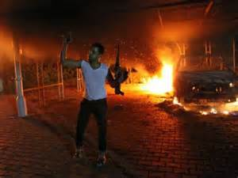
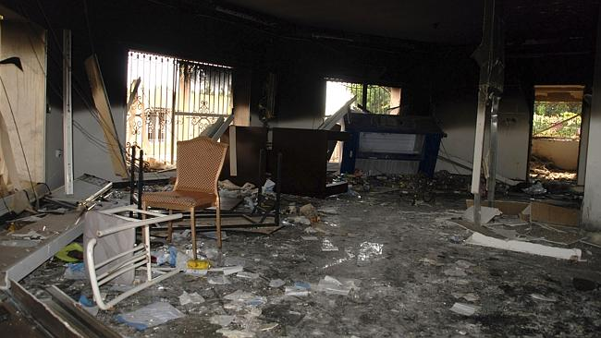
Benghazi, Libya

Slide 19
The In Amenas hostage crisis began on 16 January 2013, when al-Qaeda-linked terrorists took over 800 people hostage at the Tigantourine gas facility in Algeria. At least 39 foreign hostages were killed along with an Algerian security guard, as were 29 militants.

Slide 20
Boston
The Boston Marathon bombings and subsequent related shootings - a series of attacks and incidents which began on April 15, 2013, when two pressure cooker bombs exploded during the Boston Marathon, killing 3 people and injuring an estimated 264 others.
https://en.wikipedia.org/wiki/Timeline_of_al-Qaeda_attacks

Slide 21
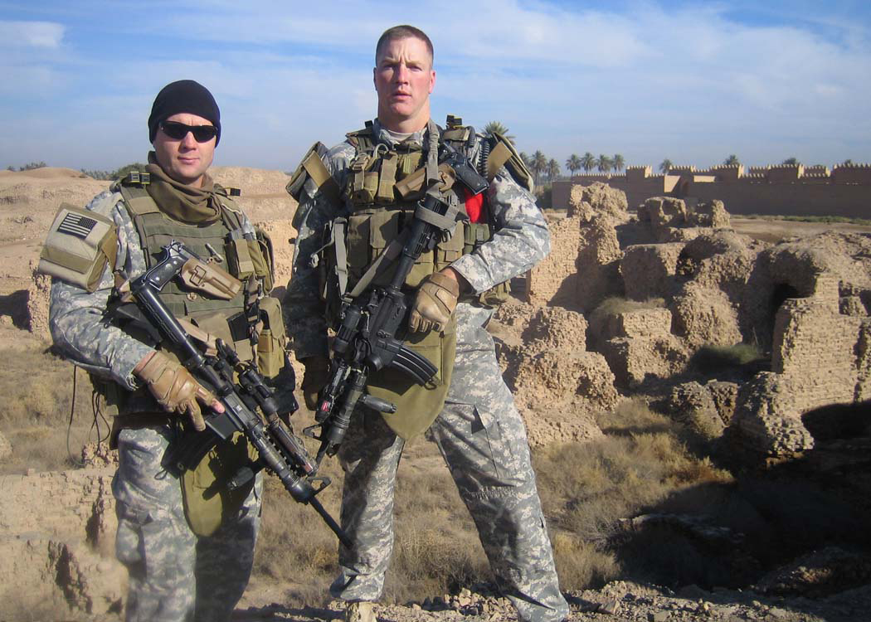
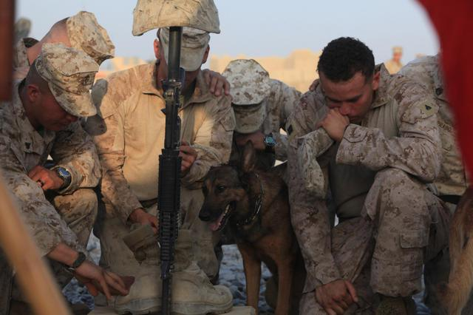

Slide 22
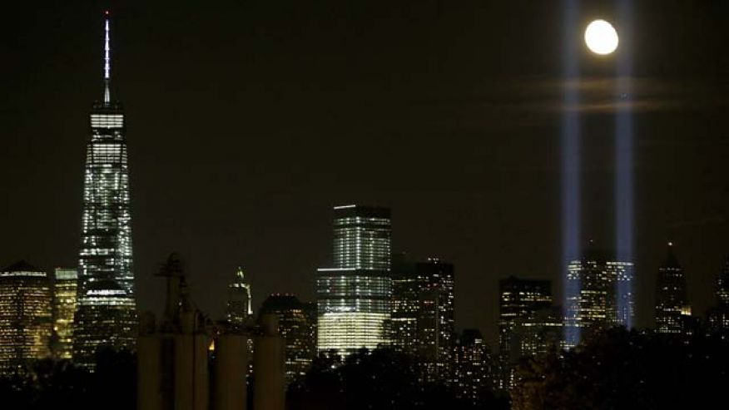

Slide 23
Why?
Bin Laden argued that the Islamic world should see itself as one seamless community, or umma, and that Muslims were obliged to unite and defend themselves. Bin Laden urged Muslims to find a leader to unite them and establish a “pious caliphate” that would be governed by Islamic law and follow Islamic principles of finance and social conduct. Bin Laden repeatedly argued that Afghanistan had become a model Islamic state under his Taliban hosts and used religious rhetoric to solicit support for the Taliban and Al Qaeda.

Slide 24
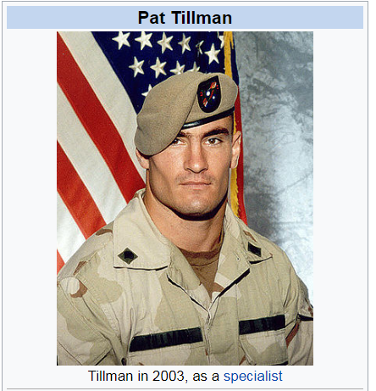
An Event that Defined a Generation
What other historical events served to “Define” the generation in which they occurred?

