Slide 1
Unit 1 Big Picture Review
Bell-Ringer: On your way to your assigned seat, please pick up a Phoenician Trade worksheet from the front table and begin working on it before the bell rings.
If you’ve not turned in your Parent Contact sheet, please turn it into the DropBox.

Slide 2
Unit 1 Big Picture Review

Slide 3
Paleolithic times
The longest span of human experience
Hunter-Gathering. (Hunter-Foraging).
Nomadic.
Used a variety of tools.
Didn’t keep lots of stuff (because they were nomadic)
Gender equality.
Men and women had specific roles.
Varied and nutritous diet.

Slide 4
Neolithic Revolution
Began with the end of the last Ice Age about 10,000 years ago.
Shift from Hunter-Forager to Systematic AGRICULTURE.
Diet more reliable but not necessarily more nutritious
People settled down in villages, to towns, to cities.
Kept more stuff.
Still used a variety of tools.
Specialized labor.
Stratified social structure (social classes) developed.
Women were no longer equal to men.

Slide 5
Pastoralists
Herders of Domesticated animals (goats, sheep, cows, etc.)
Nomadic
Not a lot of stuff
Stable diet.
Still used a variety of tools.
Stratified social structure.
Women not considered equal.
Diffusers of technology.

Slide 6
First Civilizations
Early Neolithic communities continued to expand and grow. Some of these became the first civilizations when they combined the following characteristics:
Agricultural surpluses permitted significant specialization of labor.
Cities
Systems of record keeping (writing)
Complex institutions (bureaucracies, armies, religious hierarchies).
Clearly stratified social hierarchies.
Long distance trade.
And some historians (myself included) add; monumental architecture.

Slide 7
First Civilizations
First civilizations grew up along river valleys.
Water to drink, irrigate with, and travel on.
Mesopotamia (Tigris and Euphrates)
Egypt (Nile River)
Indus River Valley (Harappan)
China (Yellow River)

Slide 8
What did the governments of the earliest civilizations have in common?
The rulers had the approval of the gods (and sometimes were gods).

Slide 9
Geography and religion were interconnected in the early civilizations.
Egypt → Gods controlled environment→ beneficial flooding = nice gods; unified religion due to geographic isolation
Mesopotamia → Violent floods = Angry, vengeful gods; introduction of new religions due to geographic “openness”
China → Mandate of Heaven could be withdrawn after natural disasters

Slide 10
Was there gender equality in early civilizations? If not, what prevented it?
All Neolithic societies → women no longer play as much of a role in food acquisition
China → Confucianism held women in lower status than any male
India → Aryan beliefs made women the equivalent to lowest caste; sati
Egypt → Limited protections and rights for women, but not equivalent of men (few female leaders)
Mesopotamia → No female “Lugals” = no legal equality for women
Nubia → Numerous female rulers; matriarchal lineages

Slide 11
The Israelites
Hebrew
Monotheistic Judaism
Patriarchal
Jerusalem, capital city of the kingdom
Conquered by larger neighbors but their legacy continues today in
Today’s Jews
Today’s nation of Israel
Christianity
The Bible
The Ten Commandments.

Slide 12
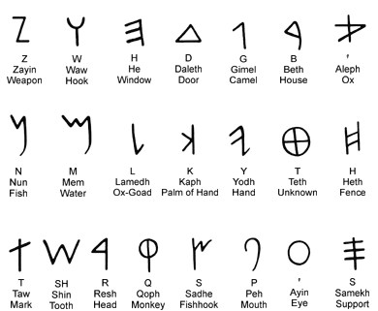
The Phoenicians
Key Concepts:
Canaanites
Confederation of City-States
Trade based
Colonies
Culture
Alphabet
Trade Products
Religion and sacrifice(Tophets)
Senate and Judges

