Slide 1
World War I Review The Beginning
Mr. Wyka’s World History
Citrus High School

Slide 2
Warm Up
Can you answer the following questions? Jot them
down and try to answer them as you take notes
on this powerpoint.
a. Whose assassination began World War I?
b. Which European country experienced a
revolution in 1917?
c. How many years did World War I rage before the U.S. entered?
d. Which treaty ended World War I?

Slide 3
Essential Question
Why did World War I Begin?

Slide 4
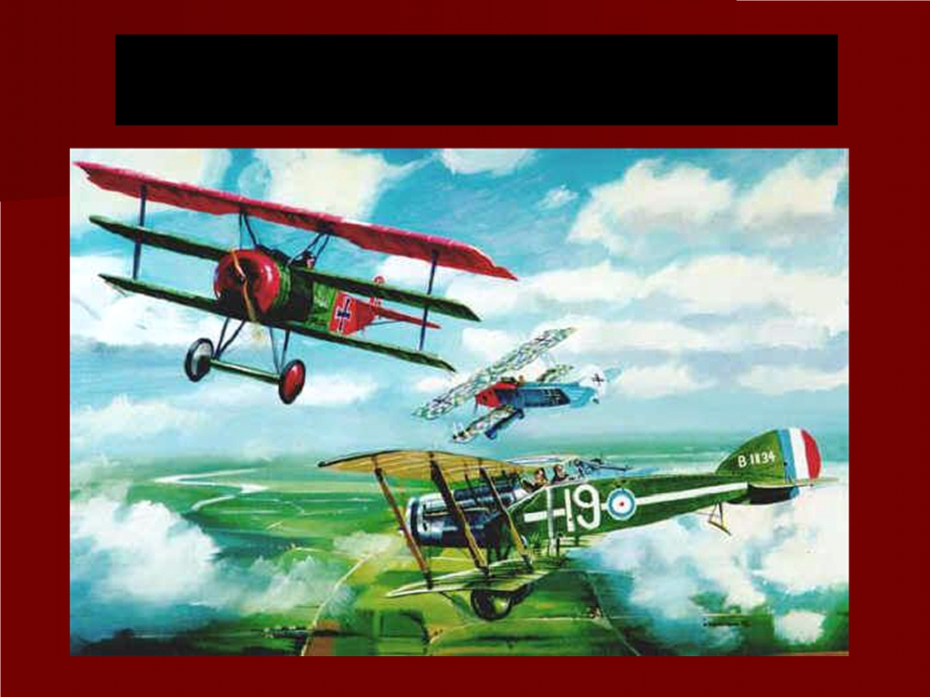
The Road to World War I

Slide 5
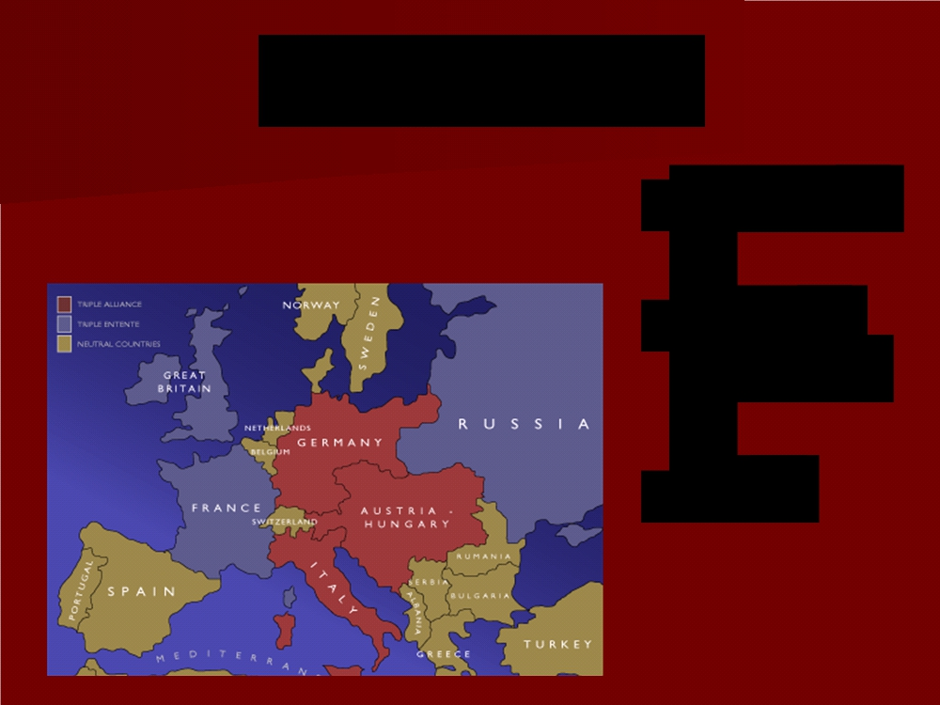
Triple Alliance
■ Germany
■ Austria- Hungary
■ Italy

Slide 6
Triple Entente
Entente means a diplomatic understanding.
■ Russia
■ France
■ Great Britain

Slide 7
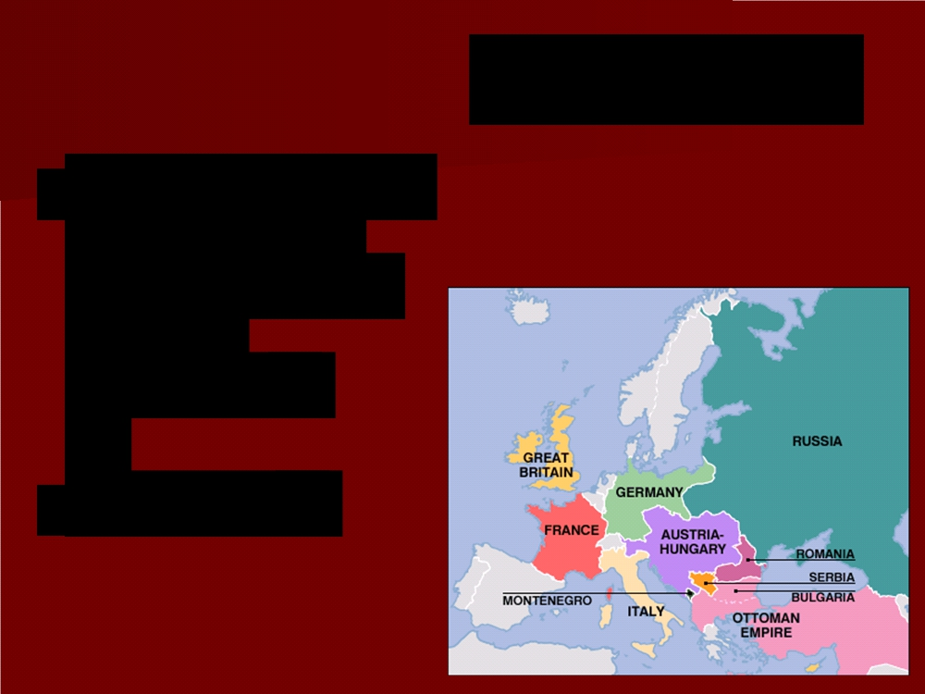
The Balkans
■ People groups of southeastern
Europe wanted to rule
themselves
■ Nationalism

Slide 8
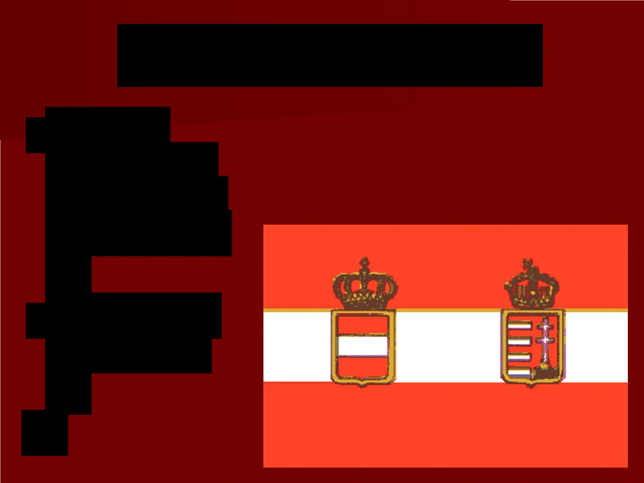
The Serbian Problem
■ Serbia
wanted to
become its own nation
■ Supported by Russia

Slide 9
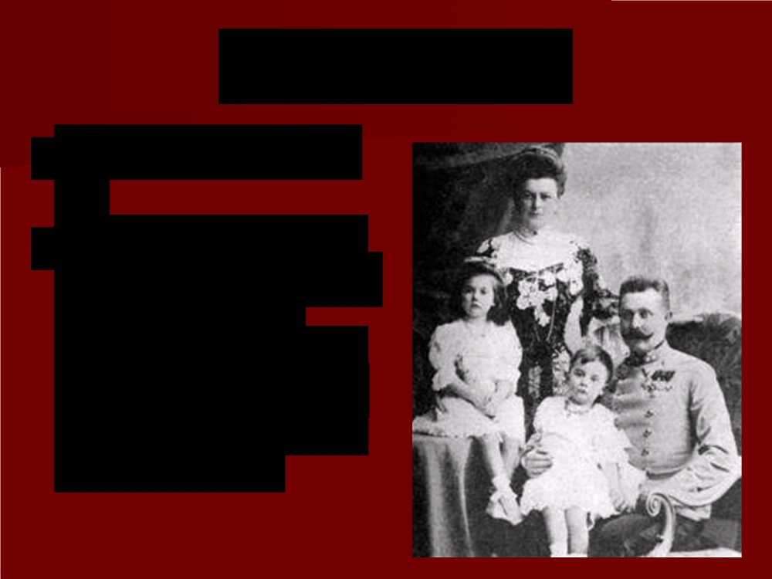
Assassination
■ Summer of 1914
■ Archduke Francis Ferdinand (heir to
the throne in
Austria-Hungary) visited the city of
Sarajevo with his
wife Sophia

Slide 10
Assassination
■ Terrorist group
known as the Black
Hand waited
■ Wanted Bosnia to be free of Austria- Hungary and
become a part of
Serbia

Slide 11
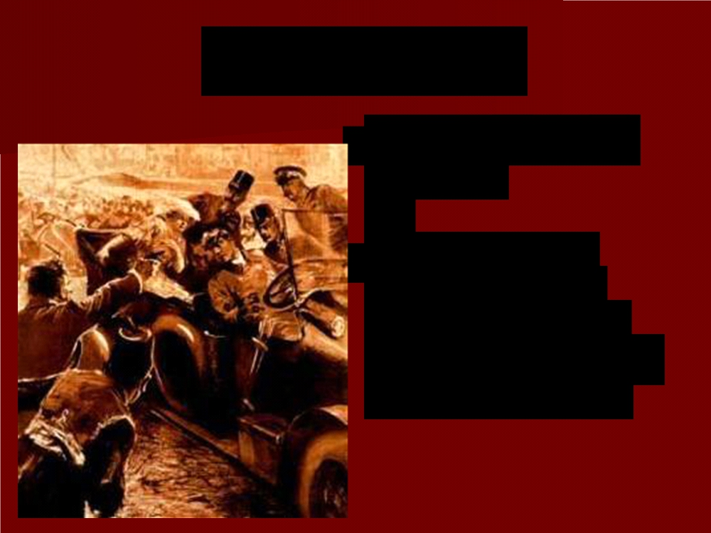
Assassination
■ Terrorist Gavrilo Princip
■ Succeeded in shooting both
Archduke Franz
Ferdinand and his
wife in their car

Slide 12
Eyewitness to the Assassination
“As the car came abreast, [the assassin] stepped
forward from the curb, drew his automatic pistol
from his coat and fired two shots. The first
struck the wife of the Archduke, the
Archduchess Sophia, in the abdomen. She was an expectant mother. She died instantly. The second bullet struck the Archduke close to the heart. He uttered only one word: “Sophia‟ - a
call to his stricken wife. Then his head fell back
and he collapsed. He died almost instantly.”

Slide 13
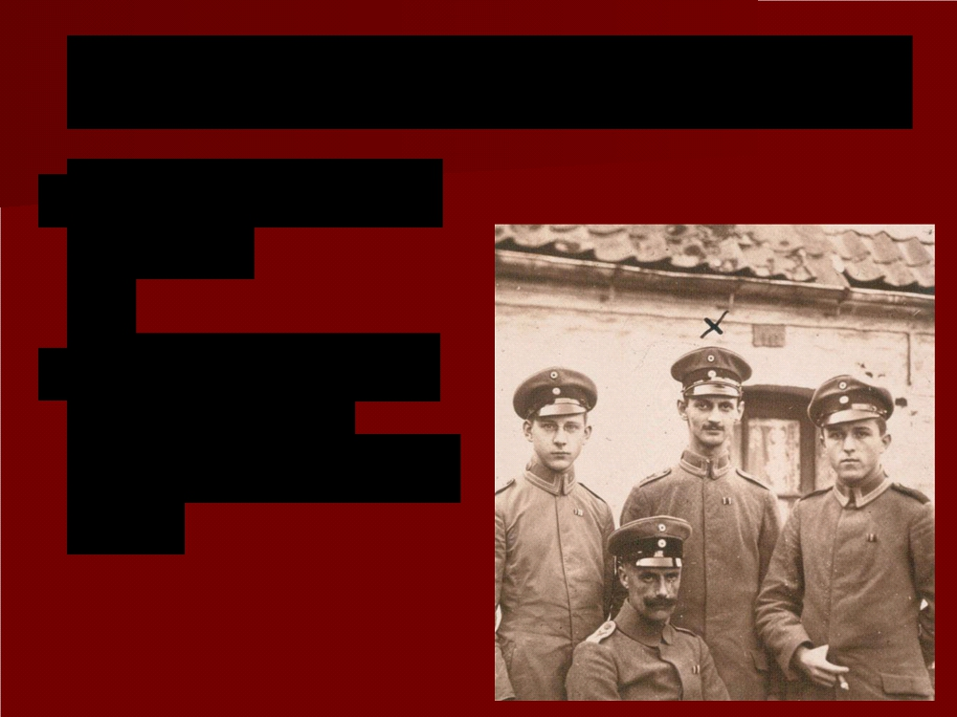
Response of Austria-Hungary
■ Declared war on
Serbia
■ Had the support of Germany
(Emperor William II)

Slide 14
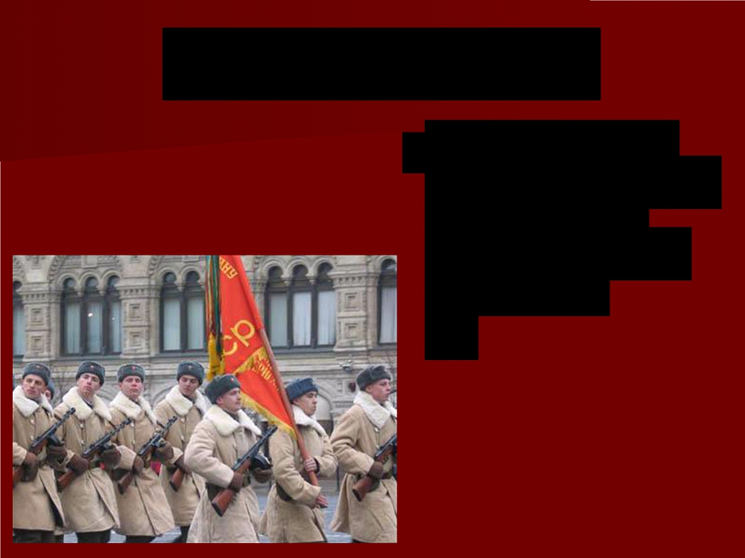
Russia’s Response
■ Russia (under
Czar Nicholas II)
ordered the
mobilization of
the army
Remember, Serbia was supported by Russia, in part due to their common religion, Orthodox Christianity.

Slide 15
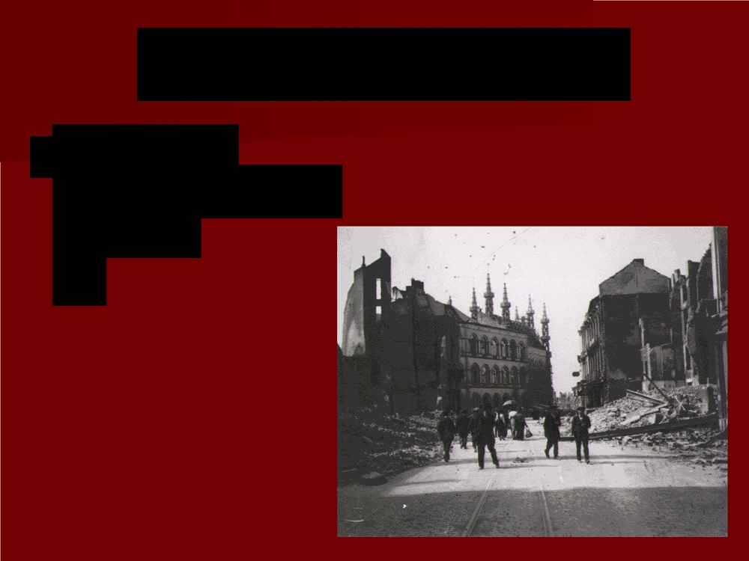
Germany’s Response
■ Germany
declared war on
Russia

Slide 16
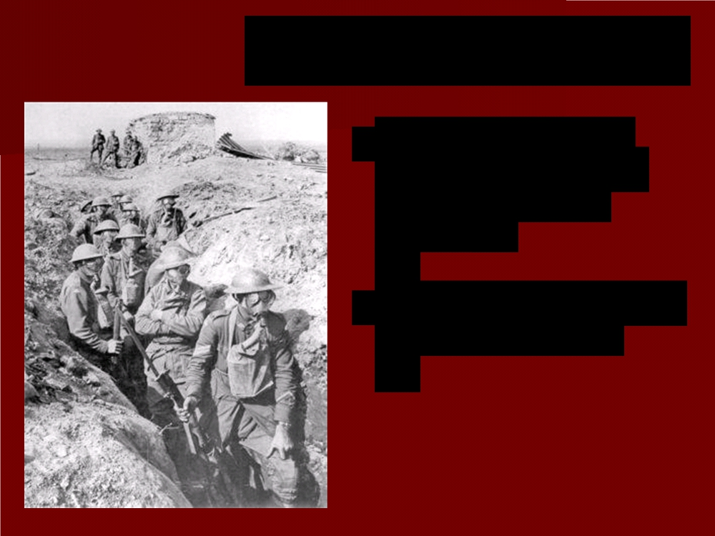
World War I Begins
■ Germany invaded
France by crossing
through neutral Belgium
■ Great Britain declared war on Germany

Slide 17
Quote - Emperor William II
“Till the world comes to an end the ultimate decision will rest with the sword.”

Slide 18
Two Sides
■ Allied
Powers
■ Central Powers

Slide 19
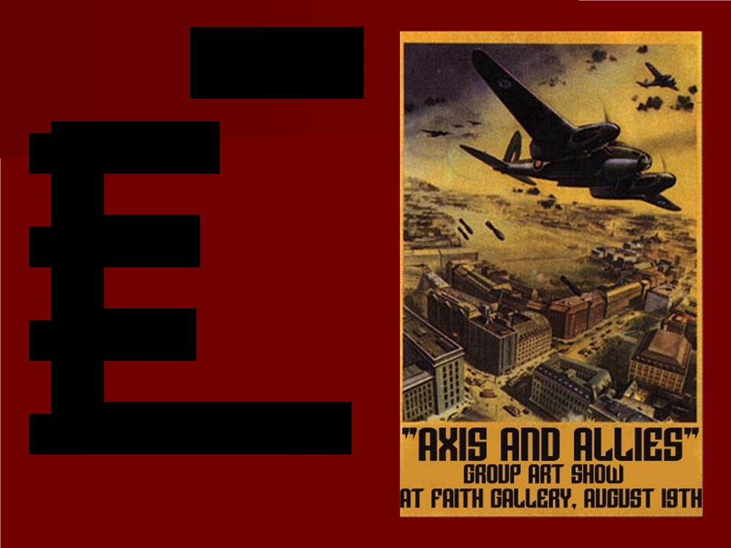
Allies
■ England
■ France  Russia
■ Italy (after 1915)

Slide 20
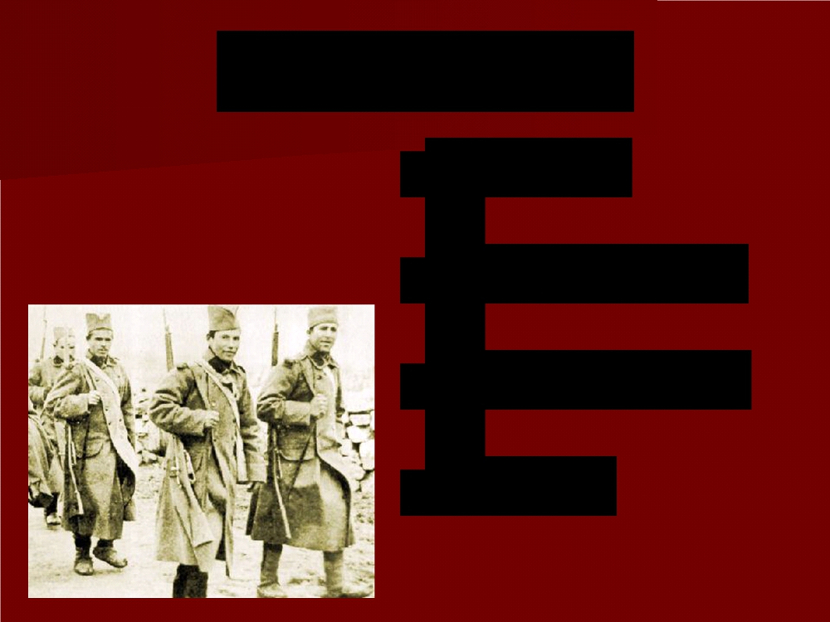
Central Powers
■ Germany
■ Austria-Hungary  Ottoman Empire  Bulgaria

Slide 21
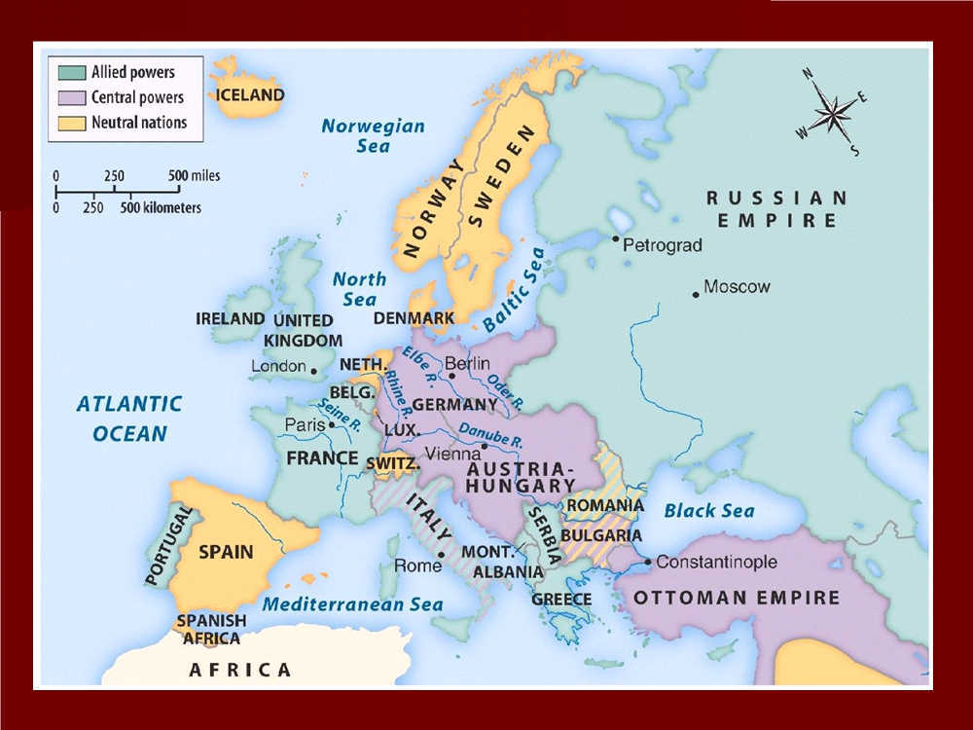

Slide 22
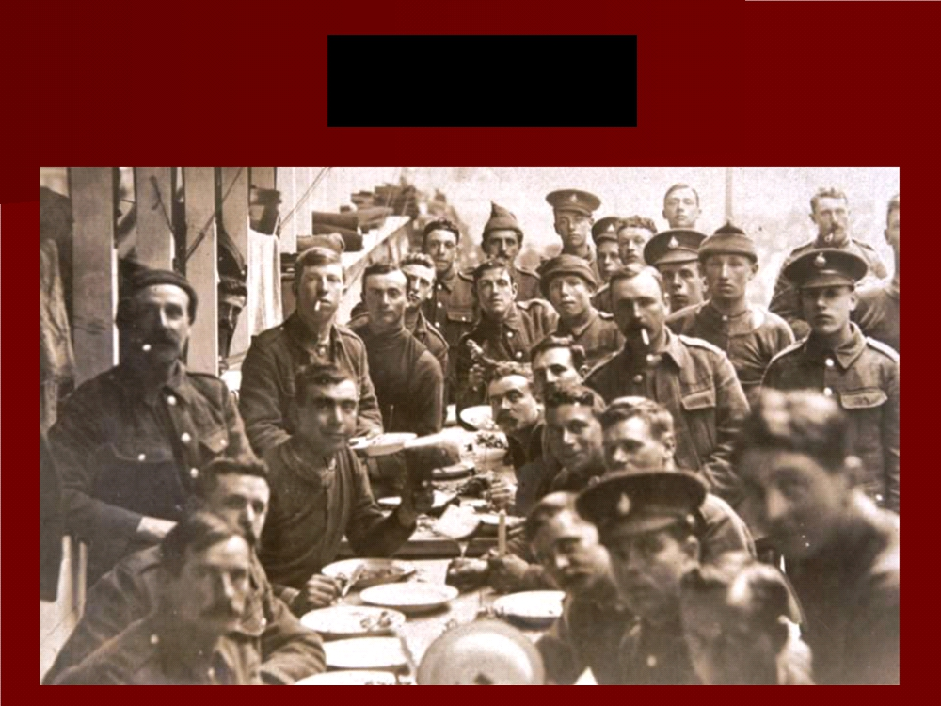
The War

Slide 23
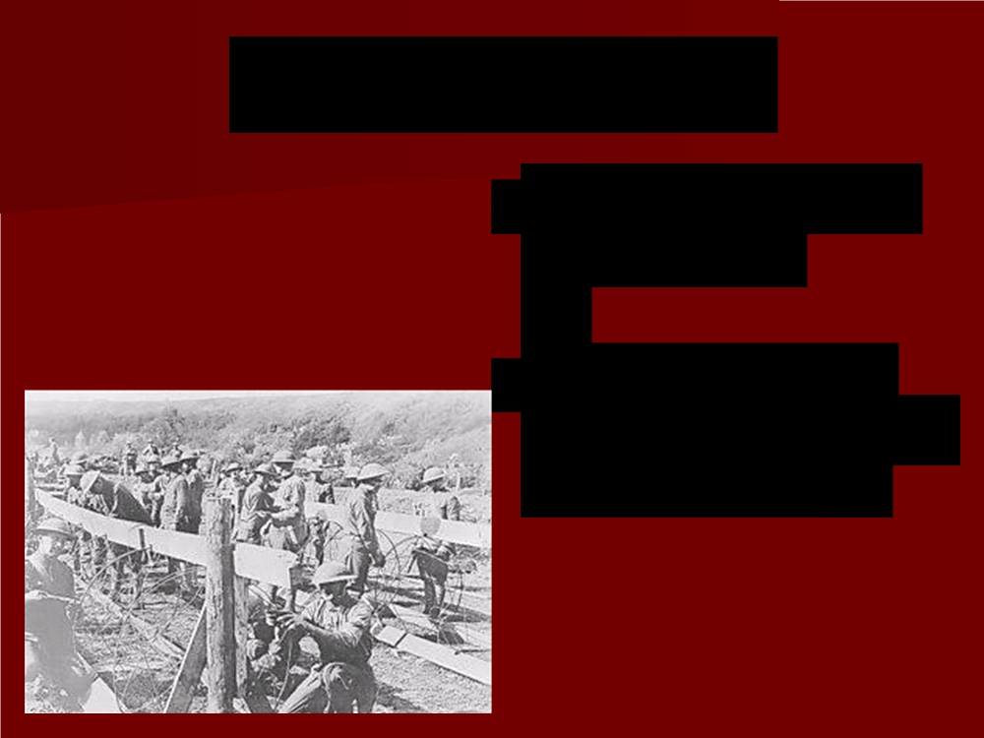
German Advance
■ Through Belgium into France
■ Stopped a short
distance from Paris by French army

Slide 24
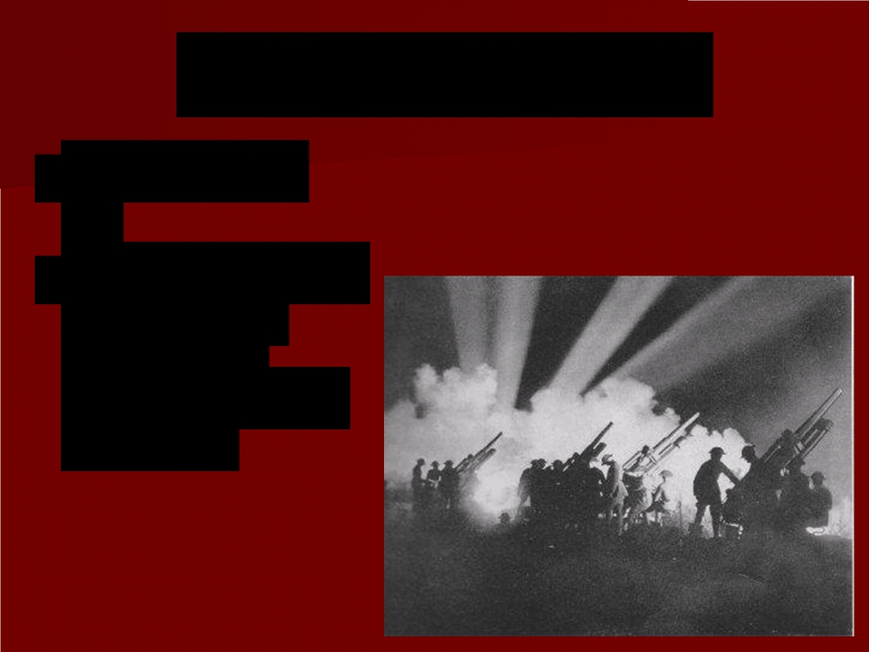
Battle of the Marne
■ Sept. 1914
■ Beginning of a stalemate
between
Germans and French

Slide 25
The Western Front
■ Both sides dug
ditches protected by barbed wire
■ Same positions for four years

Slide 26
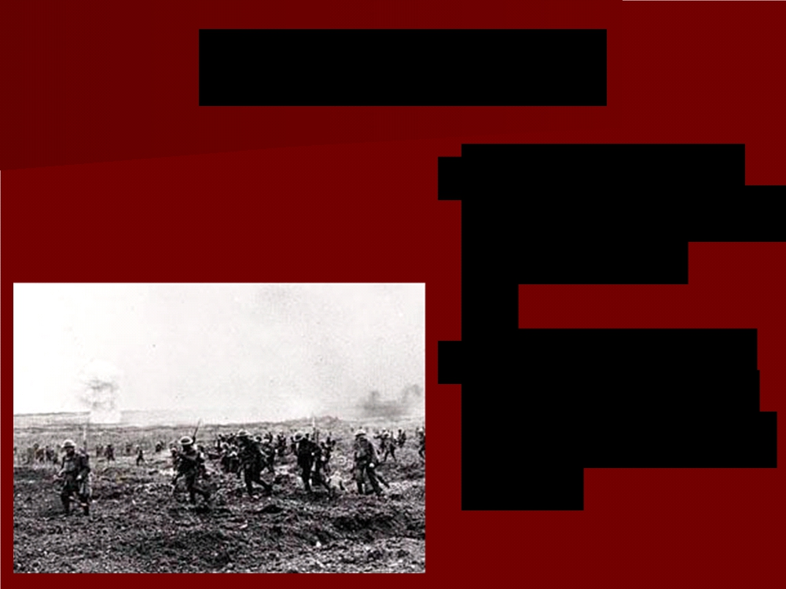
Trench Warfare
■ Troops lived in
trenches dug into the ground
■ Separated from each other by a
strip of no man‟s
land

Slide 27
Trench Warfare
■ Commanders
would send mass
armies against the enemy
■ Hoped to break through enemy lines

Slide 28
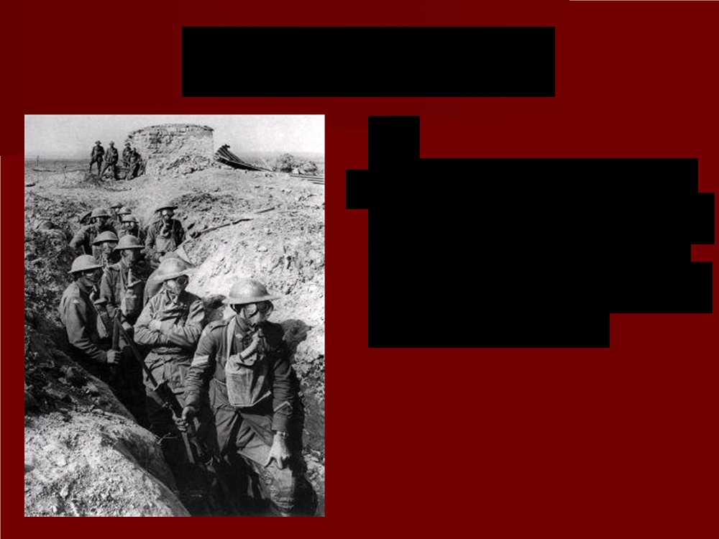
Trench Warfare
■ WWI became a war of attrition (wear the other side down by
constant attacks and
heavy losses)

Slide 29
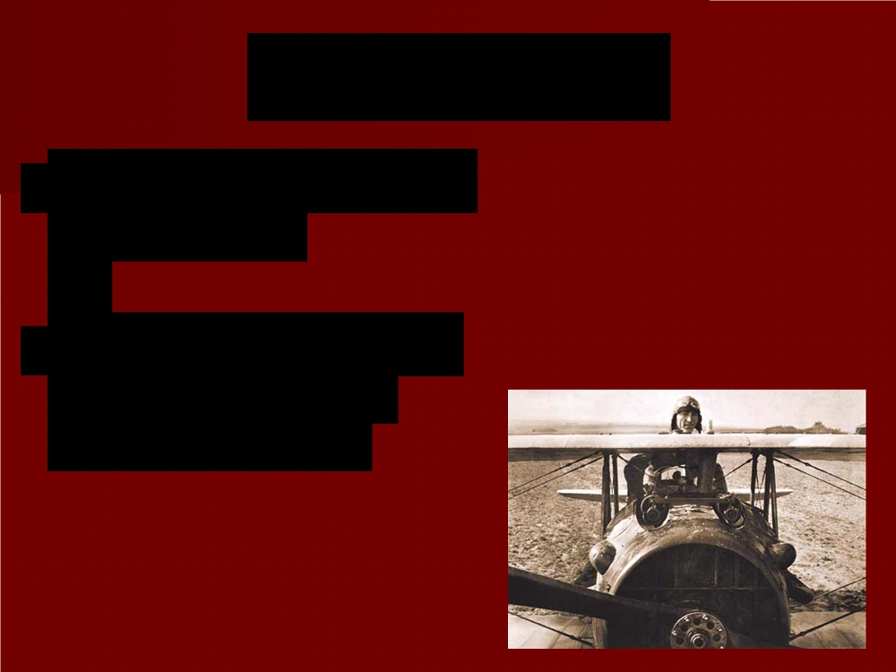
War in the Air
■ First use of airplanes for warfare
■ Used to spot enemy positions, attack
ground targets

Slide 30
Dogfights
■ Machine guns
mounted on the noses of planes

Slide 31
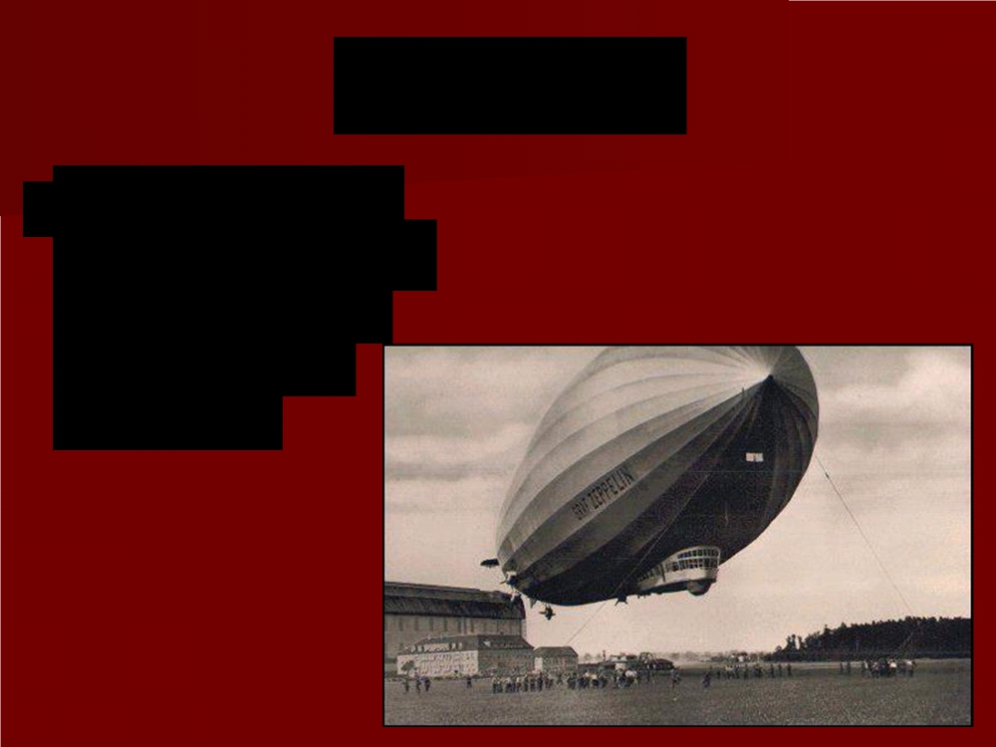
Zeppelins
■ Germans used giant airships to
bomb London and eastern
England

Slide 32
WORLD WAR I POWER POINT QUIZ
Take out a sheet of paper
At the top write, WORLD WAR I Quiz,
Your Name, and
Today’s Date.
Using your notes, answer the following questions.

Slide 33
The Triple Alliance was between what three powers?
The Triple Entente was between what three powers?
This region wanted self-rule from the Austria-Hungarian Empire and were supported by Russia.
At the war’s beginning, the Central Powers were made up of what four nations?
The assassination of _____________ sparked WWI. He was the heir to what throne?
Pass your quiz to the front. We will continue our exploration of the Great War on Wednesday and complete this quiz with, “World War I – The End.”

