Slide 1
World War I Review The End
Mr. Wyka’s World History
Citrus High School

Slide 2
Warm Up
Can you answer the following questions?
Use the map provided to answer these questions.
a. The British naval blockade protected which body of water?
b. Which region of North Africa remained neutral?
c. Which country lies directly northwest of Albania?
d. Trench warfare was primarily found in which two countries?

Slide 3
Essential Question
How did World War I end?

Slide 4
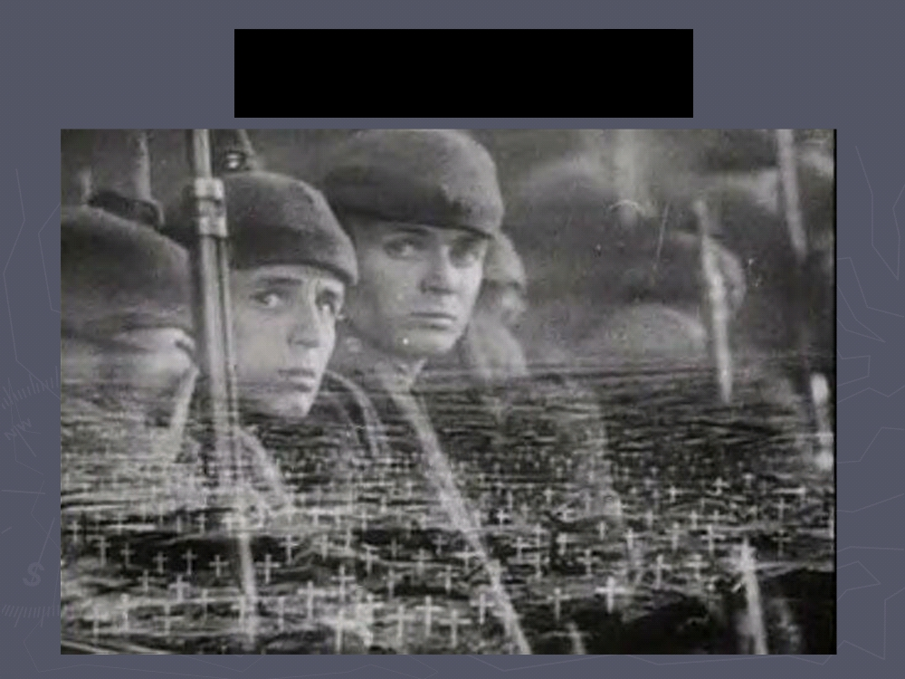
End of the War

Slide 5
Position of the United States
►At first the U.S.
attempted to remain
neutral
►Germany fought Britain at sea and used U-boats to sink British ships

Slide 6
Lusitania
►May 7, 1915
►German U-boat sunk a British passenger ship with 100
Americans on board

Slide 8
U.S. Enters the War
►By April 1917,
unrestricted German
naval warfare
brought the U.S.
into the war
►Troops arrived in 1918

Slide 9
War Efforts
►WWI became a total war (complete
mobilization of resources and
people for the
countries involved)
Is the war in Afghanistan a “total war”?
Was the Vietnam War a “total war”?
What was the last “total war” the United States fought?

Slide 10
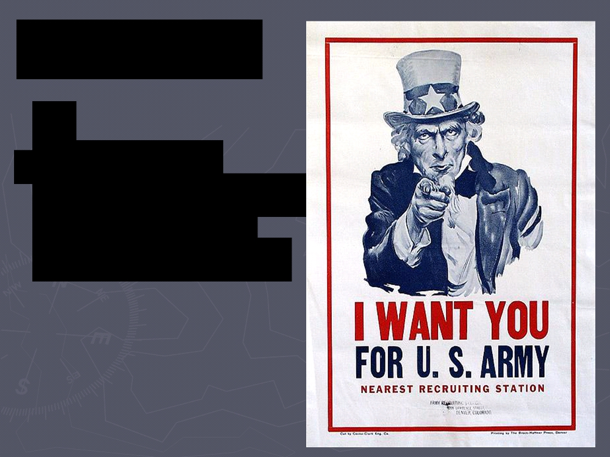
War Efforts
►Government
agencies controlled manufacturing,
prices, and wages

Slide 11
Quote - Woodrow Wilson
“The men and women who remain to till the soil and man the factories are no less a part of the army than the men beneath the battle flags.”

Slide 12
Public Opinion
►Governments could arrest protestors of
the war
►Used propaganda to influence public
opinion

Slide 13
Roles for Women
►Women took over
jobs left by men who
entered the war
►Factory workers, truck drivers, etc.

Slide 14
The Eastern Front
► Combined German
and Austrian army
pushed Russian army back with losses of
2.5 million
In 1917, the Bolshevik Revolution sweeps across Russia. The Czar and his family are murdered. Russia becomes communist.

Slide 15
1918 German Offensive
►The withdrawal of
Russia from the war
allowed Germany to launch a new attack
in France
►Led by Erich von Ludendorff

Slide 16
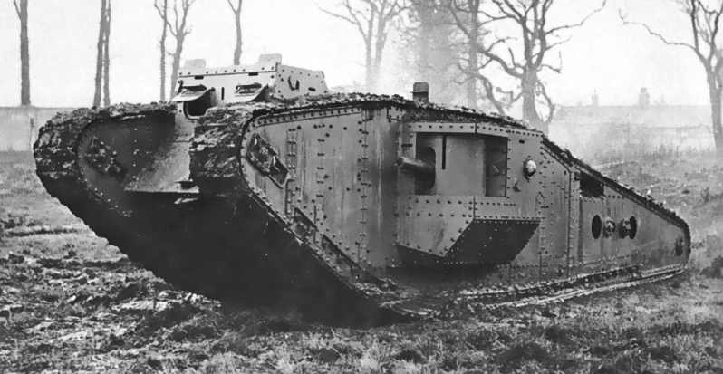
Second Battle of the Marne
►July 18, 1918
►German troops stopped 50 miles
from Paris
The British Mark IV Tank, introduced in mid 1917, played a major role.

Slide 17
Germany Weakens
► More than a
million American
troops arriving in France
► Kaiser William II, the last German emperor, abdicated and left Germany in Nov. 1918 in disgrace, for the Netherlands.

Slide 18
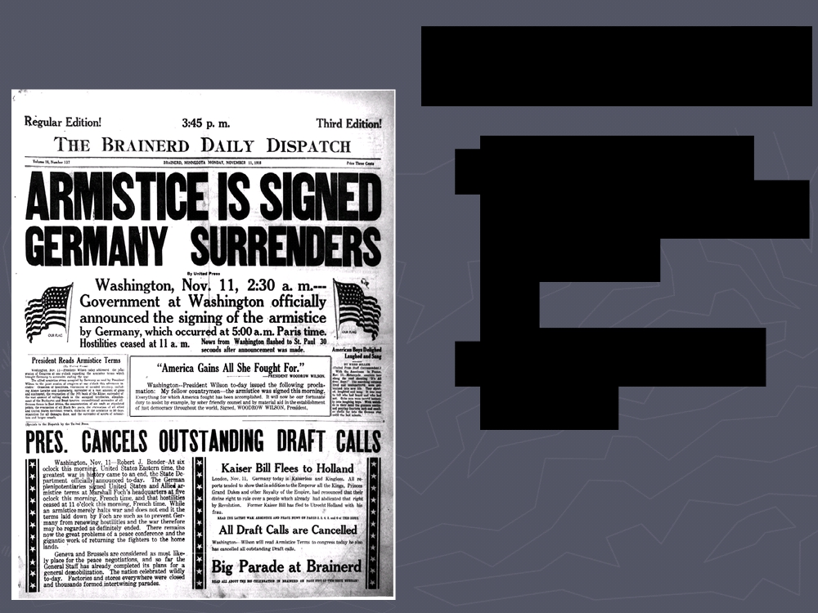
The War Ends
►Armistice = a
truce, end to the
fighting
►November 11, 1918

Slide 19
Paris Peace Conference (1919)
David Lloyd George -
British Prime
Minister
►Georges
Clemenceau - French premier
►Woodrow Wilson - U.S. president

Slide 20
Treaty of Versailles
►War Guilt
Clause:
Germany and Austria were
responsible
for starting the war

Slide 21
Treaty of Versailles
►Germany had to pay reparations to cover
the cost of the war
►Germany had to reduce army and navy, eliminate air
force

Slide 22
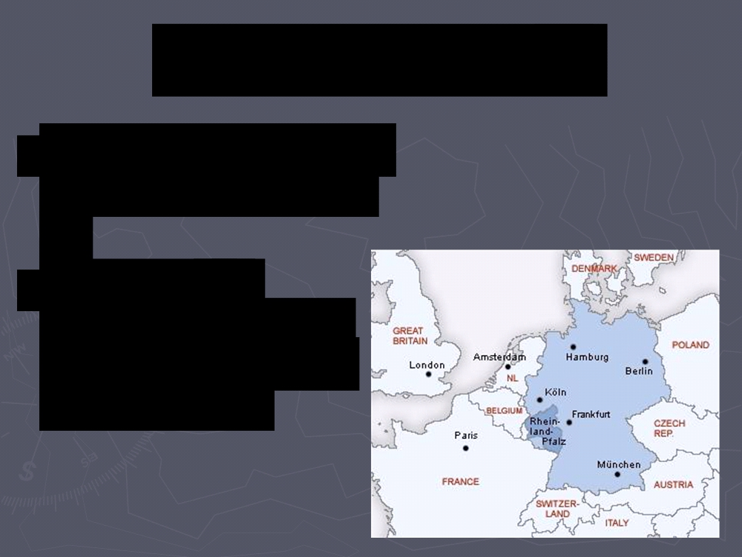
Treaty of Versailles
►Germany lost land of Alsace and Lorraine
►Rhineland -
demilitarized zone (no German bases or weapons)

Slide 23
Response of Germany
►Angered by the
terms of the
treaty, but
forced to sign
rather than
return to war

Slide 24
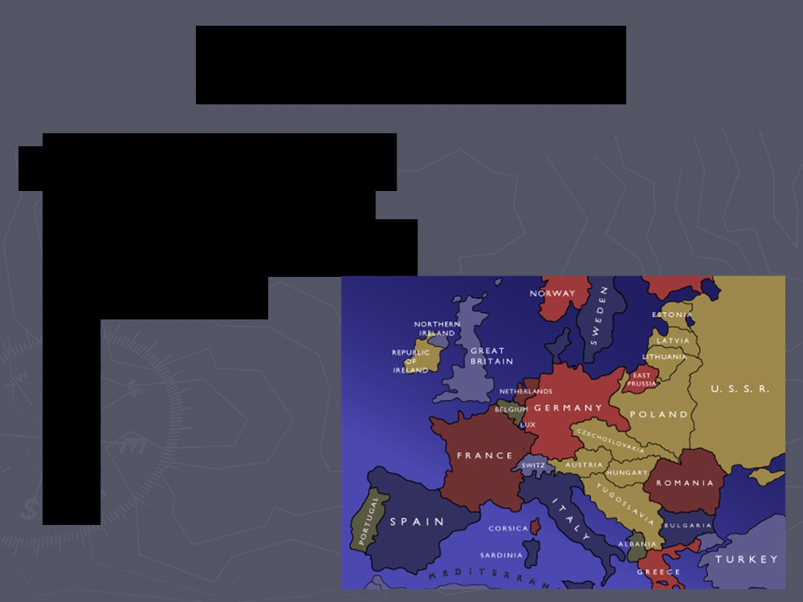
Austria-Hungary
►Nation divided into Austria, Hungary,
Czechoslovakia, and Yugoslavia

Slide 25
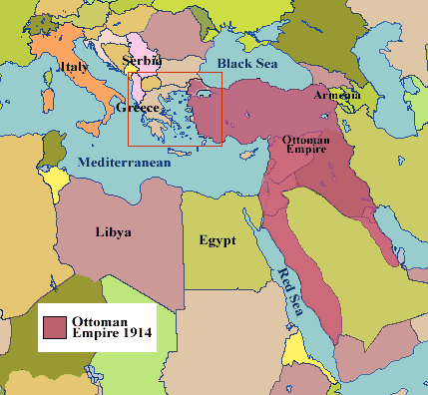
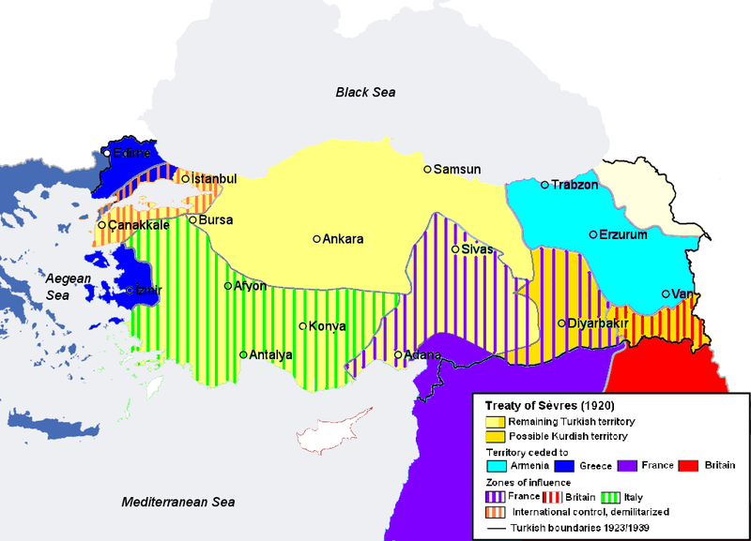
Ottoman Empire
Territory divided up after the war, effectively spelling the final end of the Ottoman Empire.
Under the terms of the Treaty of Sevres, the Ottoman Empire was partitioned. The new countries created from the former territories of the Ottoman Empire currently number 39.
The United States never declared war on the Ottoman Empire.

Slide 26
League of Nations
►Proposed by
President
Wilson
Curiously, the US never joined.
►World
organization to prevent future wars
Although it had some successes, for the most part, the League failed and was dissolved in 1946.

Slide 27
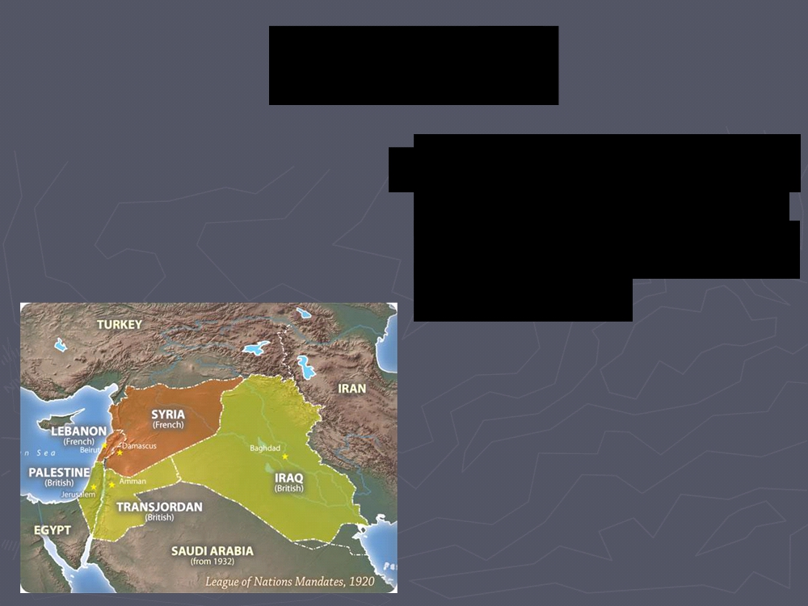
Mandates
►Territories controlled by larger nations on
behalf of the League of Nations

Slide 28
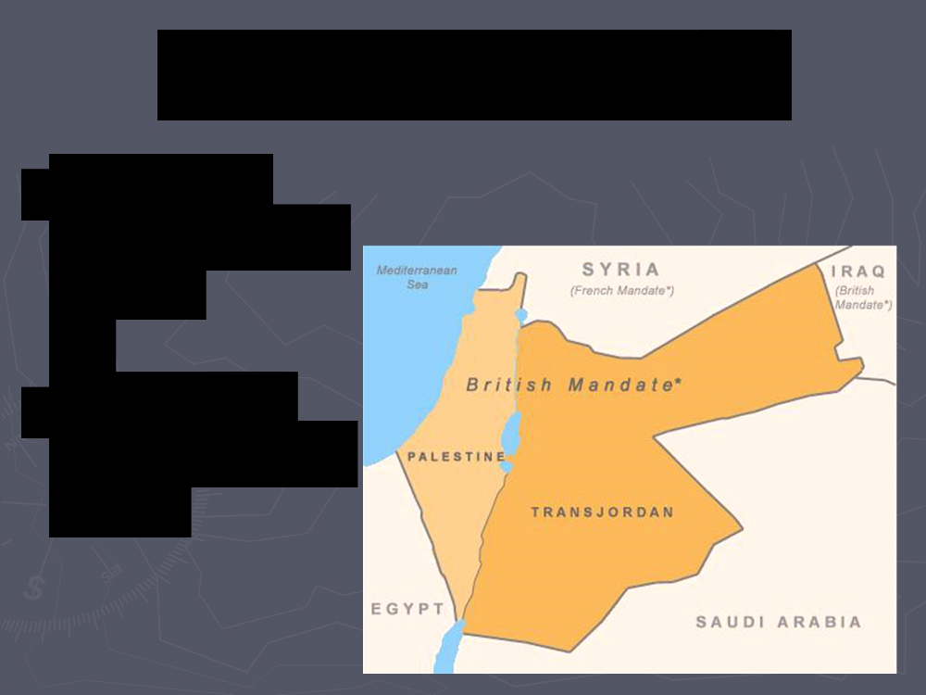
Middle East Mandates
►France -
Lebanon and
Syria
►England -
Palestine and Iraq

Slide 29
The Triple Alliance was between what three powers?
The Triple Entente was between what three powers?
This region wanted self-rule from the Austria-Hungarian Empire and were supported by Russia.
At the war’s beginning, the Central Powers were made up of what four nations?
The assassination of _____________ sparked WWI. He was the heir to what throne?
At the start of WWI, the United States was officially ___________.
Which European country experienced a revolution in 1917?
What treaty ended the war?
The organization proposed by Wilson to bring an end to all wars through diplomacy.
What happened to the Austria-Hungary after the war? Be specific.
What event allowed the Germans to launch a new offensive in France in 1918?

Slide 30
World War I - POWER POINT QUIZ
Make sure your name is on your Quiz,
Pass your quiz to a fellow student, and
Pass the first quiz you receive to another student.
Keep the second quiz you receive for grading.
Write your name at the top of the quiz.

