Slide 1
How much do you know about WWII?
Can you name the two nations chiefly responsible for bringing about WWII?
Can you name two of the Allied powers?
Can you name two of the Axis powers?
Do you know WHERE WWII was fought?
Do you know what event prompted the U.S. to get involved directly in the war?

Slide 2
World War II Review The Beginning
Mr. Wyka’s World History
Citrus High School

Slide 3
Essential Question
■ How did World War II begin?

Slide 4
Paths to War

Slide 5
Beliefs of Adolf Hitler
Germans were part of a superior, Aryan race
Where have you heard the term “Aryan” before?
The Indo-Aryan migration into India, approximately 1500 B.C.E., by a Indo-European speaking people.
Possibly supplanted the Harappan civilization already in the Indus Valley.
Germany was capable of building a great civilization; a “Thousand Year Reich”.
Germany needed more land to support a larger population.
Germany was capable of building a great civilization

Slide 6
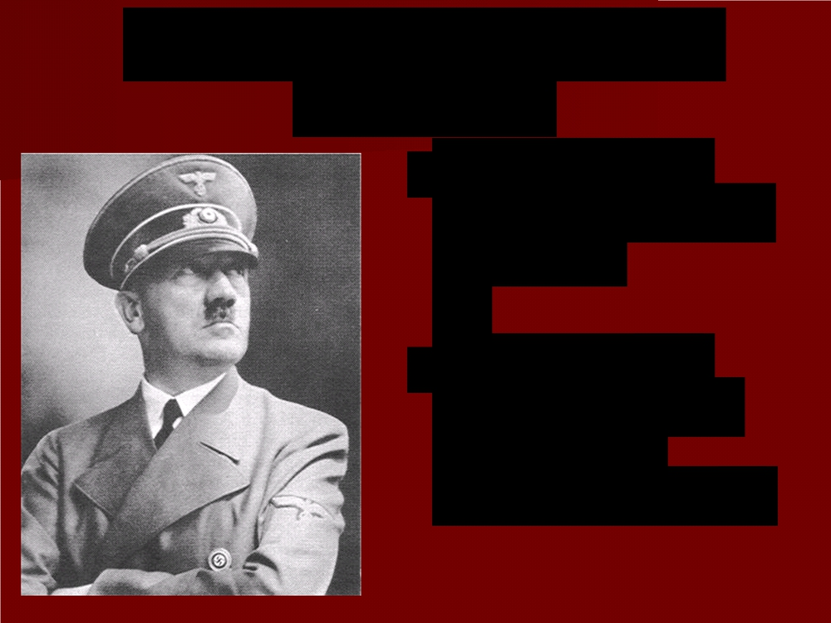
Violations of the Treaty of Versailles
1933 – ceased paying reparations.
March 1935 - military draft to strengthen German armed forces.
Secret rearmament
Rebuilt the German air force
1936- Remilitarized the Rhineland
1938 - Annexed Austria

Slide 7
To Sum Up…
Adolf Hitler grossly violated the Treaty of Versailles.
He expanded Germany into neighboring states by annexing Austria and demanded even more land.

Slide 8
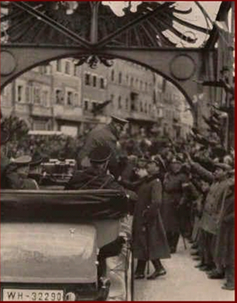
Europe’s Response
■ Refused to use
force to uphold the
treaty
■ Policy of
appeasement =
give in to demands
in order to keep
peace

Slide 9
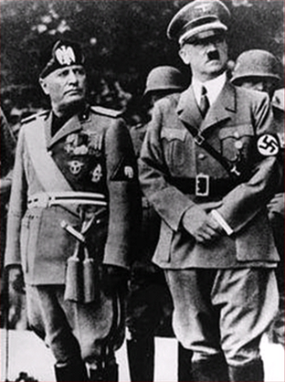
New Alliances
■ Rome-Berlin Axis – an alliance between Germany (Hitler) and Italy (Mussolini).
■ 1936 – Mussolini and Hitler sent troops into Spain to support Franco, leader of the Spanish Nationalists in the Spanish Civil War.

Slide 10
The Austrian Anschluss
■ March 1938 -
Hitler sent troops into Austria
■ Announced the unification (anschluss) of Germany and Austria

Slide 11
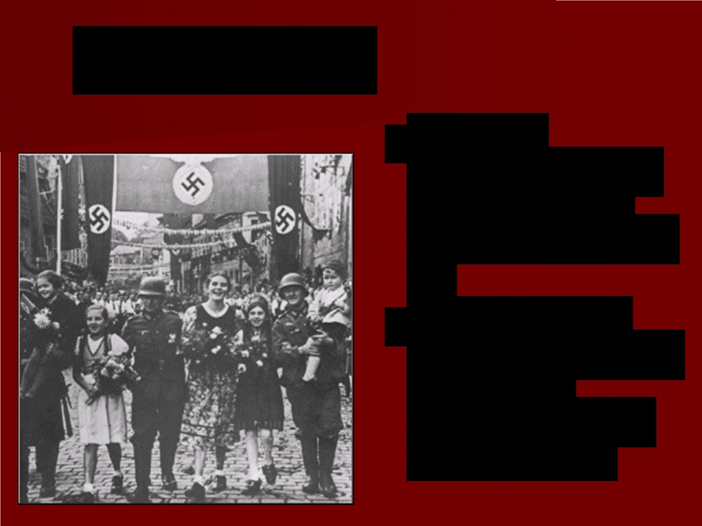
Sudetenland
■ Part of
Czechoslovakia
with German-
speaking people
■ Sept. 1938 -
Hitler demanded
this area
become a part of Germany

Slide 12
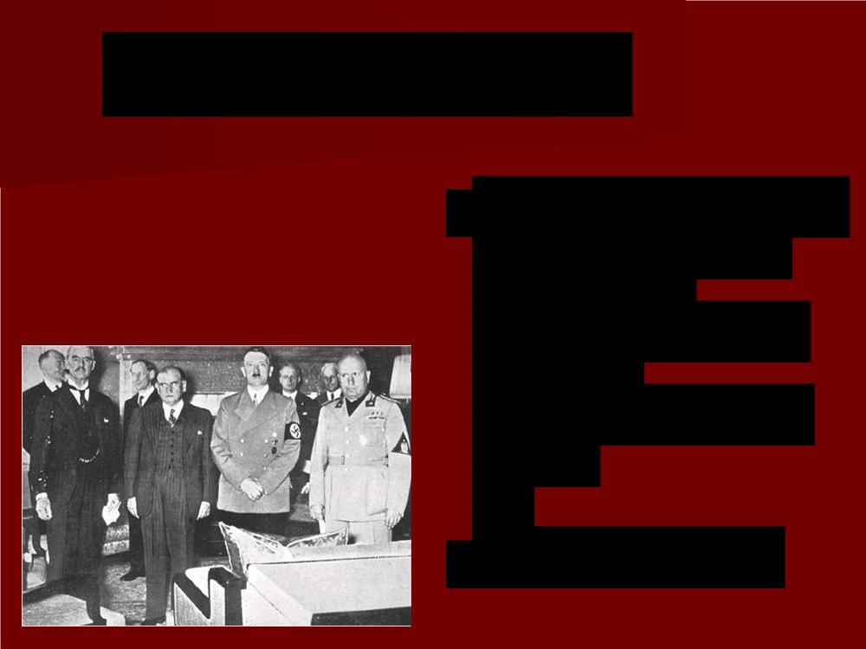
Munich Conference
Sept 29, 1938 - Representatives of Britain, France, Italy, and Germany, met to decide the fate of Czechoslovakia
Remember, Czechoslovakia had been part of the Austria-Hungarian empire before WWI.

Slide 13
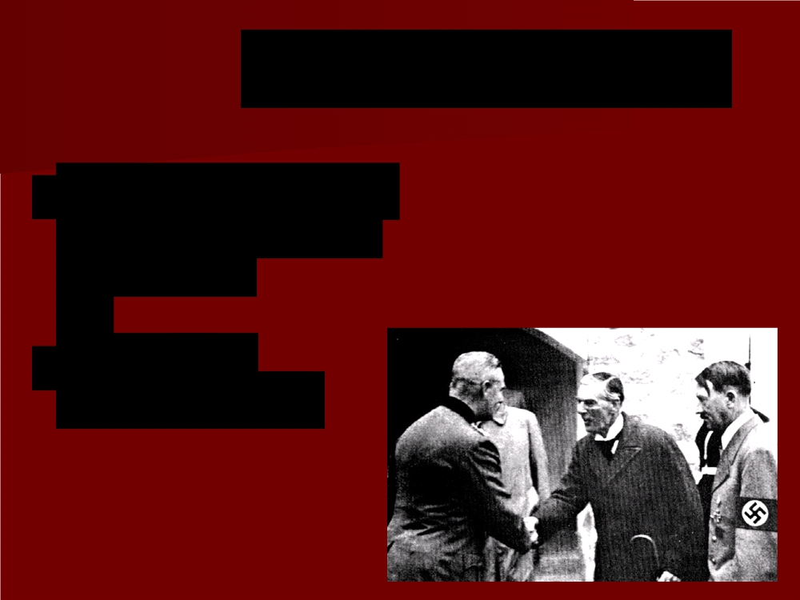
Munich Conference
■ Britain and France agree to Hitler’s demands
Marks the height of appeasement

Slide 14
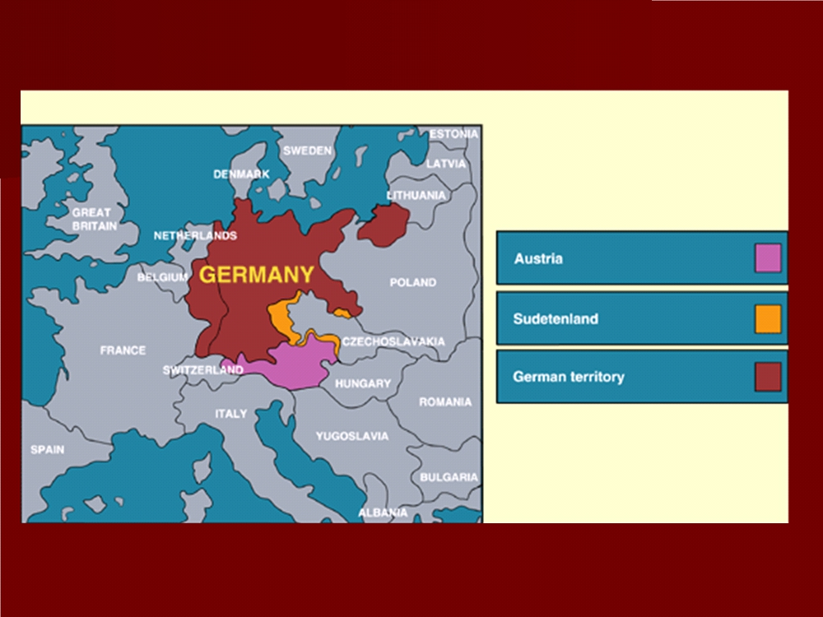

Slide 15
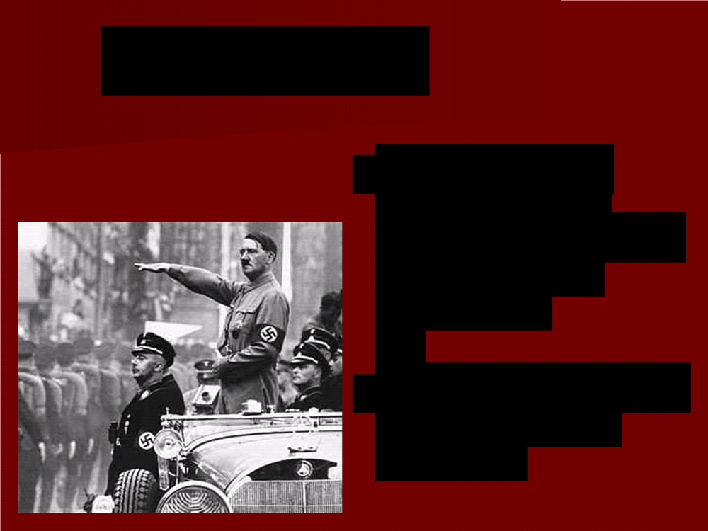
Appeasement
Supporters of appeasement believed Hitler had a few, limited demands.
The goal: Avoid war.
The means: Give Hitler what he wanted.

Slide 16
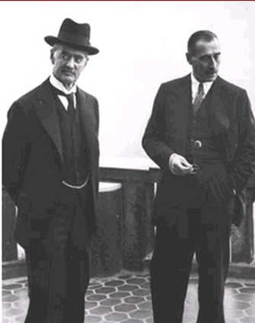
Appeasement
■ British Prime Minister Chamberlain, the primary supporter of appeasement:
“A peace with honor . . . Peace in our time.”

Slide 17
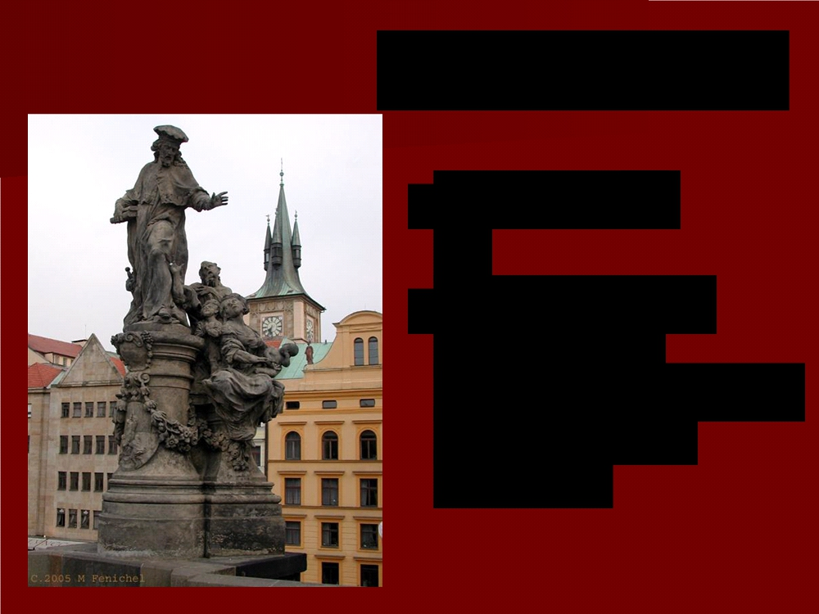
Czechoslovakia
■ March 1939
■ Germany sent troops into
Czechoslovakia and broke up the
country

Slide 18
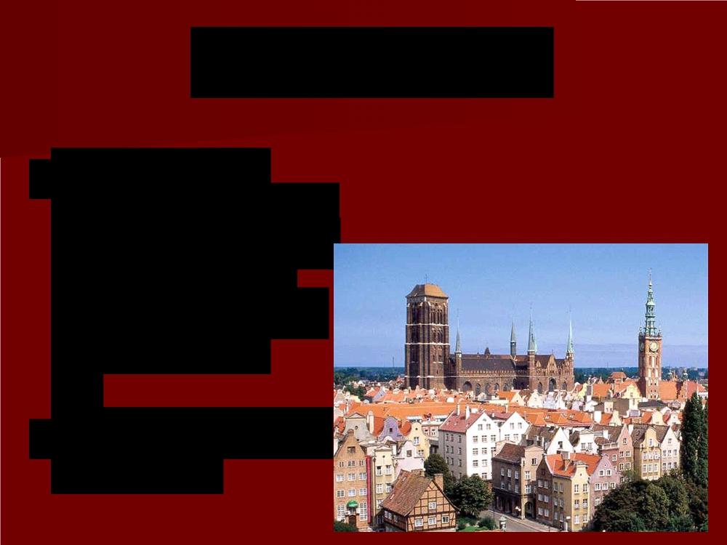
Danzig, Poland
■ Oct. 1938 -
Hitler demanded the return of the
city of Danzig
(part of Poland) to Germany
■ Important Baltic Sea port

Slide 19
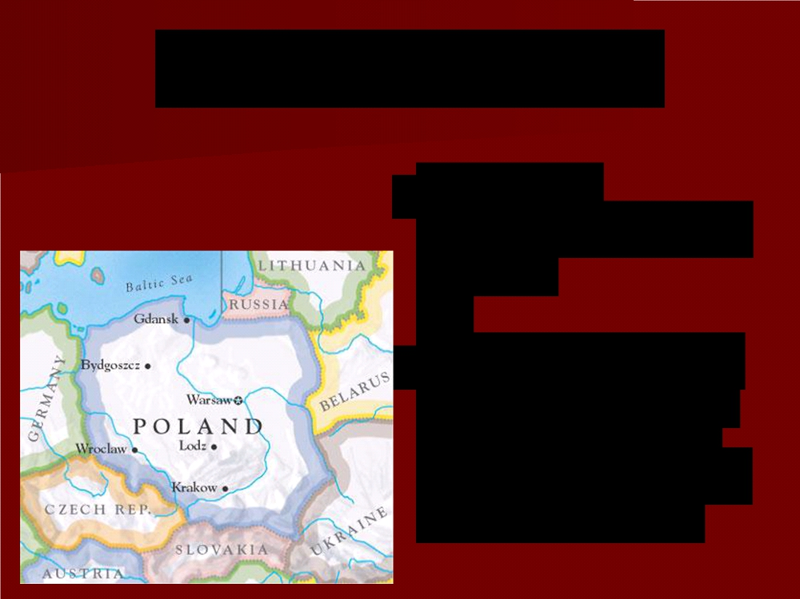
Response of Europe
■ Realized
appeasement had failed
■ If Poland went to war to defend its
territory, Britain
and France would come to its aid

Slide 20
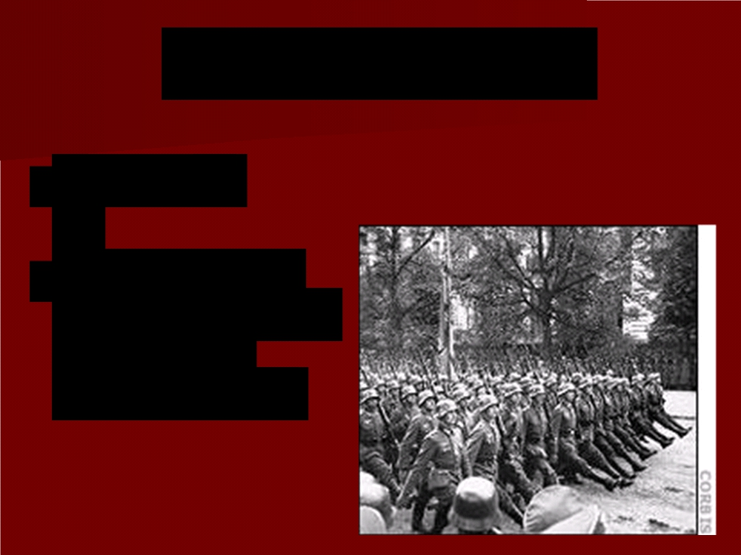
German Response
■ May 1939
■ Hitler ordered
German army to
prepare to
invade Poland

Slide 21
Nazi-Soviet Nonaggression Pact
■ August 23, 1939
■ Treaty between Germany and the
USSR
■ Secret deal to
divide Poland
between the two

Slide 22
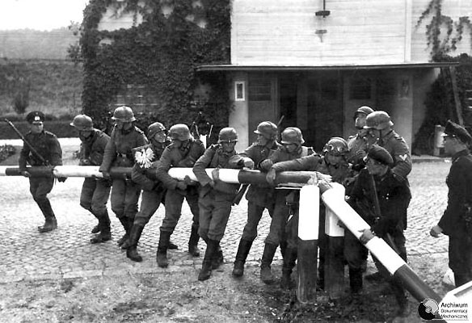
Beginning of World War II
■ Sept. 1, 1939
Germany invaded Poland from the
west.
■ Soon after, the USSR invaded Poland from the east.
German soldiers break the gate at a Polish check-point.

Slide 23
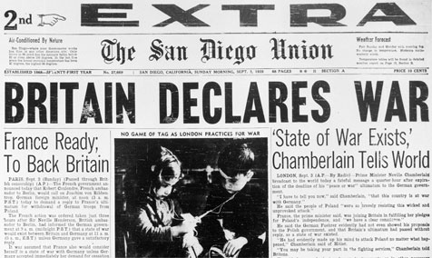
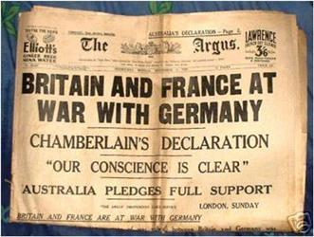
Beginning of World War II
■ In response to the German invasion of Poland, two days later, Sept. 3, 1939
France and Britain
declared war
on Germany.

Slide 24
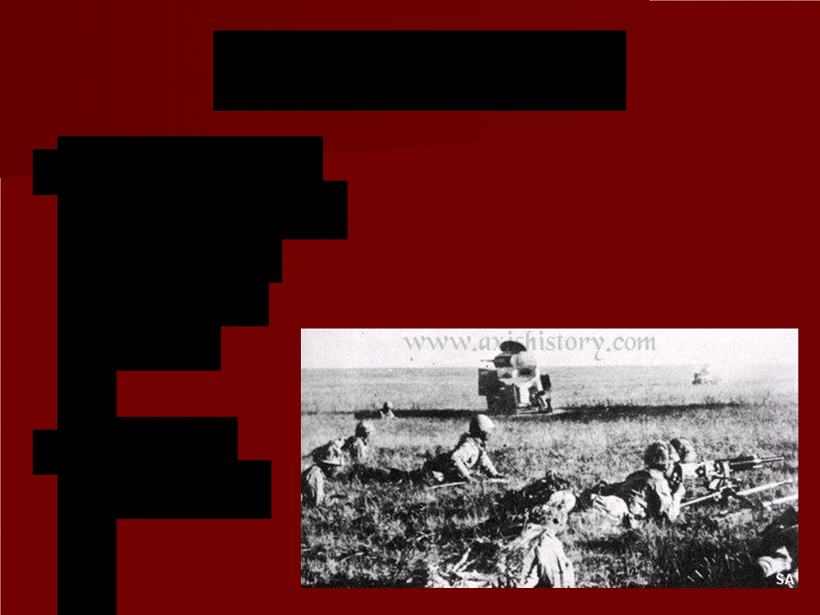
Japan and War
■ Sept. 1931 -
Japan invaded
Manchuria
(northern
China)
■ Desired resources

Slide 25
War With China
Chinese leader Chiang Kai-shek
July 1937 – Japan clashes with Chinese forces south of Beijing.

Slide 26
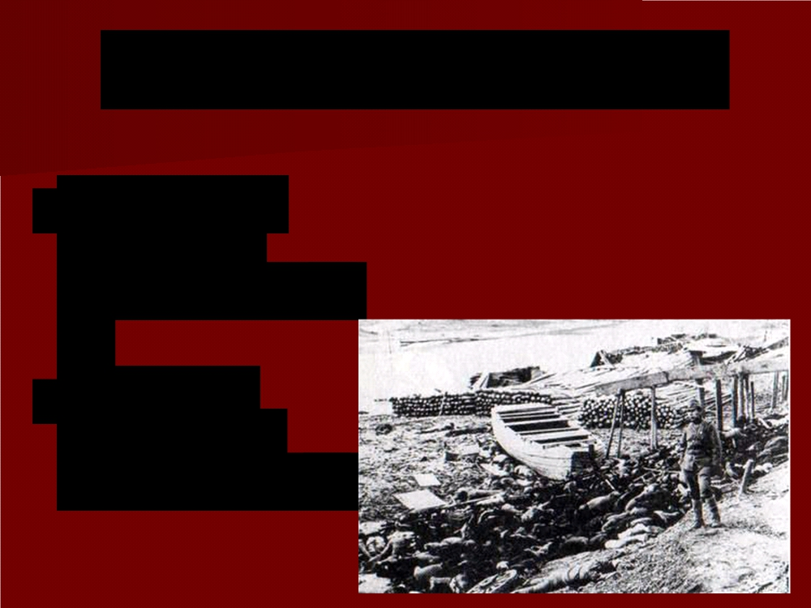
Japan Massacres Nanjing
■ 1937 - Japan took control of Nanjing (Nanking), the former capital of the Republic of China
■ Executed
250,000 to
300,000 people

Slide 27
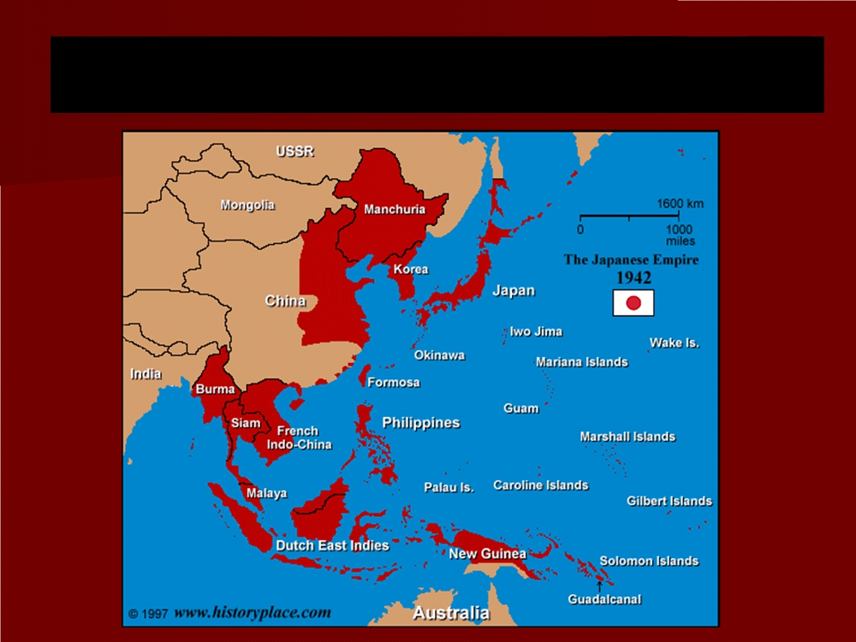
Japanese Expansion (1933-1942)

Slide 28
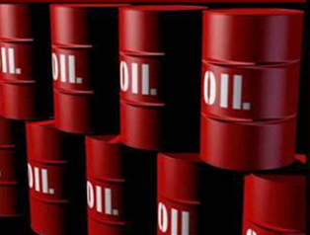
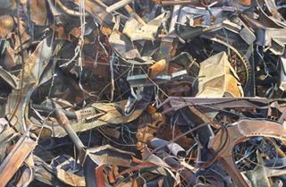
Japanese Imports and Sanctions
Pre-war, Japan imported oil and scrap iron from the U.S.A.
In response to Japanese
aggression in China, the
United States initially
threatened sanctions
(restrictions intended to
enforce international laws)
on Japan.
Does that sound familiar?

Slide 29
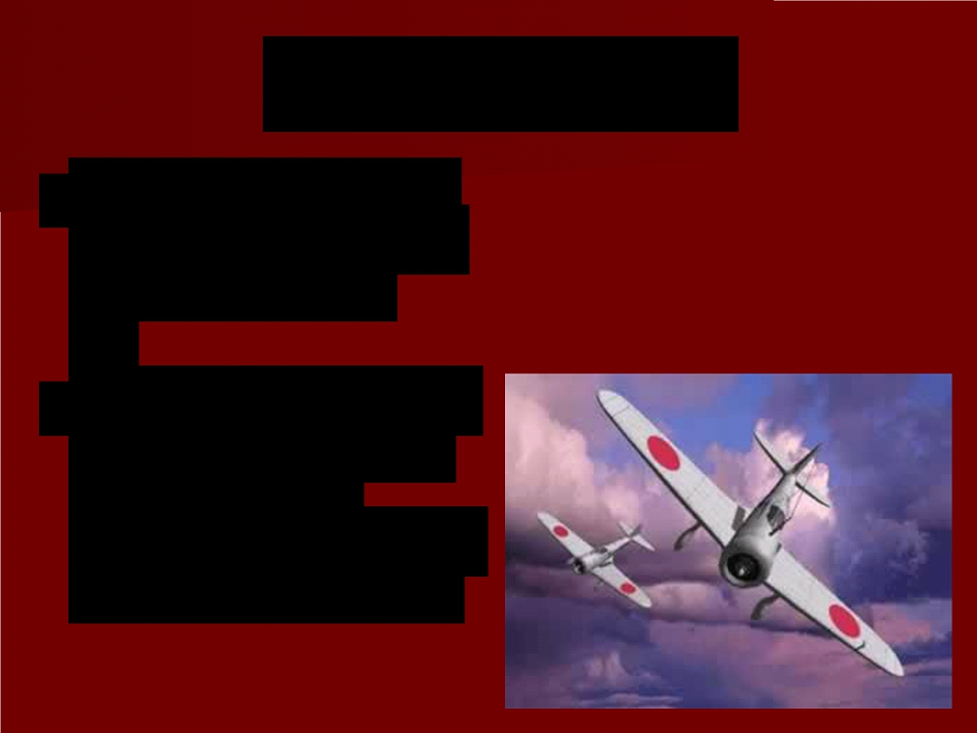
Japanese Response
Knowing they did not have the resources for a long, drawn-out war…
Japan decided to launch a surprise attack on the U.S. and on European colonies in southeast Asia

Slide 30
WORLD WAR II POWER POINT QUIZ
Take out a sheet of paper
At the top write, WORLD WAR II Quiz,
Your Name, and
Today’s Date.
Do your own work. Discussion of the quiz will be considered cheating and result in a zero.
Using your notes, answer the following questions.

Slide 31
What is the name of the German “master race” as envisioned by Hitler (it’s not the Nazis)?
Germany violated the Treaty of Versailles in many ways leading up to WWII. Among them, in 1938, Germany annexed what neighboring country?
Giving in to Hitler’s demands in order to keep the peace was called the Policy of ___________________.
Who was the main proponent of this policy? Hint: He was the Prime Minister of Great Britain before the war.
The Rome-Berlin Axis was a military alliance between what two countries?
The invasion of what country in 1939 prompted Great Britain and France to declare war on Germany?
What was the initial US response to Japanese aggression in China?

