Slide 1
World War II Review The Beginning
Mr. Wyka’s World History
Citrus High School

Slide 2
Essential Question
How did World War II begin?
What created the atmosphere
in Europe for Fascist
and Nationalist
Dictatorships to take
over so many nations?

Slide 3
Paths to War

Slide 4
Beliefs of Adolf Hitler
Germans were part of a superior, Aryan race
Where have you heard the term “Aryan” before?
The Indo-Aryan migration into India, approximately 1500 B.C.E., by a Indo-European speaking people.
Possibly supplanted the Harappan civilization already in the Indus Valley.
Germany was capable of building a great civilization; a “Thousand Year Reich”.
Germany more land to support a larger population.
Germany was capable of building a great civilization

Slide 5
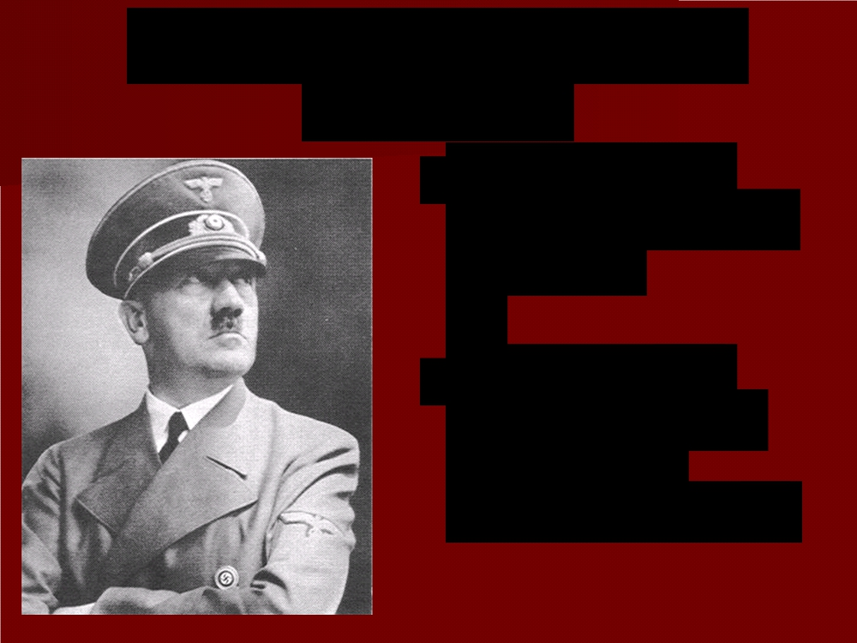
Violations of the Treaty of Versailles
1933 – ceased paying reparations.
March 1935 - military draft to strengthen German armed forces.
Secret rearmament
Rebuilt the German air force
1936- Remilitarized the Rhineland
1938 - Annexed Austria

Slide 6
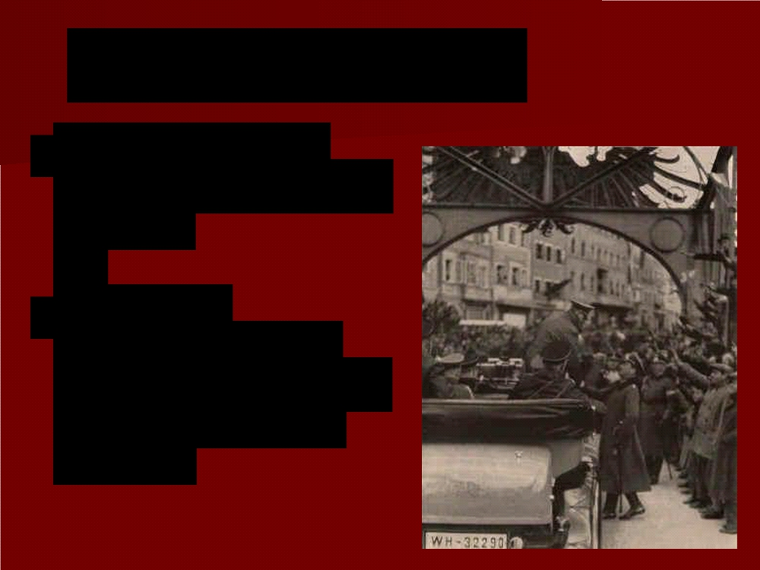
Europe’s Response
■ Refused to use
force to uphold the
treaty
■ Policy of
appeasement =
give in to demands
in order to keep
peace

Slide 7
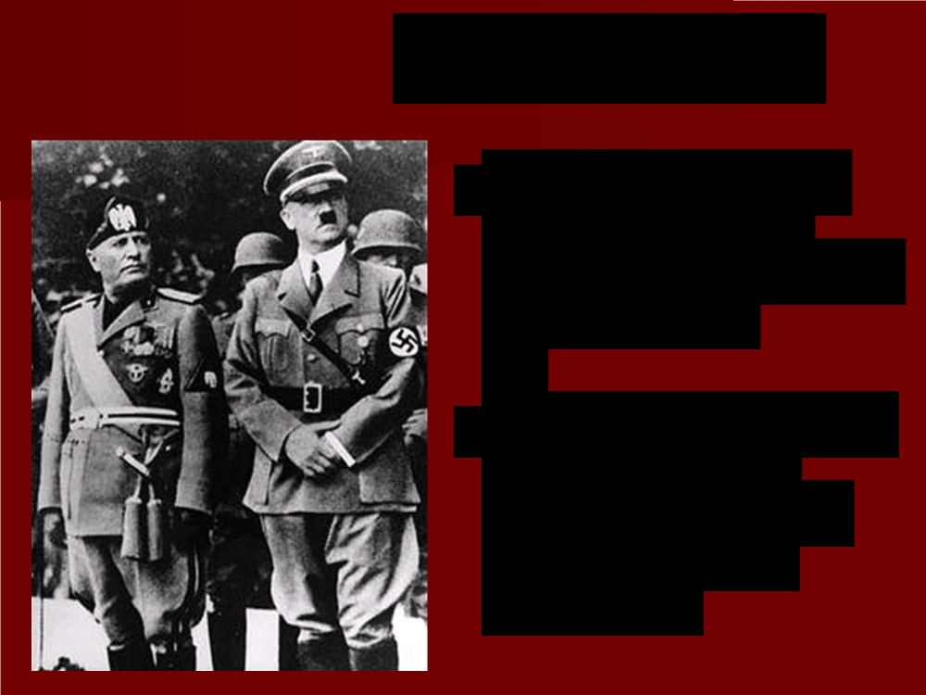
New Alliances
■ 1936 – Mussolini and Hitler sent troops into Spain to support Franco, leader of the Spanish Nationalists in the Spanish Civil War.
■ Rome-Berlin Axis – agreement on common political and economic interests between Germany and Italy.

Slide 8
The Austrian Anschluss
■ March 1938 -
Hitler sent troops into Austria
■ Announced the unification (anschluss) of Germany and Austria

Slide 9
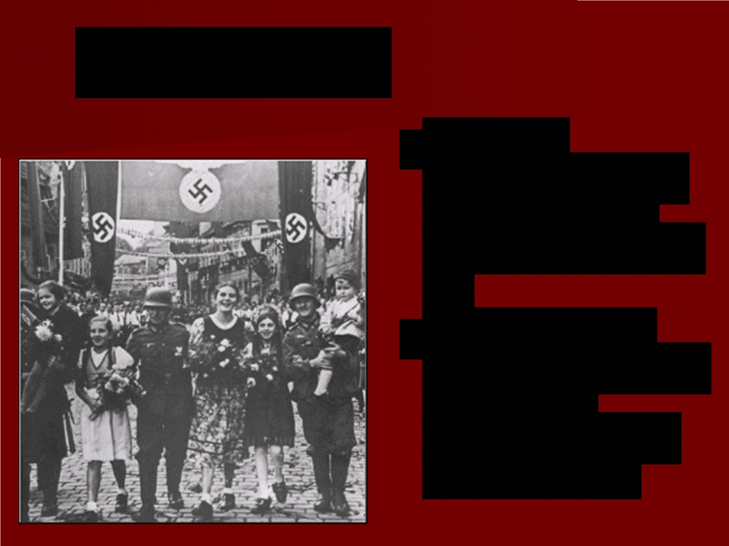
Sudetenland
■ Part of
Czechoslovakia
with German-
speaking people
■ Sept. 1938 -
Hitler demanded
this area
become a part of Germany

Slide 10
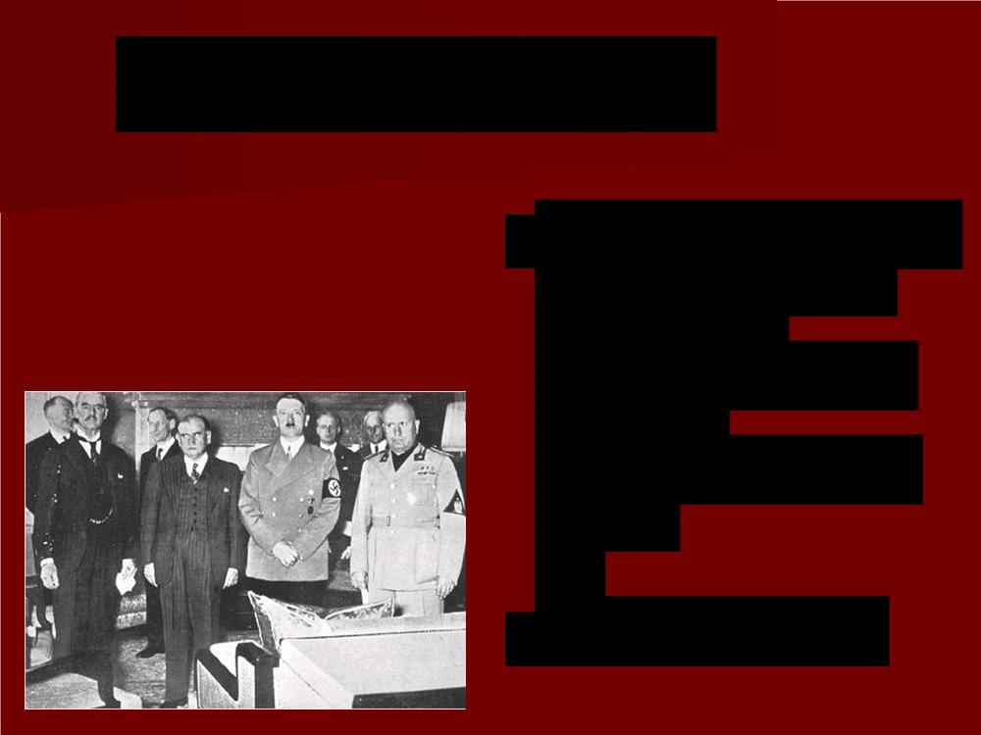
Munich Conference
Sept 29, 1938 - Representatives of Britain, France, Italy, and Germany, met to decide the fate of Czechoslovakia
Remember, Czechoslovakia had been part of the Austria-Hungarian empire before WWI.

Slide 11
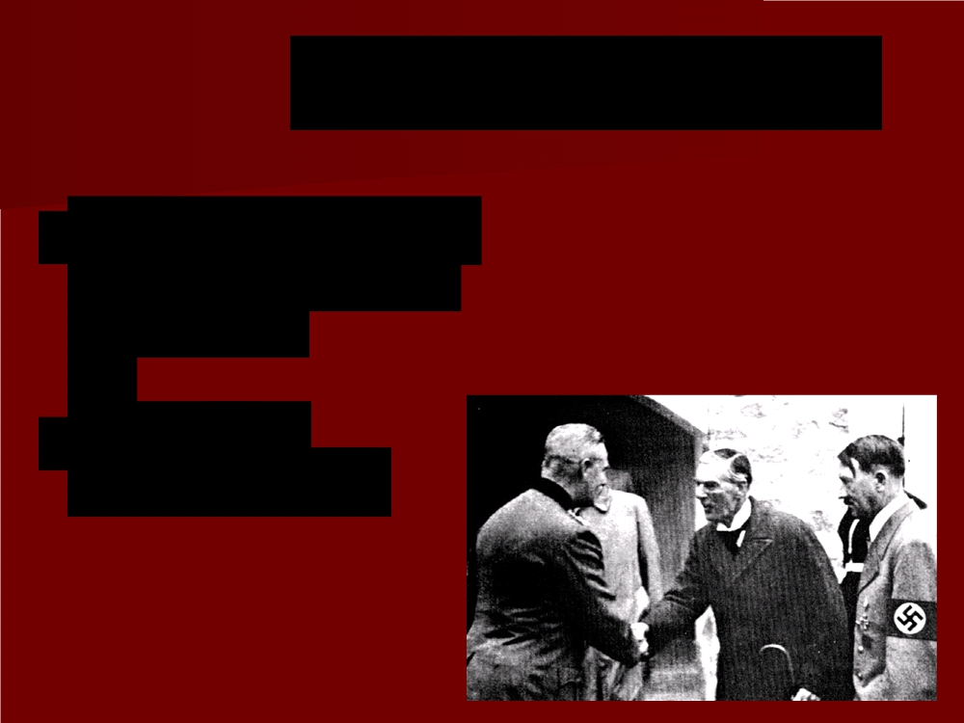
Munich Conference
■ Britain and France agree to Hitler’s demands
Marks the height of appeasement

Slide 12
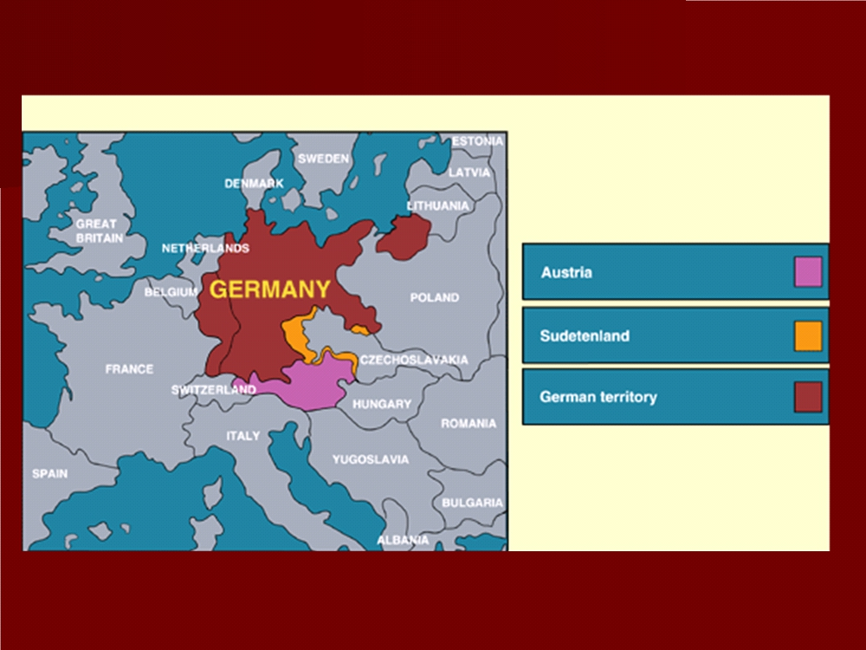

Slide 13
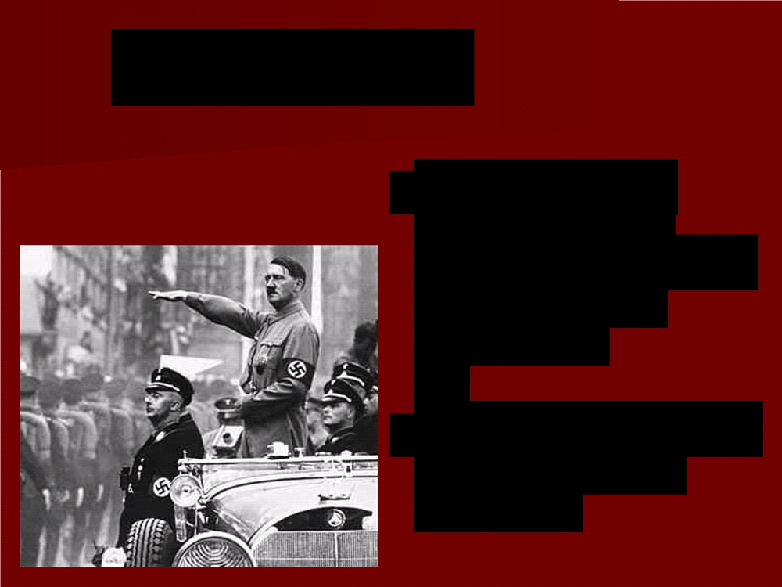
Appeasement
Supporters of appeasement believed Hitler had a few, limited demands.
The goal: Avoid war.
The means: Give Hitler what he wanted.

Slide 14
Appeasement
■ British Prime Minister Chamberlain, the primary supporter of appeasement:
“A peace with honor . . . Peace in our
time.”

Slide 15
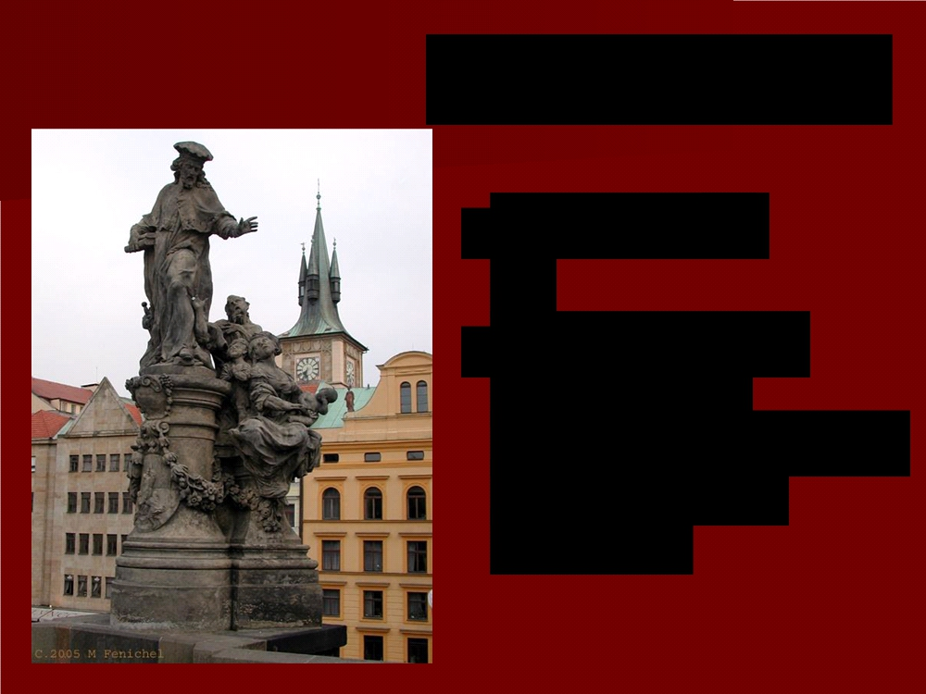
Czechoslovakia
■ March 1939
■ Germany sent troops into
Czechoslovakia and broke up the
country

Slide 16
Danzig, Poland
■ Oct. 1938 -
Hitler demanded the return of the
city of Danzig
(part of Poland) to Germany
■ Important Baltic Sea port

Slide 17
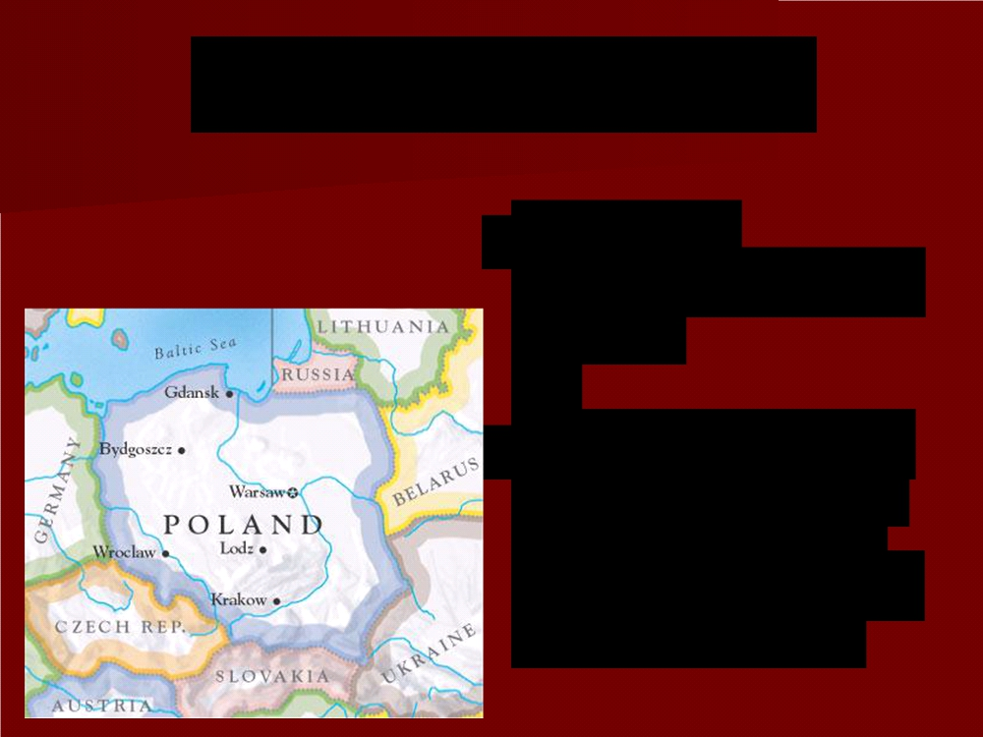
Response of Europe
■ Realized
appeasement had failed
■ If Poland went to war to defend its
territory, Britain
and France would come to its aid

Slide 18
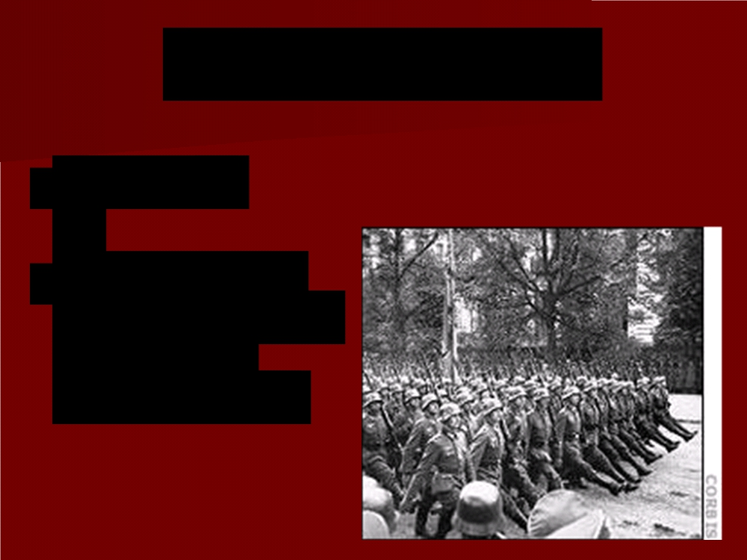
German Response
■ May 1939
■ Hitler ordered
German army to
prepare to
invade Poland

Slide 19
Nazi-Soviet Nonaggression Pact
■ August 23, 1939
■ Treaty between Germany and the
USSR
■ Secret deal to
divide Poland
between the two

Slide 20
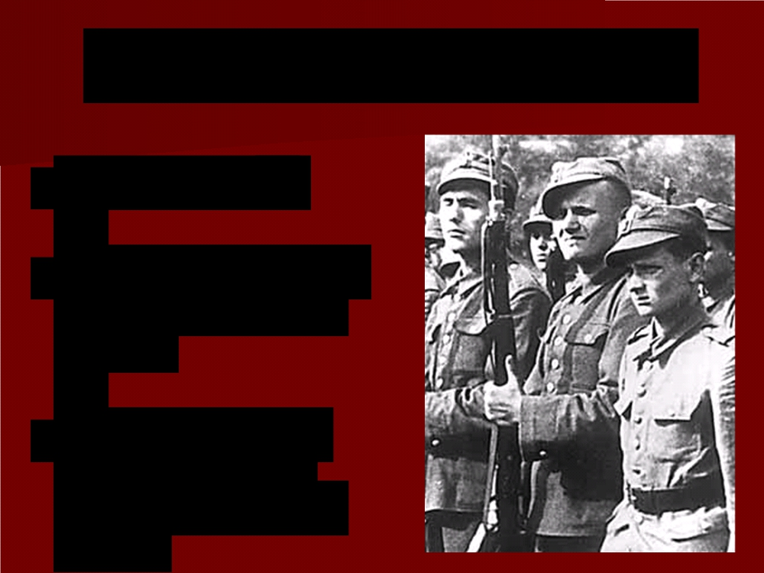
Beginning of World War II
■ Sept. 1, 1939
■ Germany invaded Poland from the
west
■ Soon after, the USSR invaded Poland from the
east

Slide 21
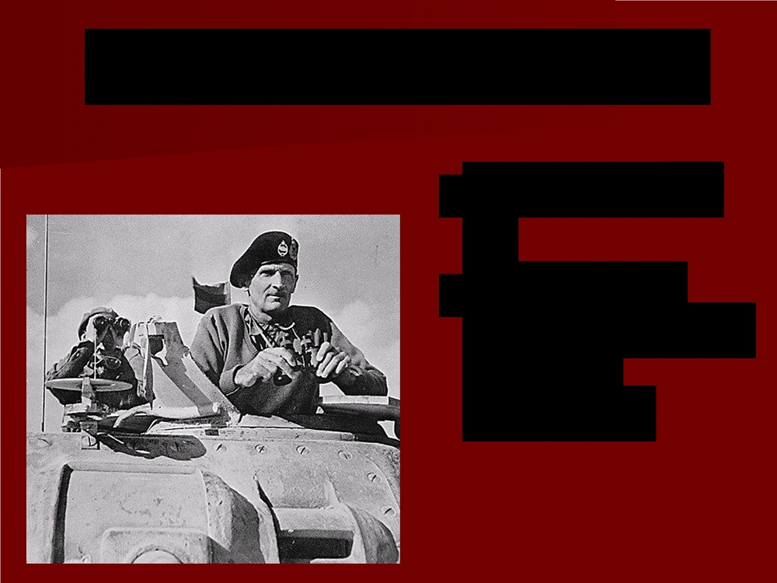
Beginning of World War II
■ Two days later, Sept. 3, 1939
■ France and
Britain declared
war on
Germany

Slide 22
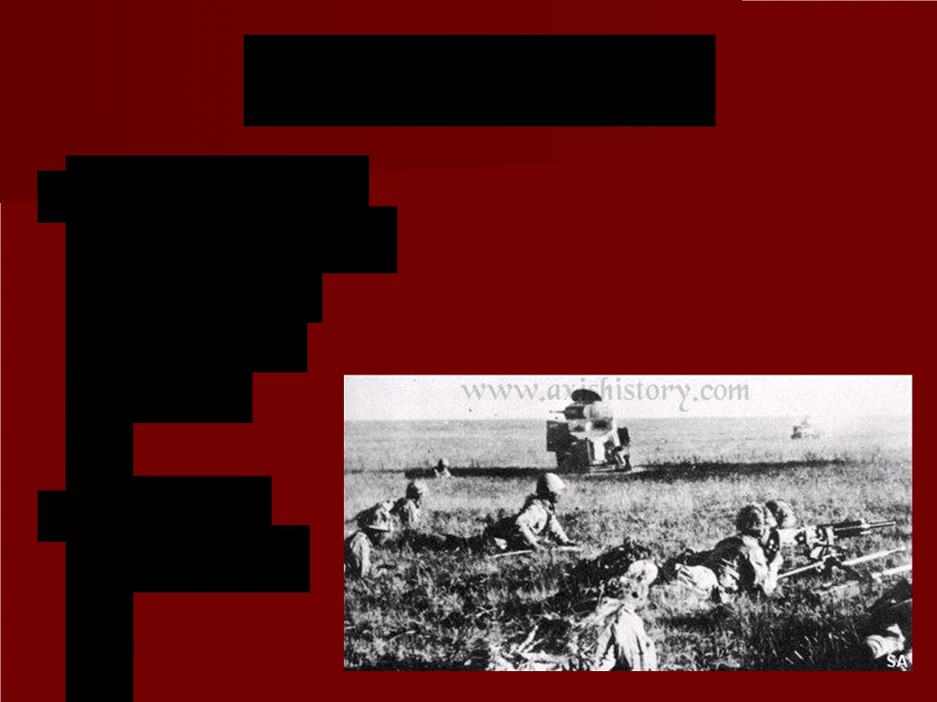
Japan and War
■ Sept. 1931 -
Japan invaded
Manchuria
(northern
China)
■ Desired resources

Slide 23
War With China
Chinese leader Chiang Kai-shek
Remember him?
July 1937 – Japan clashes with Chinese forces south of Beijing.

Slide 24
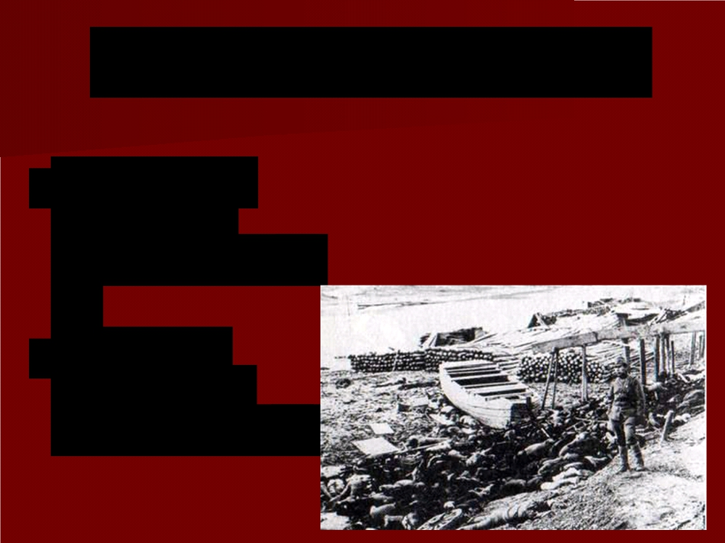
Japan Massacres Nanjing
■ 1937 - Japan took control of Nanjing (Nanking), the former capital of the Republic of China
■ Executed
250,000 to
300,000 people

Slide 25
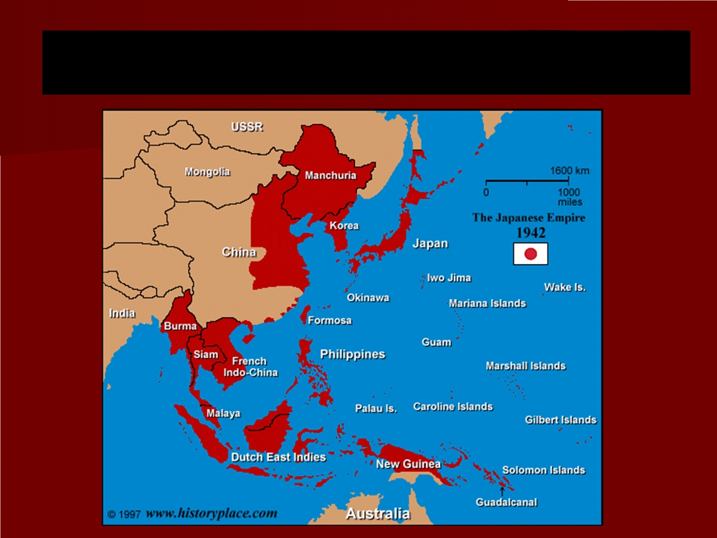
Japanese Expansion (1933-1942)

Slide 26
U.S. Sanctions
U.S. threatened to apply Sanctions to Japan (restrictions intended to enforce international laws).
Does that sound familiar?

Slide 27
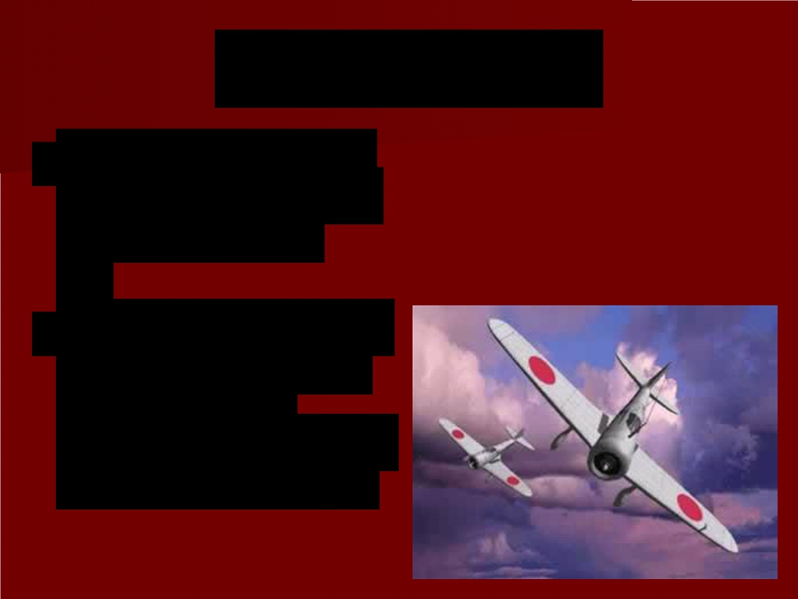
U.S. Sanctions
Japan imported oil and scrap iron from the United States.
Decided to launch a surprise attack on the U.S. and on European colonies in southeast Asia

