Slide 1
Mr. Wyka’s World History
Citrus High School

Slide 10
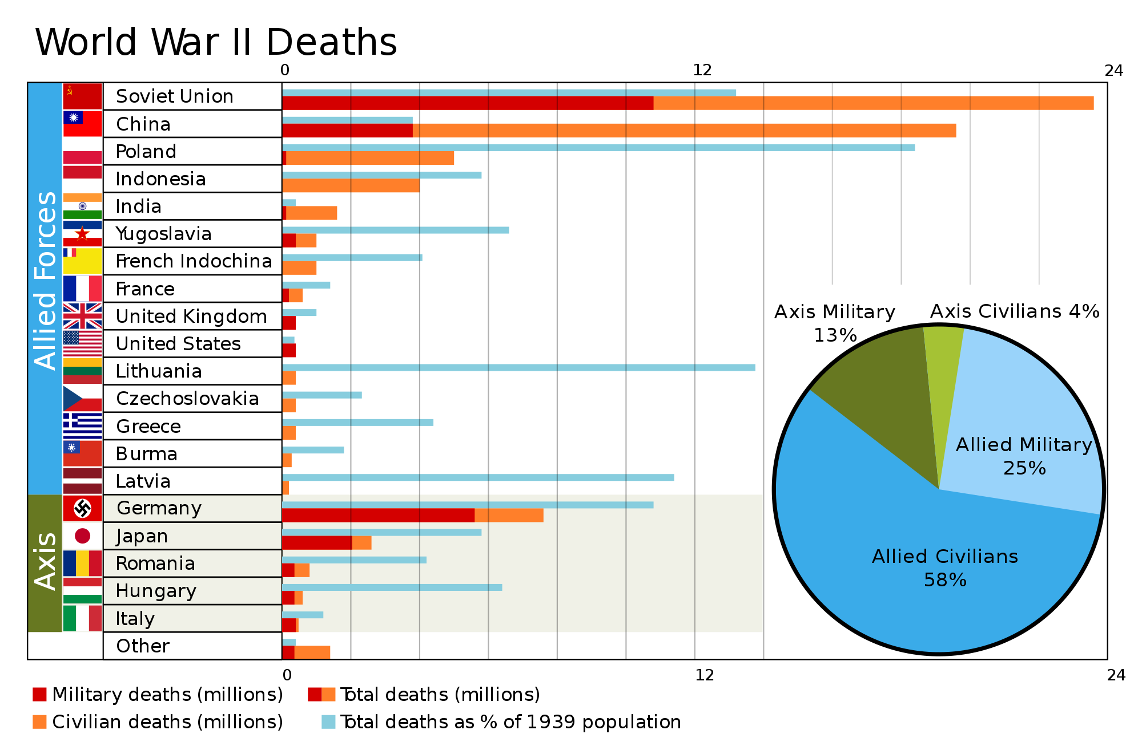

Slide 11
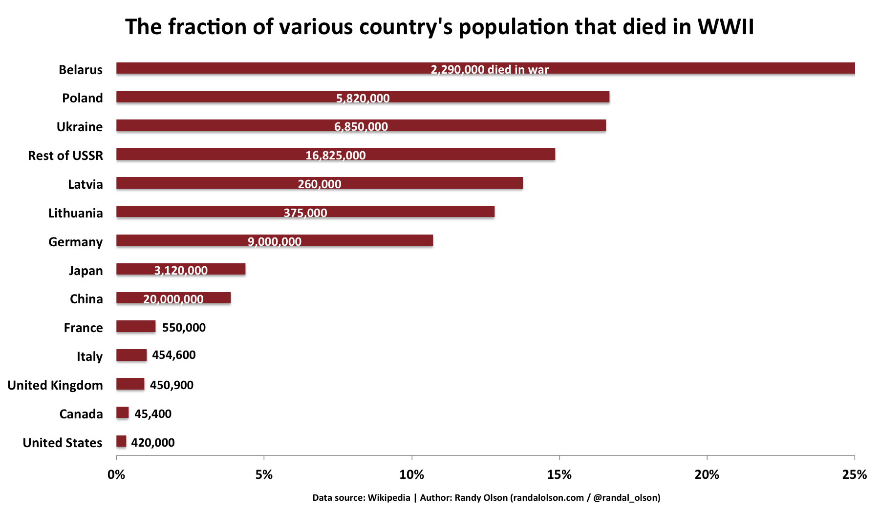

Slide 13
In WWII over 60 million died.
That’s 3% of the total world population in 1940.

