Slide 1
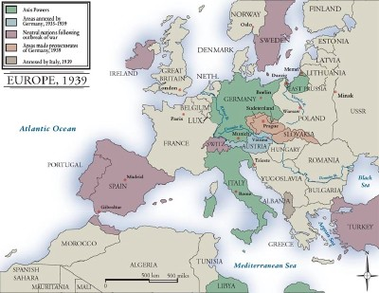
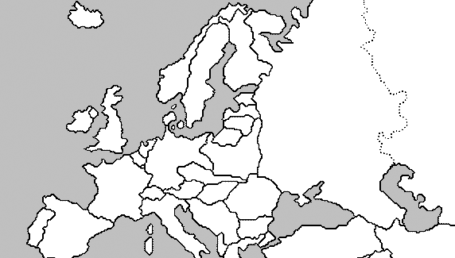
Bellringer: World War II Europe. How many nations can you identify?

Slide 2
World War II Review The End
Mr. Wyka’s World History
Citrus High School

Slide 3
Essential Question
How did World War II end?

Slide 4
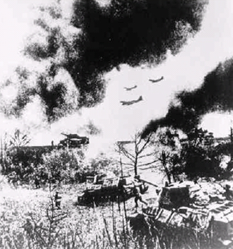
Hitler’s War
Used blitzkrieg or
“lightning” warfare.
Airplanes supported
divisions of tanks
(called panzers)

Slide 5
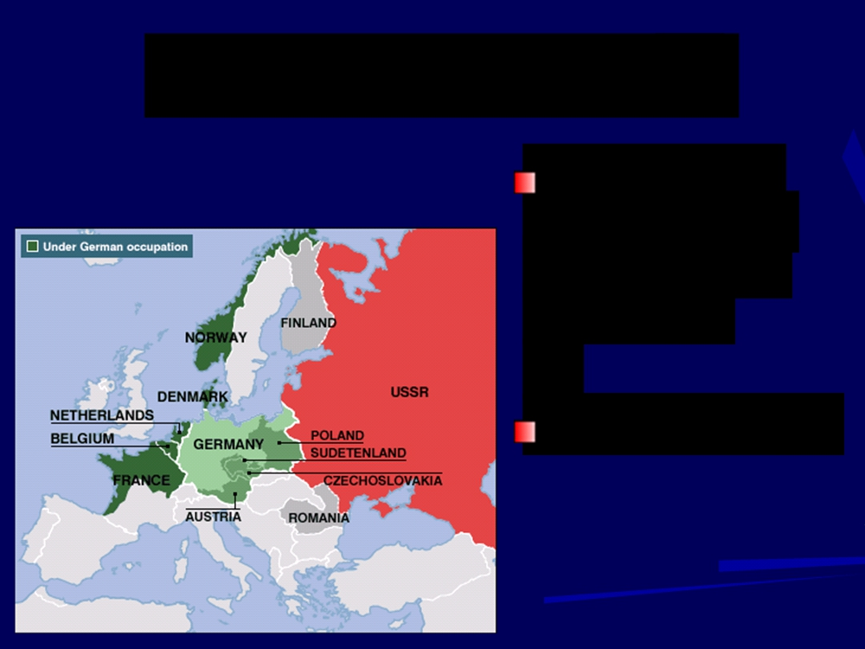
Denmark and Norway
Attacked on
April 9, 1940
with another blitzkrieg
German victory

Slide 6
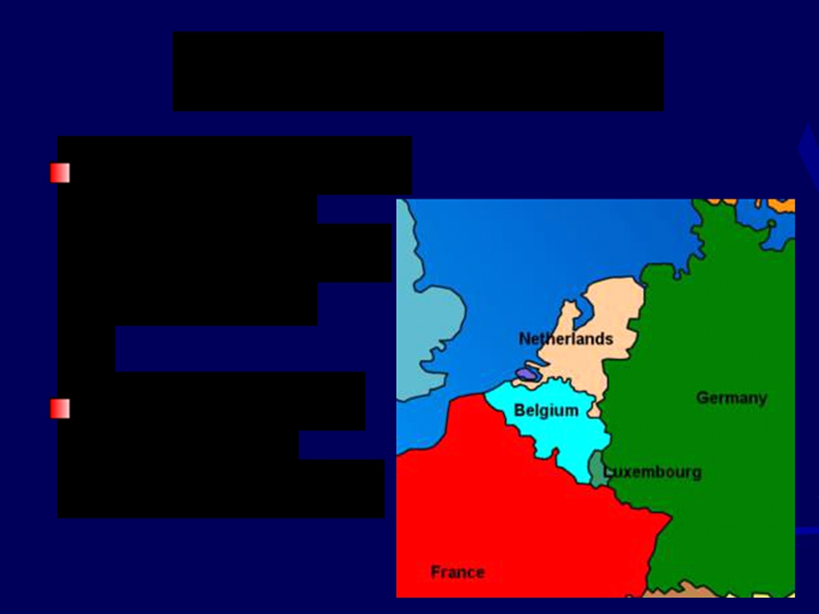
Invasion of France
Germany attacked
Belgium, the
Netherlands, and Luxembourg
Entered France through the Ardennes Forest, bypassing the French Maginot Line, a defensive works created after WWI.

Slide 7
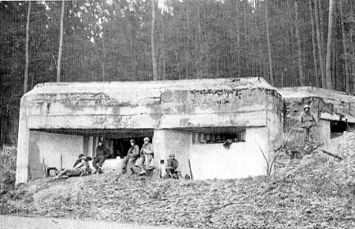
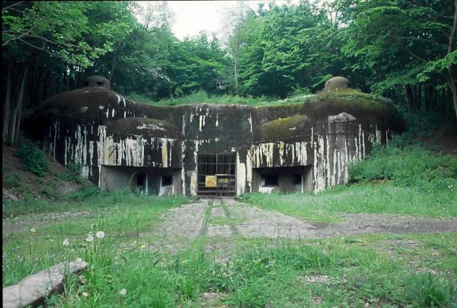
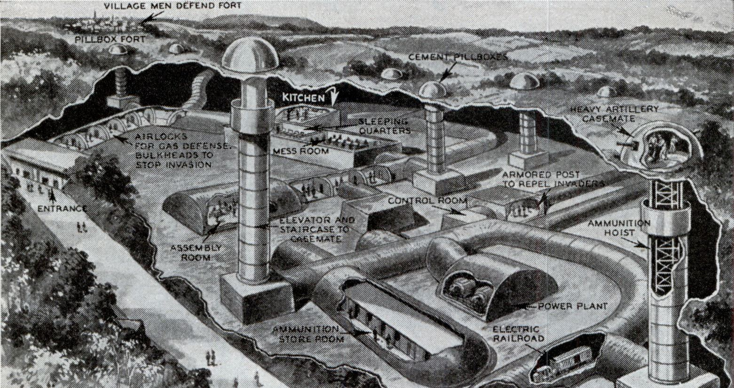

Slide 8
French Surrender
June 22,
1940
Germany controlled France, set up own
government

Slide 9
The United States
Followed a policy
of isolationism
Tried to stay neutral, not be involved in
European wars

Slide 10
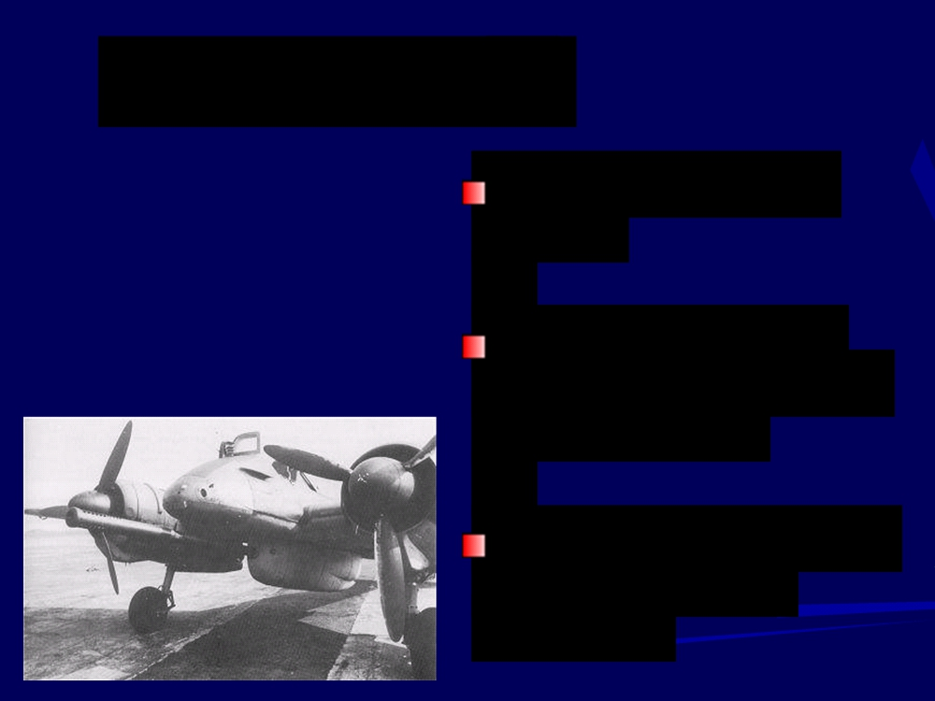
Battle of Britain
Began in August
Fought in the air over England.
1940
German air force
(Luftwaffe) bombed
Great Britain
Also attacked major
cities, such as
London

Slide 11
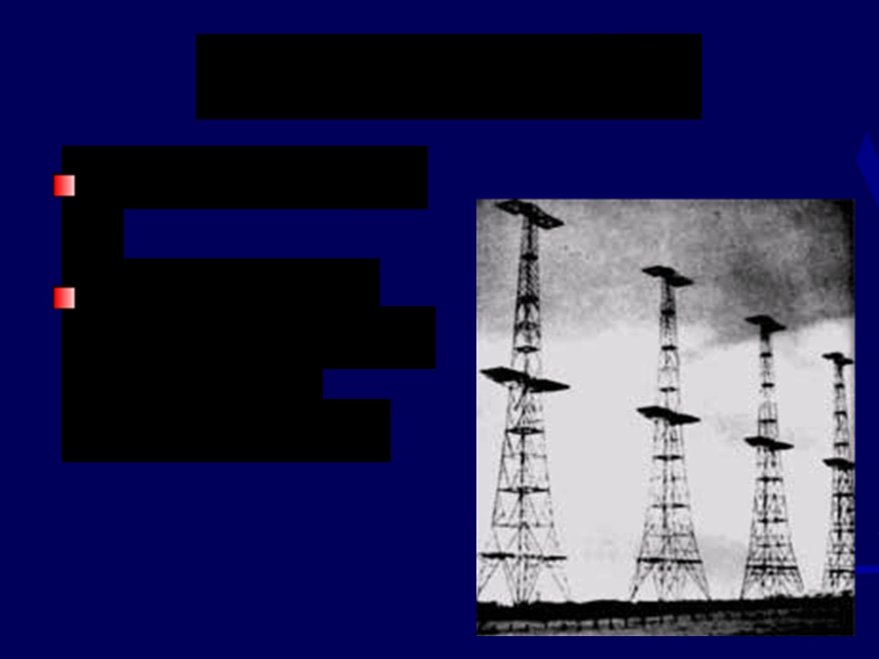
British Advantage
Invention of radar
Allowed British
Royal Air Force to shoot down
German planes

Slide 12
Germany Invades the USSR
June 1941
Captured 2
million Russian soldiers

Slide 13
Pearl Harbor
Japanese attacked
on Dec. 7, 1941
Also attacked the
Philippines
By spring 1942,
controlled southeast
Asia and the
western Pacific

Slide 14
Pearl Harbor

Slide 15
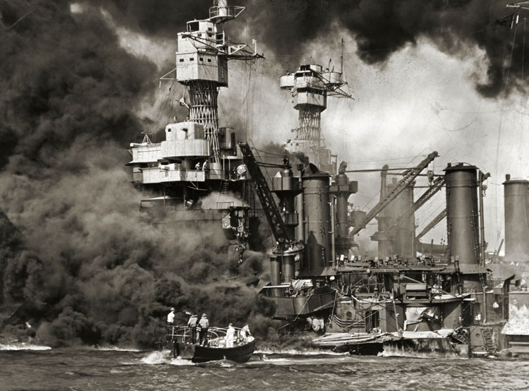
Pearl Harbor

Slide 16
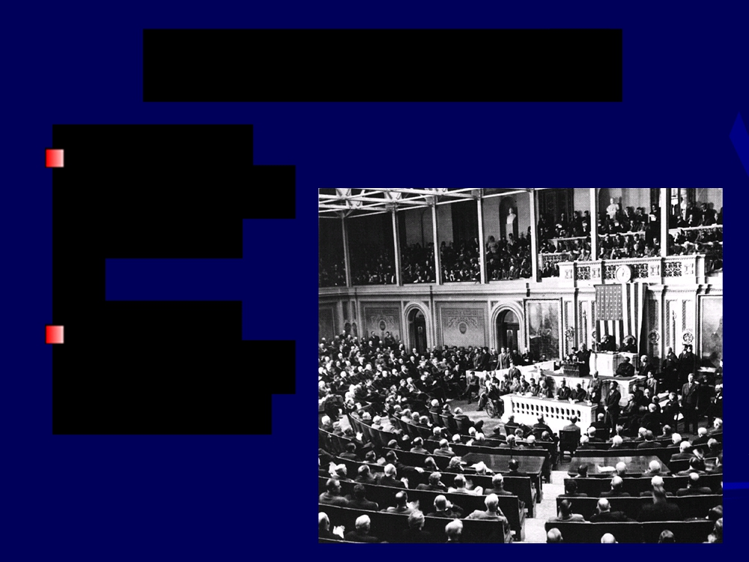
U.S. Enters the War
After Pearl Harbor, the US Congress
declares war
on Japan
Germany
declares war on the U.S.

Slide 17
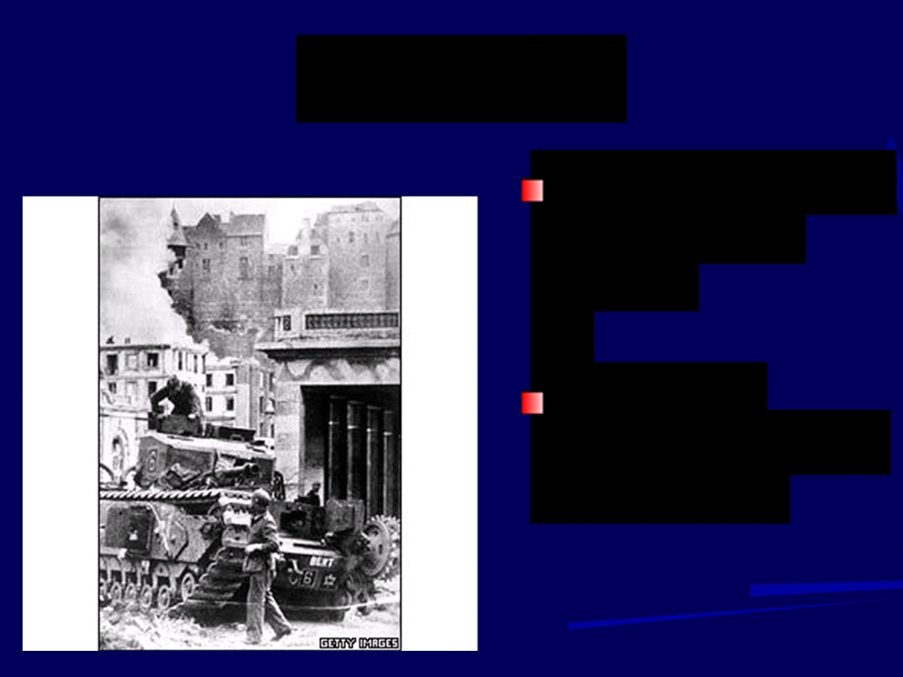
The Allies
Great Britain, the
U.S., Soviet
Union
Agreed to
overlook political differences

Slide 18
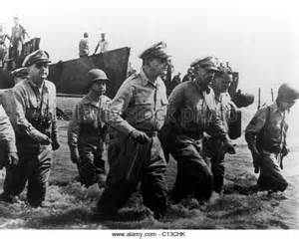
World War II Ends
MacArthur Returns to the Philippines

Slide 19
Afrika Korps
Germany’s troops in
North Africa
Led by general Erwin Rommel

Slide 20
Turning Points in the War
U.S. and British
troops invade North
Africa
German and Italian
troops surrendered in May 1943

Slide 21
Battle of Stalingrad
Hitler attacked
Stalingrad
Soviets launched a counterattack
Germans forced to
surrender in winter

Slide 22
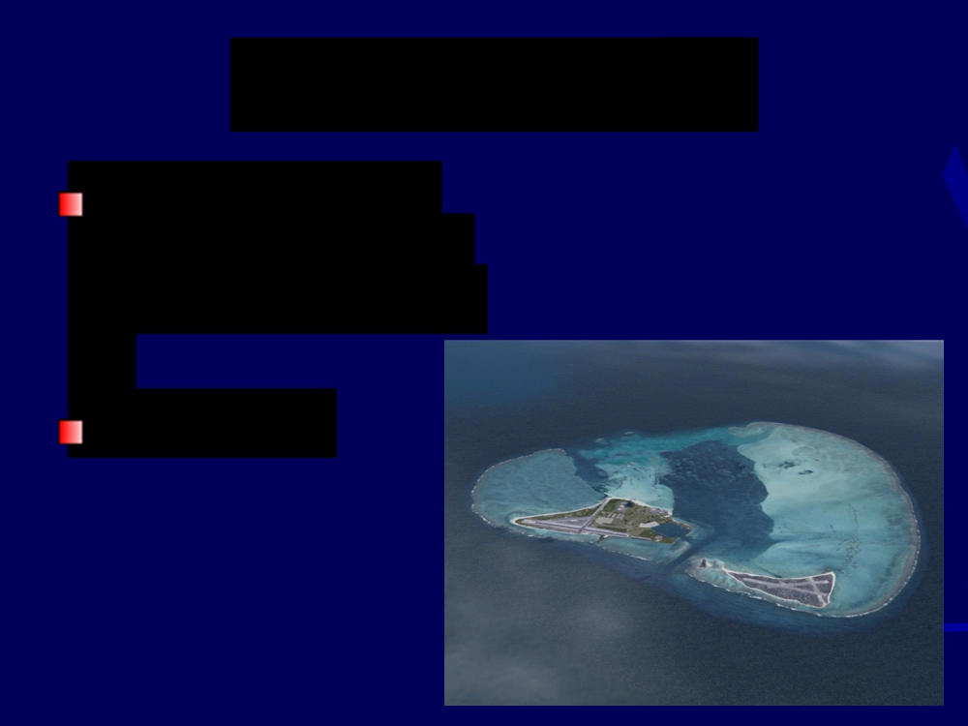
Battle of Midway
U.S. launched a
surprise attack on
the Japanese fleet
June 1942

Slide 23
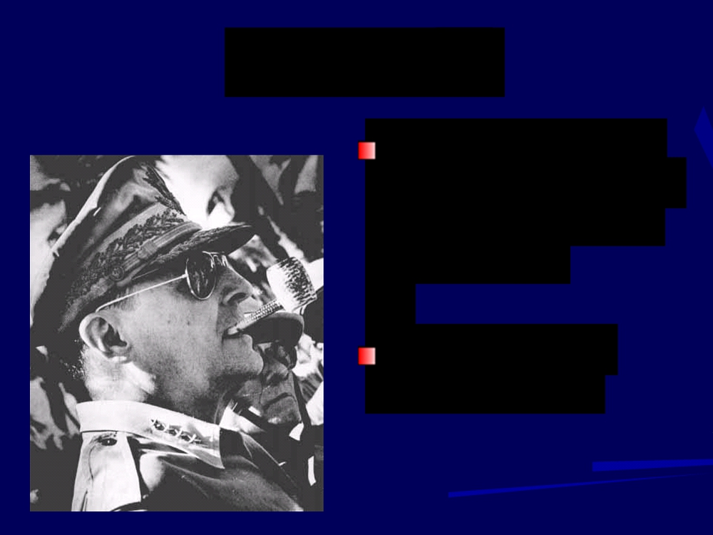
Philippines
U.S. troops led by
Douglas MacArthur
took control in the fall of 1942
Began moving toward Japan

Slide 24
War in Italy
American and British troops
took Sicily, began
moving up the Italian peninsula
Mussolini
removed from office
Rome fell in June 1944

Slide 25
D-Day
June 6, 1944
Allied forces led by
Dwight D. Eisenhower
landed at Normandy,
France
Within 3 months, the Allies landed 2 million men

Slide 26
D-Day

Slide 27
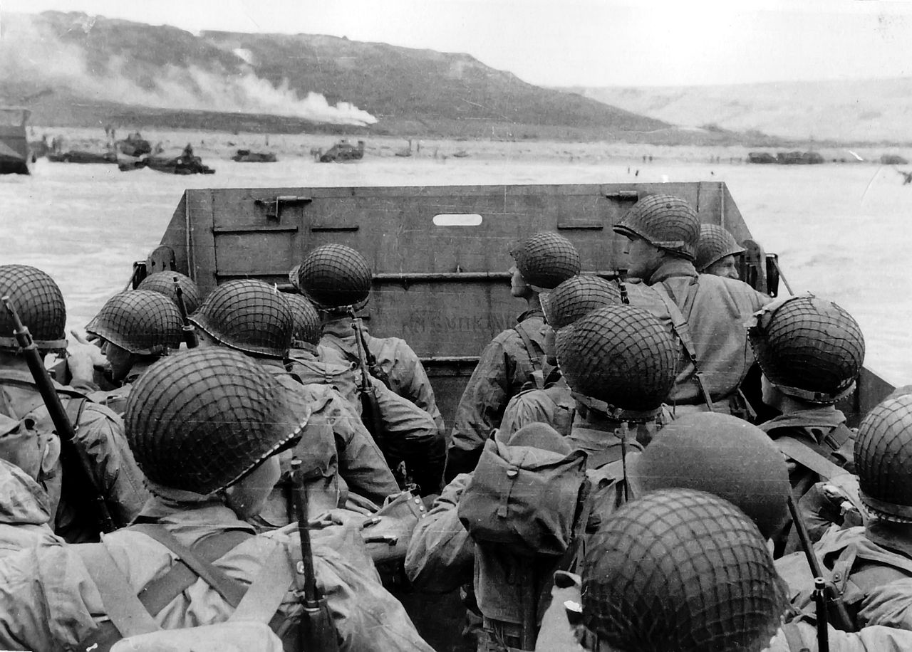
D-Day

Slide 28
D-Day

Slide 29
D-Day

Slide 30
Paris
The Allies
liberated Paris in
August 1944
March 1945 -
Allies crossed into Germany

Slide 31
End of War in Europe
Soviet troops
moved westward and entered Berlin
in April 1945

Slide 32
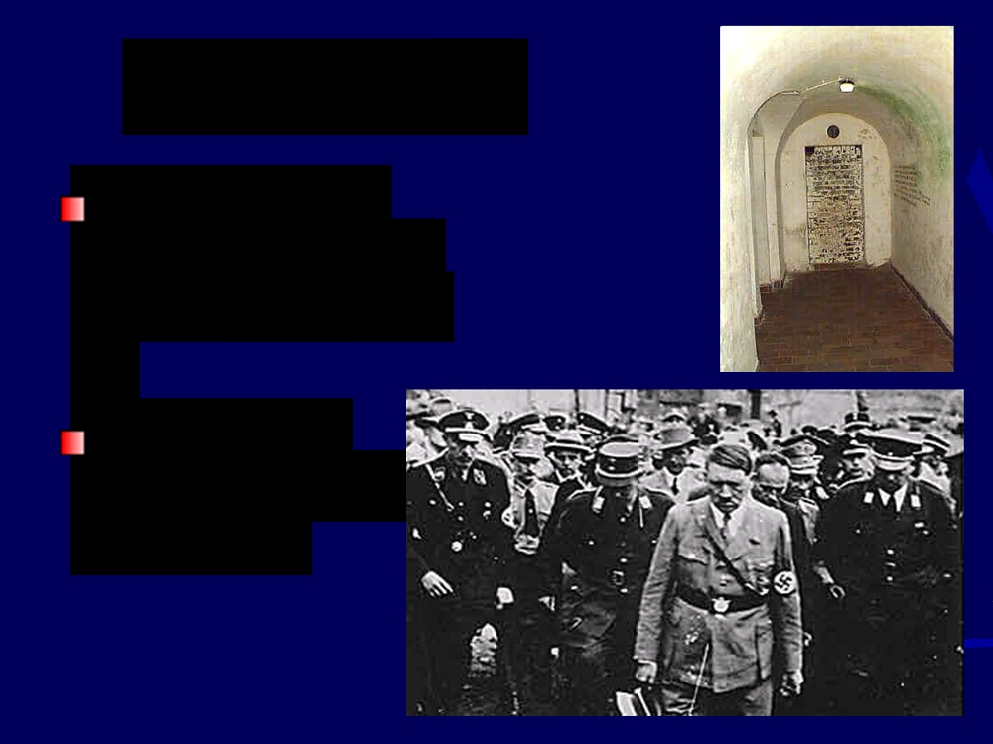
Hitler’s End
Moved into a
bunker in Berlin
in January 1945
Committed suicide on April 30, 1945

Slide 33
Germany Surrenders
May 7, 1945
German
commanders
surrender to end the war in Europe

Slide 34
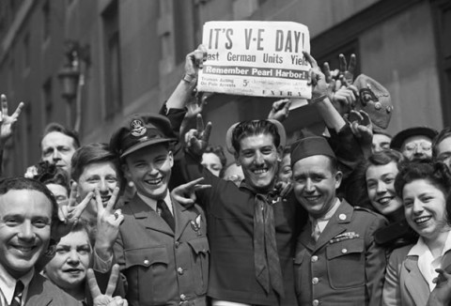
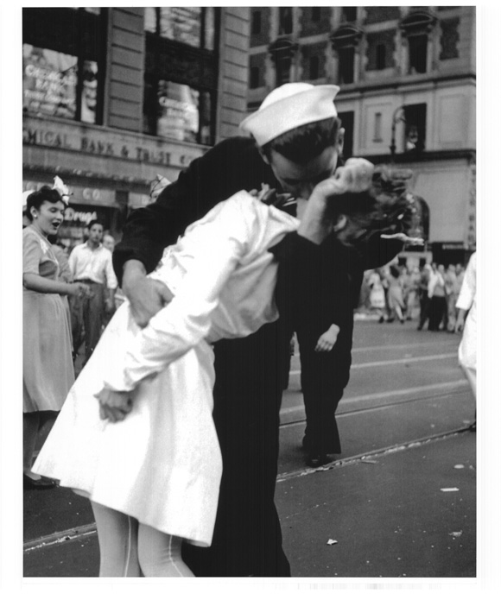
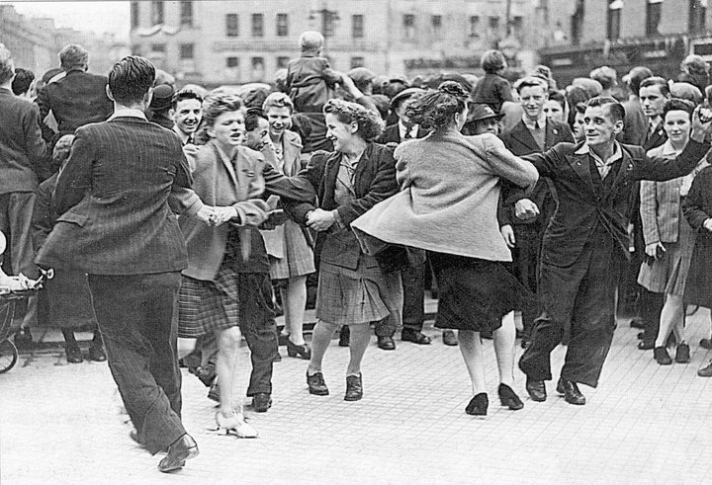

Slide 35
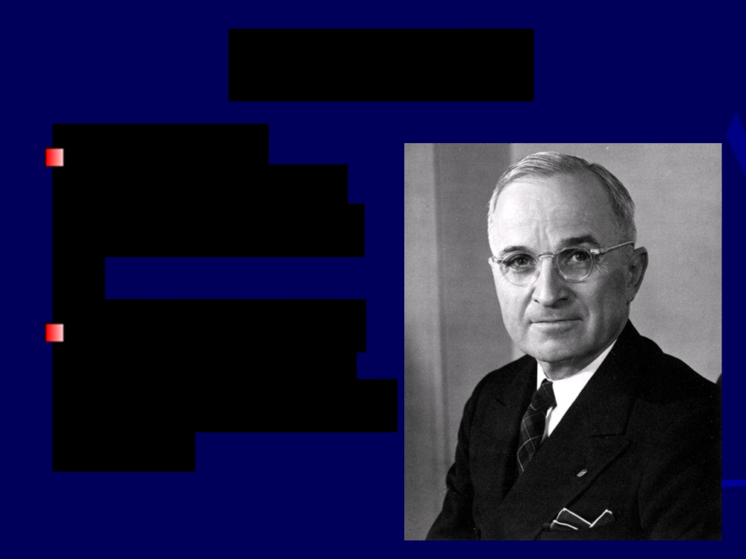
War in Asia
U.S. forces
advanced slowly
across the Pacific
President Harry S
Truman hoped to
avoid an invasion of Japan

Slide 36
Atomic Bombs
August 6,1945 -
dropped on
Hiroshima
August 9, 1945 -
dropped on
Nagasaki

Slide 37
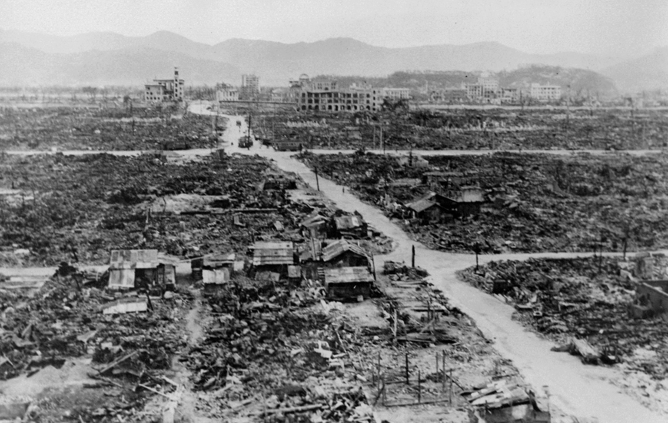
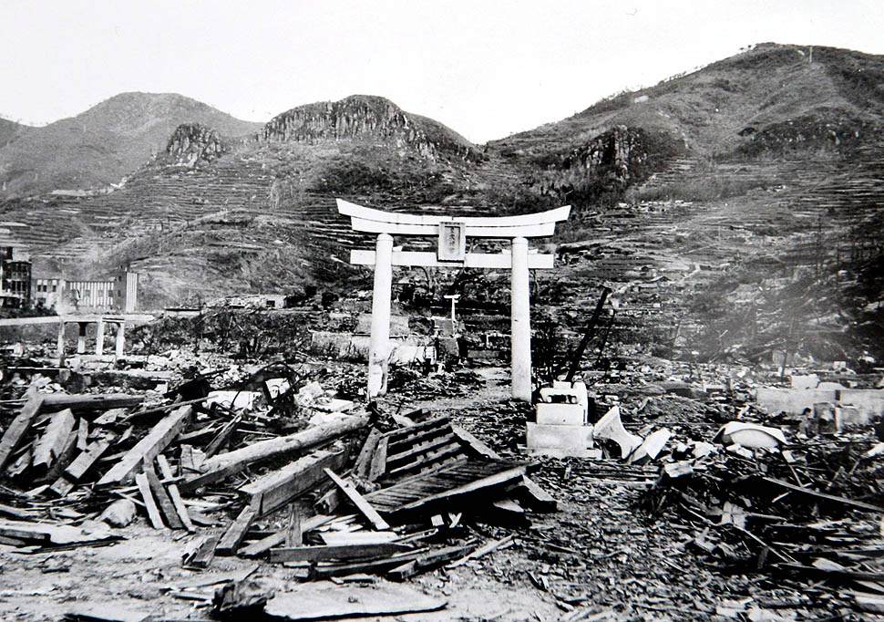
Nagasaki

Slide 38
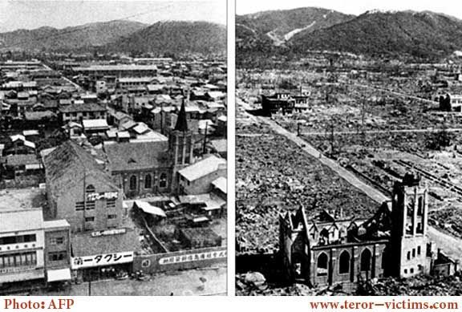
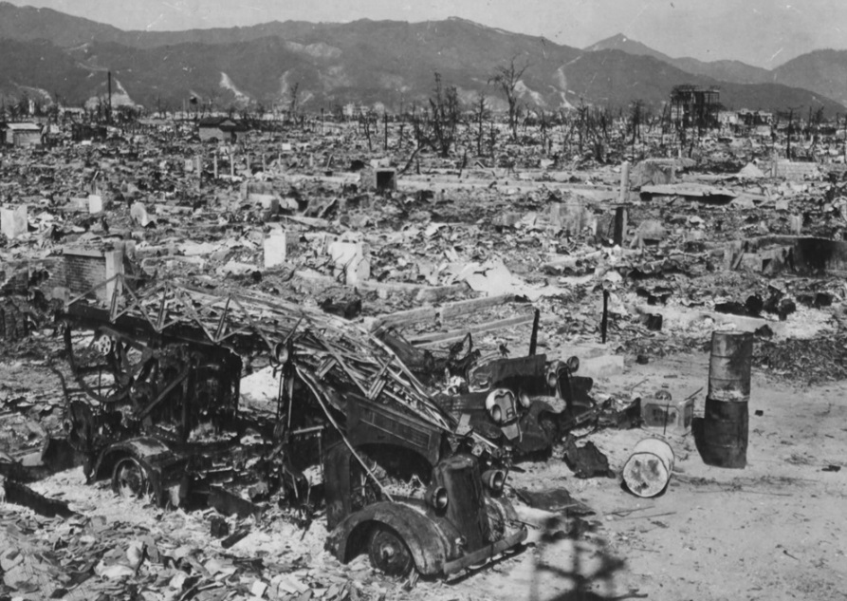
Hiroshima

Slide 39
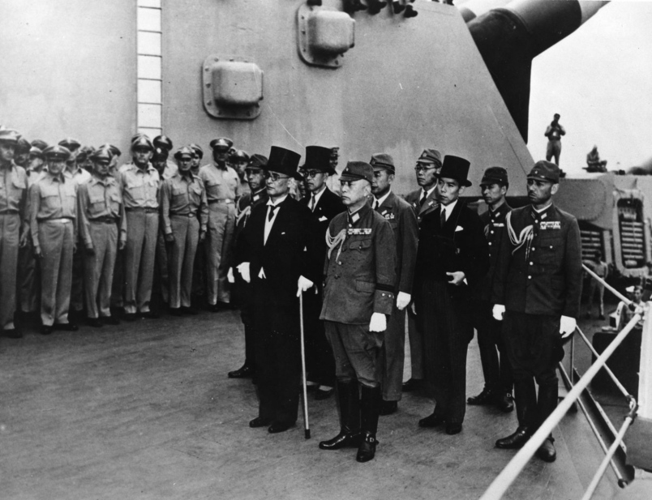
JAPAN Surrenders
August 14, 1945 – Japan Surrenders
On the deck of the battleship Missouri
World War II is over

Slide 40
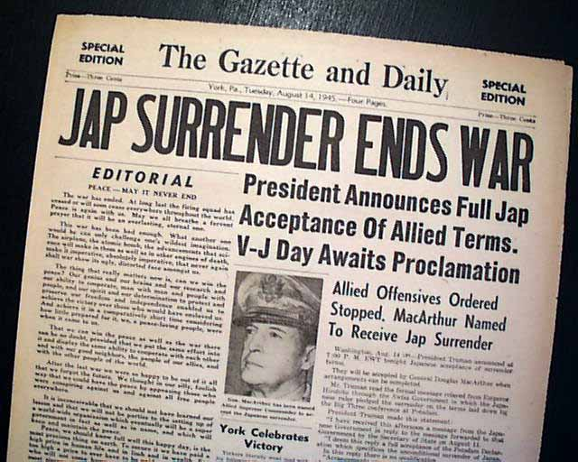
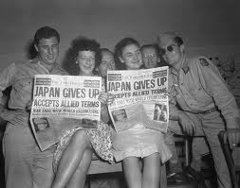

Slide 41
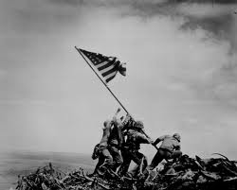
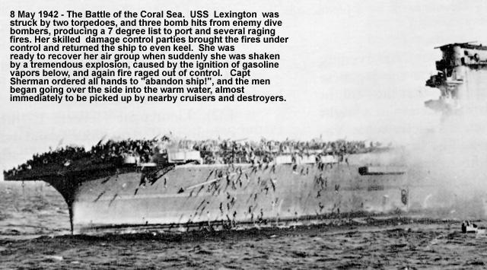
WORLD WAR II POWER POINT QUIZ
Lets finish what we started.
Remember to do your own work. Discussion of the quiz will be considered cheating and result in a zero.
Using your notes, answer the following questions.

Slide 42
What is the name of the German “master race” as envisioned by Hitler (it’s not the Nazis)?
Germany violated the Treaty of Versailles in many ways leading up to WWII. Among them, in 1938, Germany annexed what neighboring country?
Giving in to Hitler’s demands in order to keep the peace was called the Policy of ___________________.
Who was the main proponent of this policy? Hint: He was the Prime Minister of Great Britain before the war.
The Rome-Berlin Axis was a military alliance between what two countries?
The invasion of what country in 1939 prompted Great Britain and France to declare war on Germany?
What was the initial US response to Japanese aggression in China?

Slide 43
Another name for Hitler’s mechanized, lightning warfare is…
Did the Germans win the Battle of Stalingrad?
The United States entered the war after ___________________.
The name given to the invasion of France by allied forces on
June 6, 1944.
General Douglas MacArthur took the ____________ from the Japanese in the fall of 1942, fulfilling his promise to return to the archipelago.
Name the two Japanese cities destroyed by American atomic bombs?
Was the Battle of Britain a naval battle, land battle, or air battle?
In the Battle of Britain, what new technology gave Great Britain an edge?
Place in order of surrender to allied forces – Italy, North Africa, Germany, Japan.
In your opinion, what was the most important factor in deciding the outcome of World War II?

Slide 44
World War II - POWER POINT QUIZ
Make sure your name is on your Quiz,
Pass your quiz to a fellow student, and
Pass the first quiz you receive to another student.
Keep the second quiz you receive for grading.
Write your name at the top of the quiz.

Slide 45
What is the name of the German “master race” as envisioned by Hitler (it’s not the Nazis)? The Aryan Race
Germany violated the Treaty of Versailles in many ways leading up to WWII. Among them, in 1938, Germany annexed what neighboring country? Austria
Giving in to Hitler’s demands in order to keep the peace was called the Policy of Appeasement.
Who was the main proponent of this policy? Hint: He was the Prime Minister of Great Britain before the war. Neville Chamberlain
The Rome-Berlin Axis was a military alliance between what two countries? Germany and Italy
The invasion of what country in 1939 prompted Great Britain and France to declare war on Germany? Poland
What was the initial US response to Japanese aggression in China? Trade Sanctions on Japan

Slide 46
Another name for Hitler’s mechanized, lightning warfare is… Blitzkrieg
Did the Germans win the Battle of Stalingrad? No
The United States entered the war after the Japanese surprise attack on Pearl Harbor, Hawaii.
The name given to the invasion of France by allied forces on
June 6, 1944. D-Day
General Douglas MacArthur took the Philippines from the Japanese in the fall of 1942, fulfilling his promise to return to the archipelago.
Name the two Japanese cities destroyed by American atomic bombs? Hiroshima and Nagasaki
Was the Battle of Britain a naval battle, land battle, or air battle? Air
In the Battle of Britain, what new technology gave Great Britain an edge? Radar
Place in order of surrender to allied forces – Italy, North Africa, Germany, Japan. North Africa, Italy, Germany, and finally, Japan.
In your opinion, what was the most important factor in deciding the outcome of World War II? ????

