Slide 1
World War II Review The End
Mr. Wyka’s World History
Citrus High School

Slide 2
Do you know?
Which body of water lies between England and Norway?

Slide 3
Essential Question
How did World War II end?

Slide 4
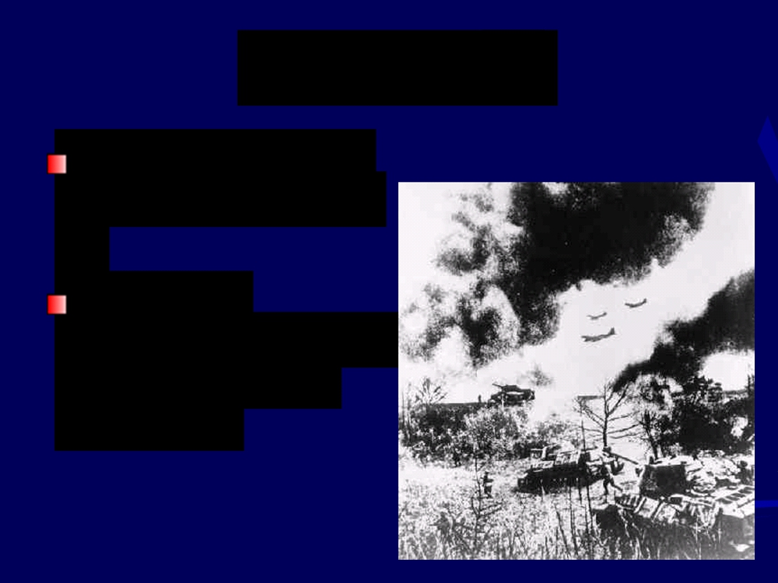
Hitler’s War
Used blitzkrieg or
“lightning” warfare
Airplanes
supported divisions of tanks (called panzers)

Slide 5
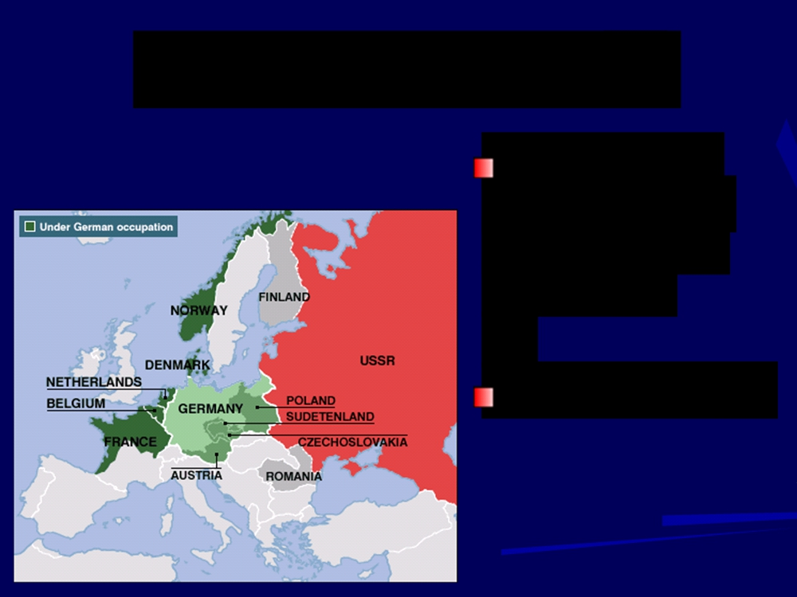
Denmark and Norway
Attacked on
April 9, 1940
with another blitzkrieg
German victory

Slide 6
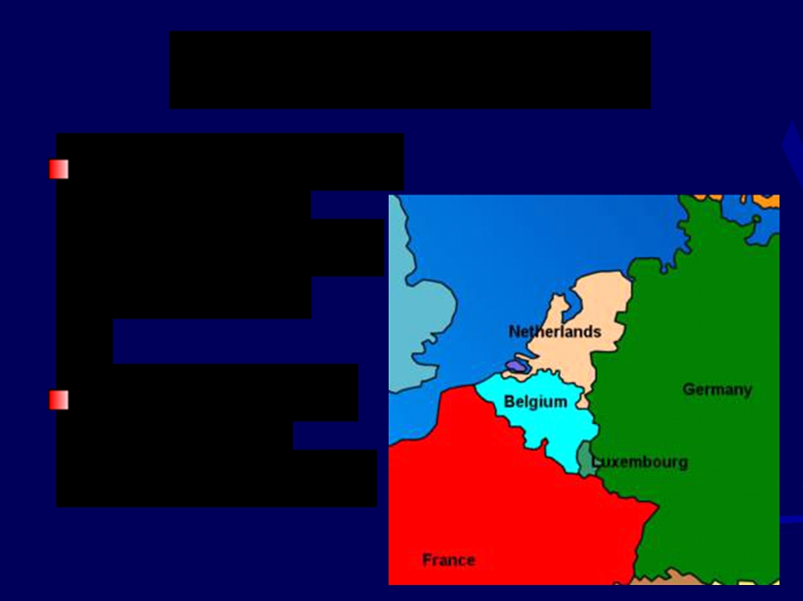
Invasion of France
Germany attacked
Belgium, the
Netherlands, and Luxembourg
Entered France through the Ardennes Forest, bypassing the French Maginot Line, a defensive works created after WWI.

Slide 7
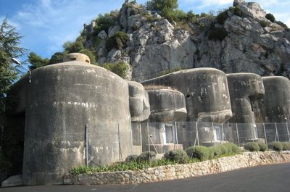
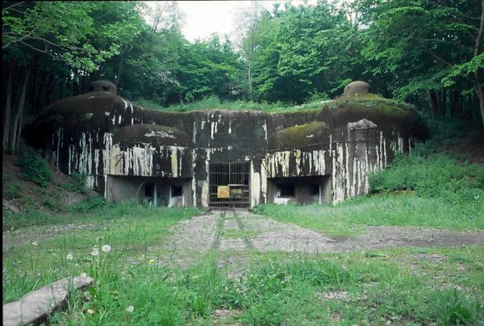
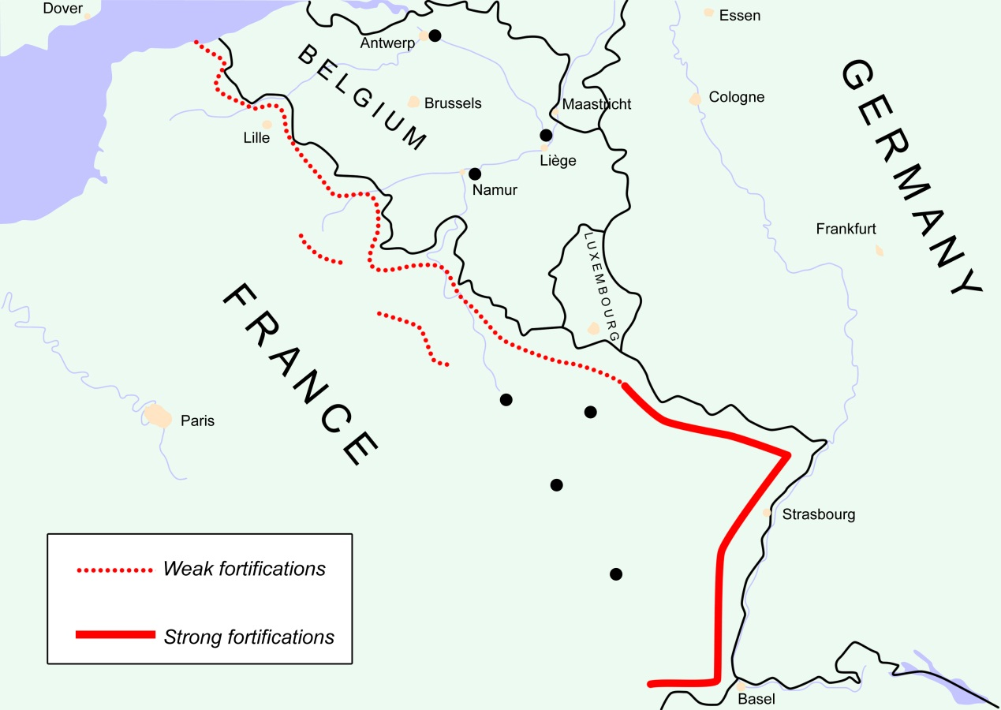

Slide 8
French Surrender
June 22,
1940
Germany controlled France, set up own
government

Slide 9
The United States
Followed a policy
of isolationism
Tried to stay neutral, not be involved in
European wars

Slide 10
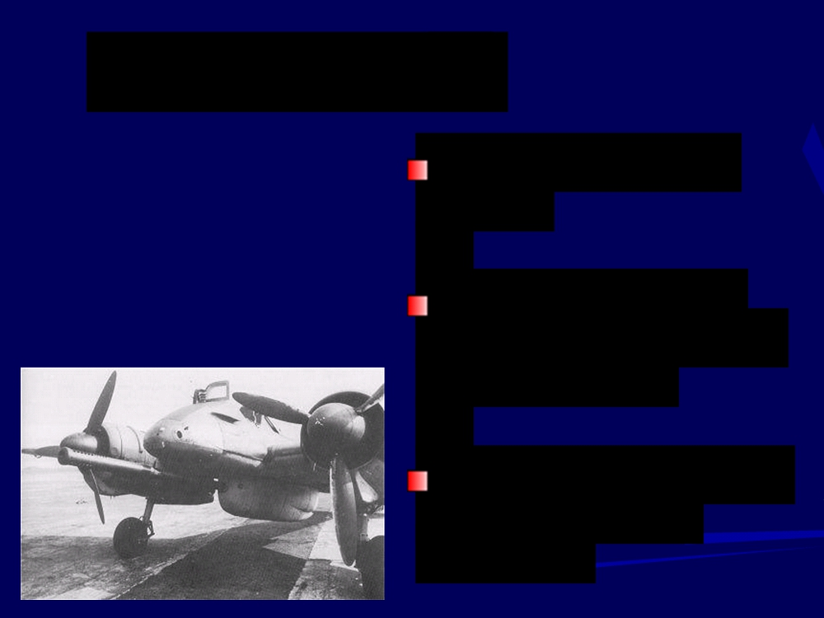
Battle of Britain
Began in August
1940
German air force
(Luftwaffe) bombed
Great Britain
Also attacked major
cities, such as
London

Slide 11
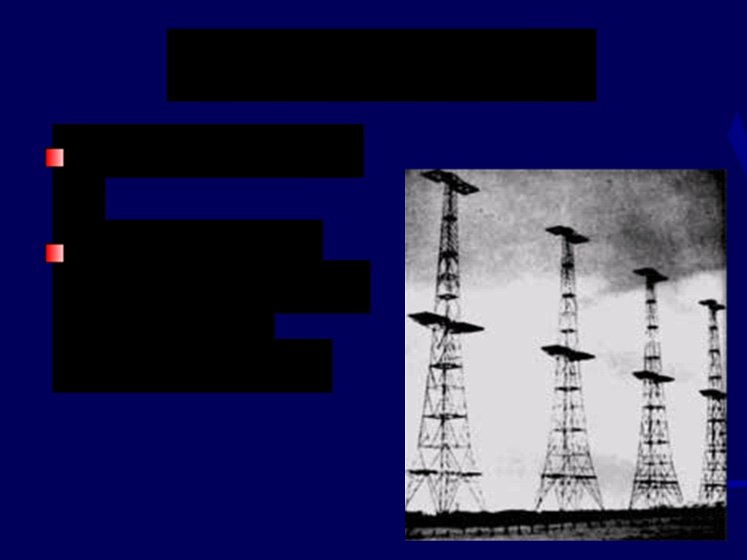
British Advantage
Invention of radar
Allowed British
Royal Air Force to shoot down
German planes

Slide 12
Germany Invades the USSR
June 1941
Captured 2
million Russian soldiers

Slide 13
Pearl Harbor
Japanese attacked
on Dec. 7, 1941
Also attacked the
Philippines
By spring 1942,
controlled southeast
Asia and the
western Pacific

Slide 14
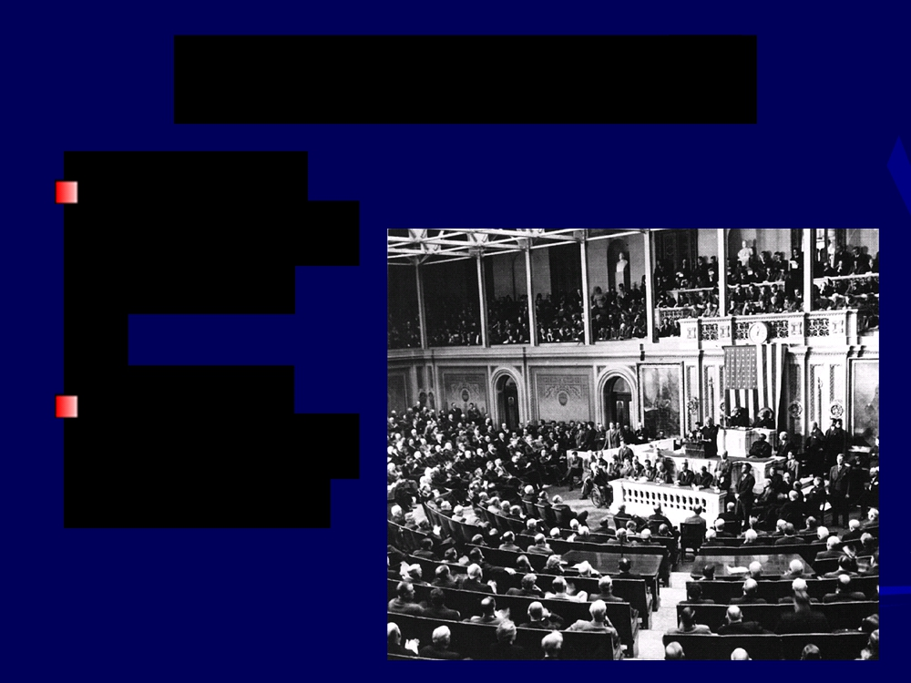
U.S. Enters the War
The US Congress
declares war
on Japan
Germany
declares war on the U.S.

Slide 15
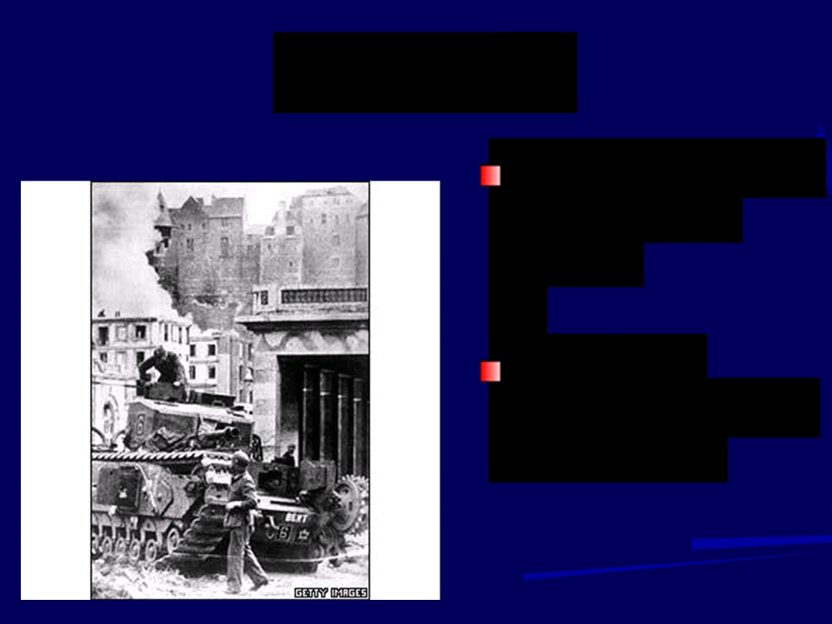
The Allies
Great Britain, the
U.S., Soviet
Union
Agreed to
overlook political differences

Slide 16
World War II Ends

Slide 17
Afrika Korps
Germany’s troops in
North Africa
Led by general Erwin Rommel

Slide 18
Turning Points for Germany
U.S. and British
troops invade North
Africa
German and Italian
troops surrendered in May 1943

Slide 19
Battle of Stalingrad
Hitler attacked
Stalingrad
Soviets launched a counterattack
Germans forced to
surrender in winter

Slide 20
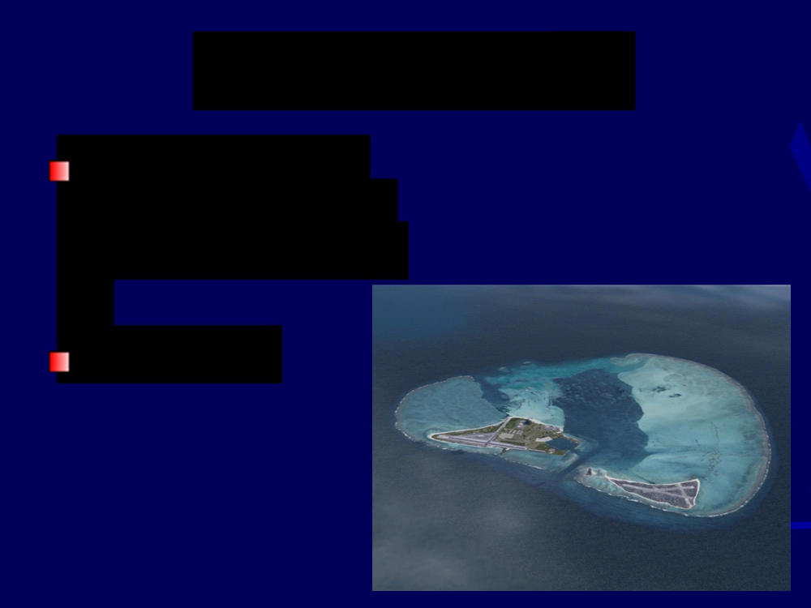
Battle of Midway
U.S. launched a
surprise attack on
the Japanese fleet
June 1942

Slide 21
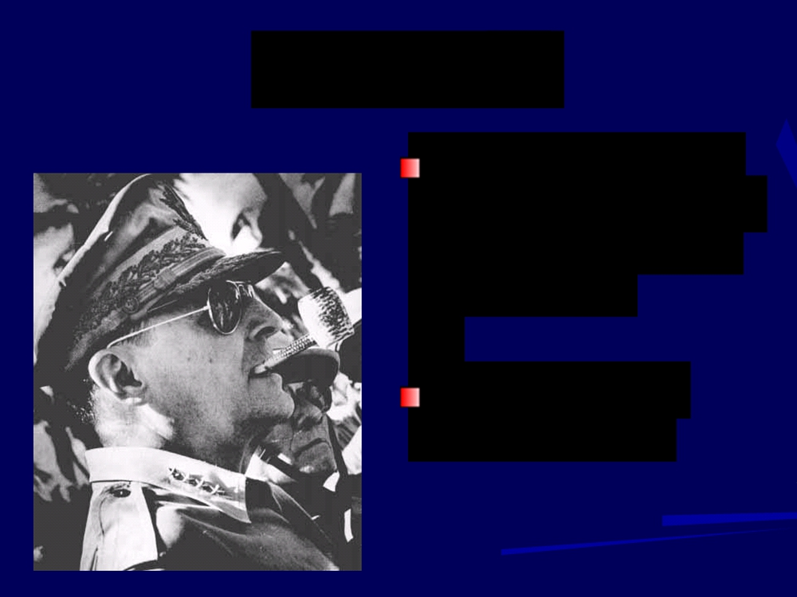
Philippines
U.S. troops led by
Douglas MacArthur
took control in the fall of 1942
Began moving toward Japan

Slide 22
War in Italy
American and British troops
took Sicily, began
moving up the Italian peninsula
Mussolini
removed from office
Rome fell in June 1944

Slide 23
D-Day
June 6, 1944
Allied forces led by
Dwight D. Eisenhower
landed at Normandy,
France
Within 3 months, the Allies landed 2 million men

Slide 24
Paris
The Allies
liberated Paris in
August 1944
March 1945 -
Allies crossed into Germany

Slide 25
End of War in Europe
Soviet troops
moved westward and entered Berlin
in April 1945

Slide 26
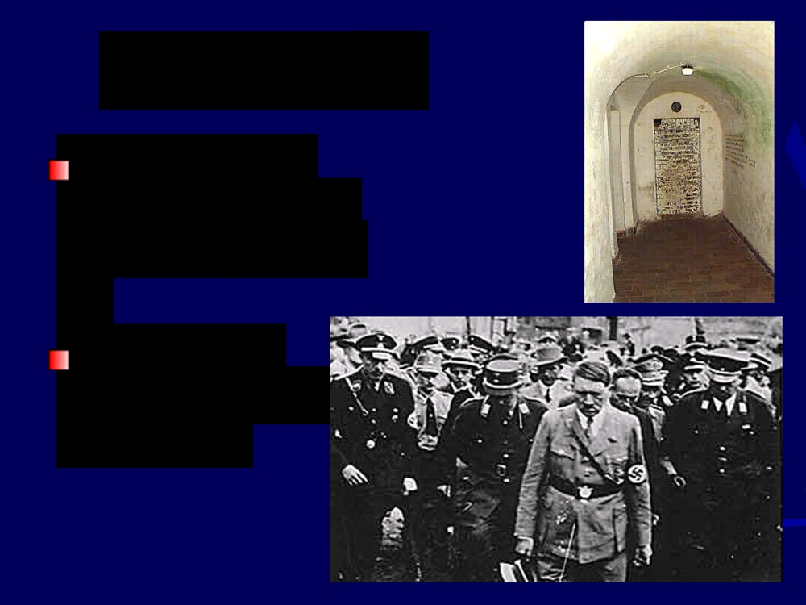
Hitler’s End
Moved into a
bunker in Berlin
in January 1945
Committed suicide on April 30, 1945

Slide 27
Germany Surrenders
May 7, 1945
German
commanders
surrender to end the war in Europe

Slide 28
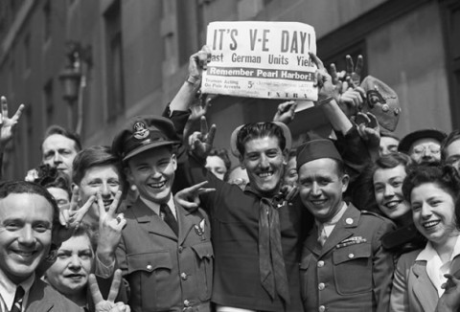
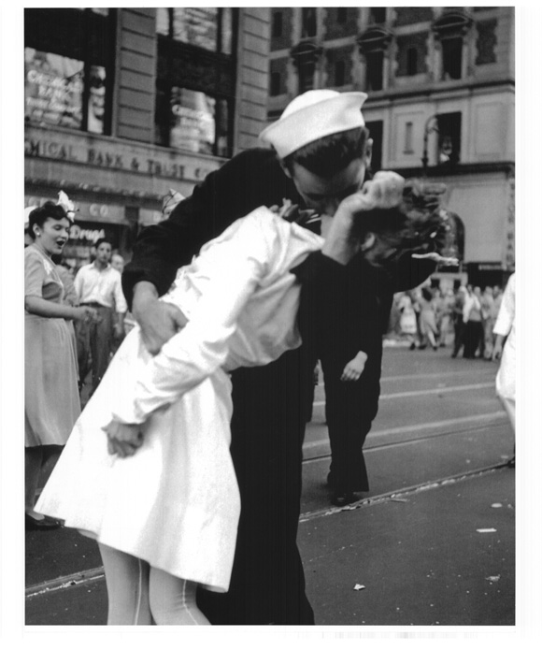
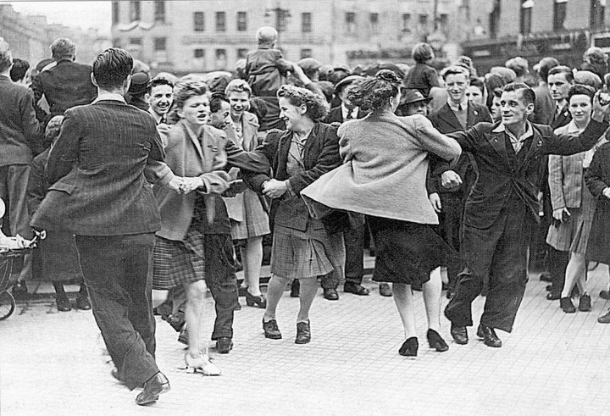

Slide 29
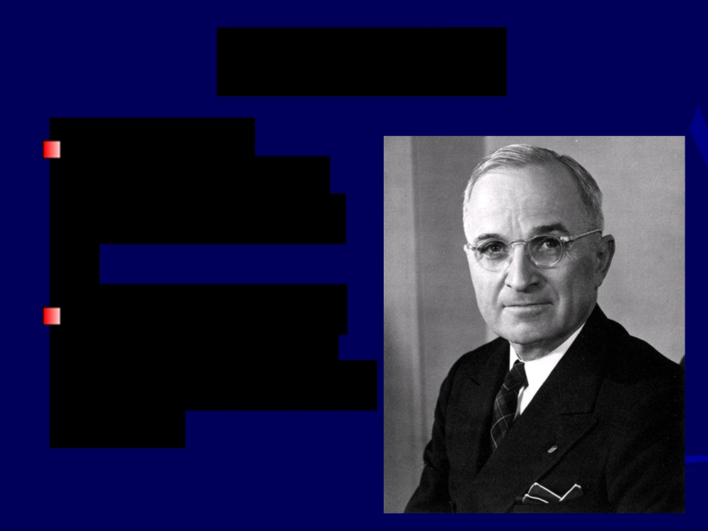
War in Asia
U.S. forces
advanced slowly
across the Pacific
President Harry S
Truman hoped to
avoid an invasion of Japan

Slide 30
Atomic Bombs
August 6,1945 -
dropped on
Hiroshima
August 9, 1945 -
dropped on
Nagasaki

Slide 31
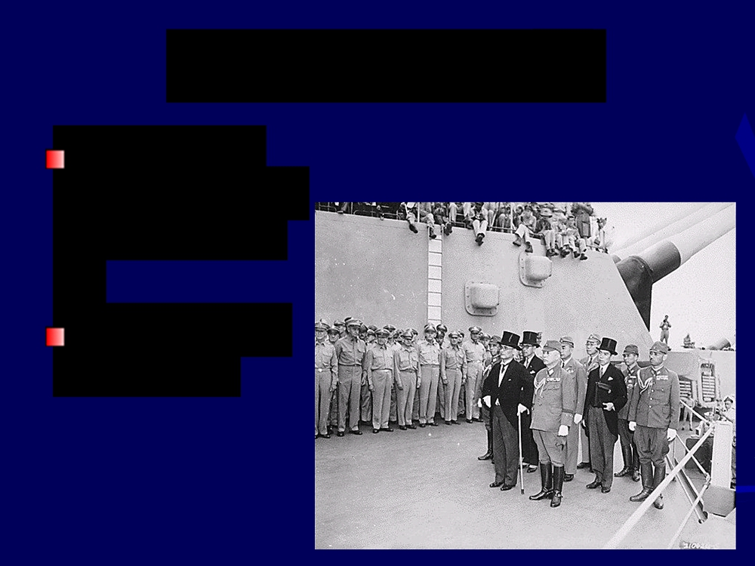
Japan Surrenders
August 14,
1945 - Japan
surrendered
World War II
was over

Slide 32
Who was the fascist leader of Italy?
Germany violated the Treaty of Versailles in many ways leading up to WWII. Among them, in 1938, Germany annexed what neighboring country?
Giving in to Hitler’s demands in order to keep the peace was called the Policy of ___________________.
Who was the main proponent of this policy? Hint: He was the Prime Minister of Great Britain before the war.
The Rome-Berlin Axis was a military alliance between what two countries?
The invasion of what country in 1939 prompted Great Britain and France to declare war on Germany?
What was the initial US response to Japanese aggression in China?

Slide 33
Which body of water lies between England and Norway?
Did the Germans win the Battle of Stalingrad?
The United States entered the war after ___________________.
The name given to the invasion of France by allied forces on
June 6, 1944.
General Douglas MacArthur took the ____________ from the Japanese in the fall of 1942, fulfilling his promise to return to the archipelago.
Name the two Japanese cities destroyed by American atomic bombs?
Was the Battle of Britain a naval battle, land battle, or air battle?
In the Battle of Britain, what new technology gave Great Britain an edge?
Place in order of surrender to allied forces – Italy, North Africa, Germany, Japan.
In your opinion, what was the most important factor in deciding the outcome of World War II?

